Slide 1


Building A
Maintainable
Jenkins
Automation
Architecture
Jeff McKenzie
@jeffreymckenzie
mail@mcknz.com
Notes:
Hello everyone –
Thanks for being here to take a look
At Jenkins, and how best to organize and maintain
the work that you use Jenkins for.
My name is Jeff McKenzie,
and I’m a Principal Consultant
At Cardinal Solutions and work
With the AMI Meters team at AEP

Slide 2

Notes:
Today, talk about/work with Jenkins
How many have worked with Jenkins?
What is Jenkins here supposed to be? [butler]
=========
Logo from https://jenkins.io/artwork

Slide 3

Notes:
Why a butler?
What does that have to do with Jenkins? [discussion]
=========
Image from http://www.pensandpatron.com/lists/never-knew-downton-abbey-ob/
http://d3f88t1ya8f0ec.cloudfront.net/wp-content/uploads/2018/07/23152933/charles-carlson.jpg

Slide 4

Notes:
What I like about the Butler theme –
Jenkins does what you tell it
Will do almost whatever you say
Up to you to guide/make good decisions about what butler does
And if you don’t…
=========
Image from https://getyarn.io/yarn-clip/da131918-6565-4be8-91f3-3f9564e9808
https://www.google.com/url?sa=i&rct=j&q=&esrc=s&source=images&cd=&cad=rja&uact=8&ved=2ahUKEwiCycmjtNndAhUK04MKHZAiAAcQjRx6BAgBEAU&url=https%3A%2F%2Fgetyarn.io%2Fyarn-clip%2Fda131918-6565-4be8-91f3-3f9564e98088&psig=AOvVaw3mZTtbp4cJsUQWwudTn2T3&ust=1538076646833110

Slide 5

Notes:
-- end up with unhappy butler.
For those who have used Jenkins, how have you used it?
Basic freestyle point-&-click-jobs?
pipeline?
global libraries?
job-dsl?
=========
Logo from https://jenkins.io/artwork

Slide 6
Notes:
i am by no means an expert
-- but I have been using Jenkins extensively for the last couple of years
-- want to share not so much how to use jenkins itself (a little, but not the focus)
but what options you have for improving your maintenance of Jenkins automation,
….basically its care and feeding.
=========
Logo from https://jenkins.io/artwork

Slide 7
Job / Project
Notes:
Basic unit of work in Jenkins
Difference between job/project
-- PROJECT, gonna try
What is a job? examples, *you*
“will Show example of freestyle job”

Slide 8
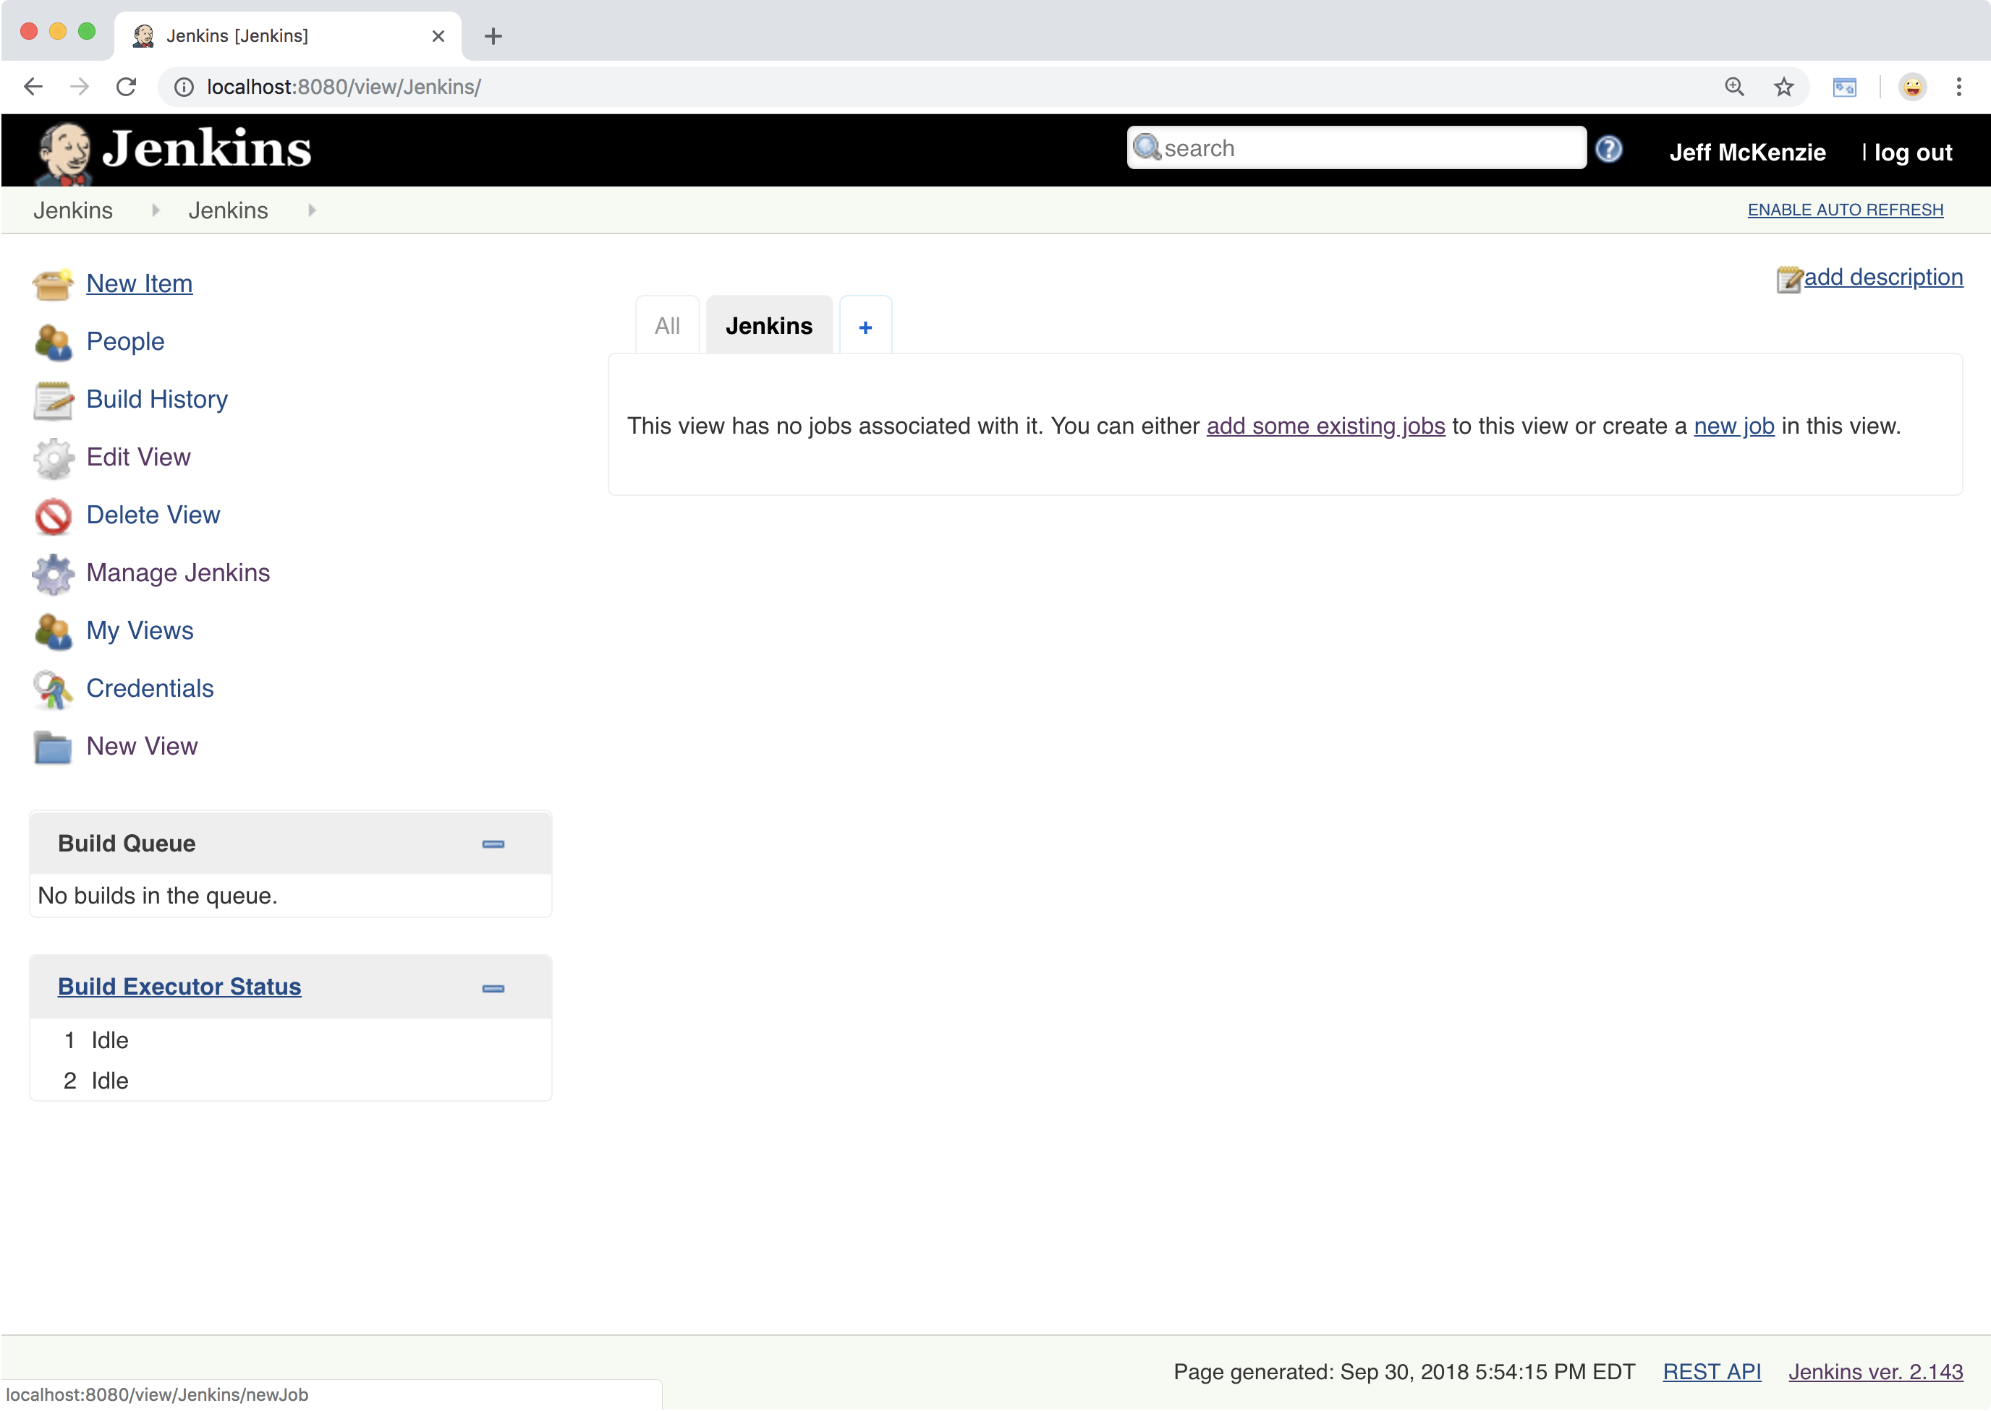
Notes:
-- disclaimer – not a full Jenkins tutorial, but want to set groundwork
In case ppl seeing for first time
-- after install, default view
-- what you see
-- new item, it all starts with that….

Slide 9
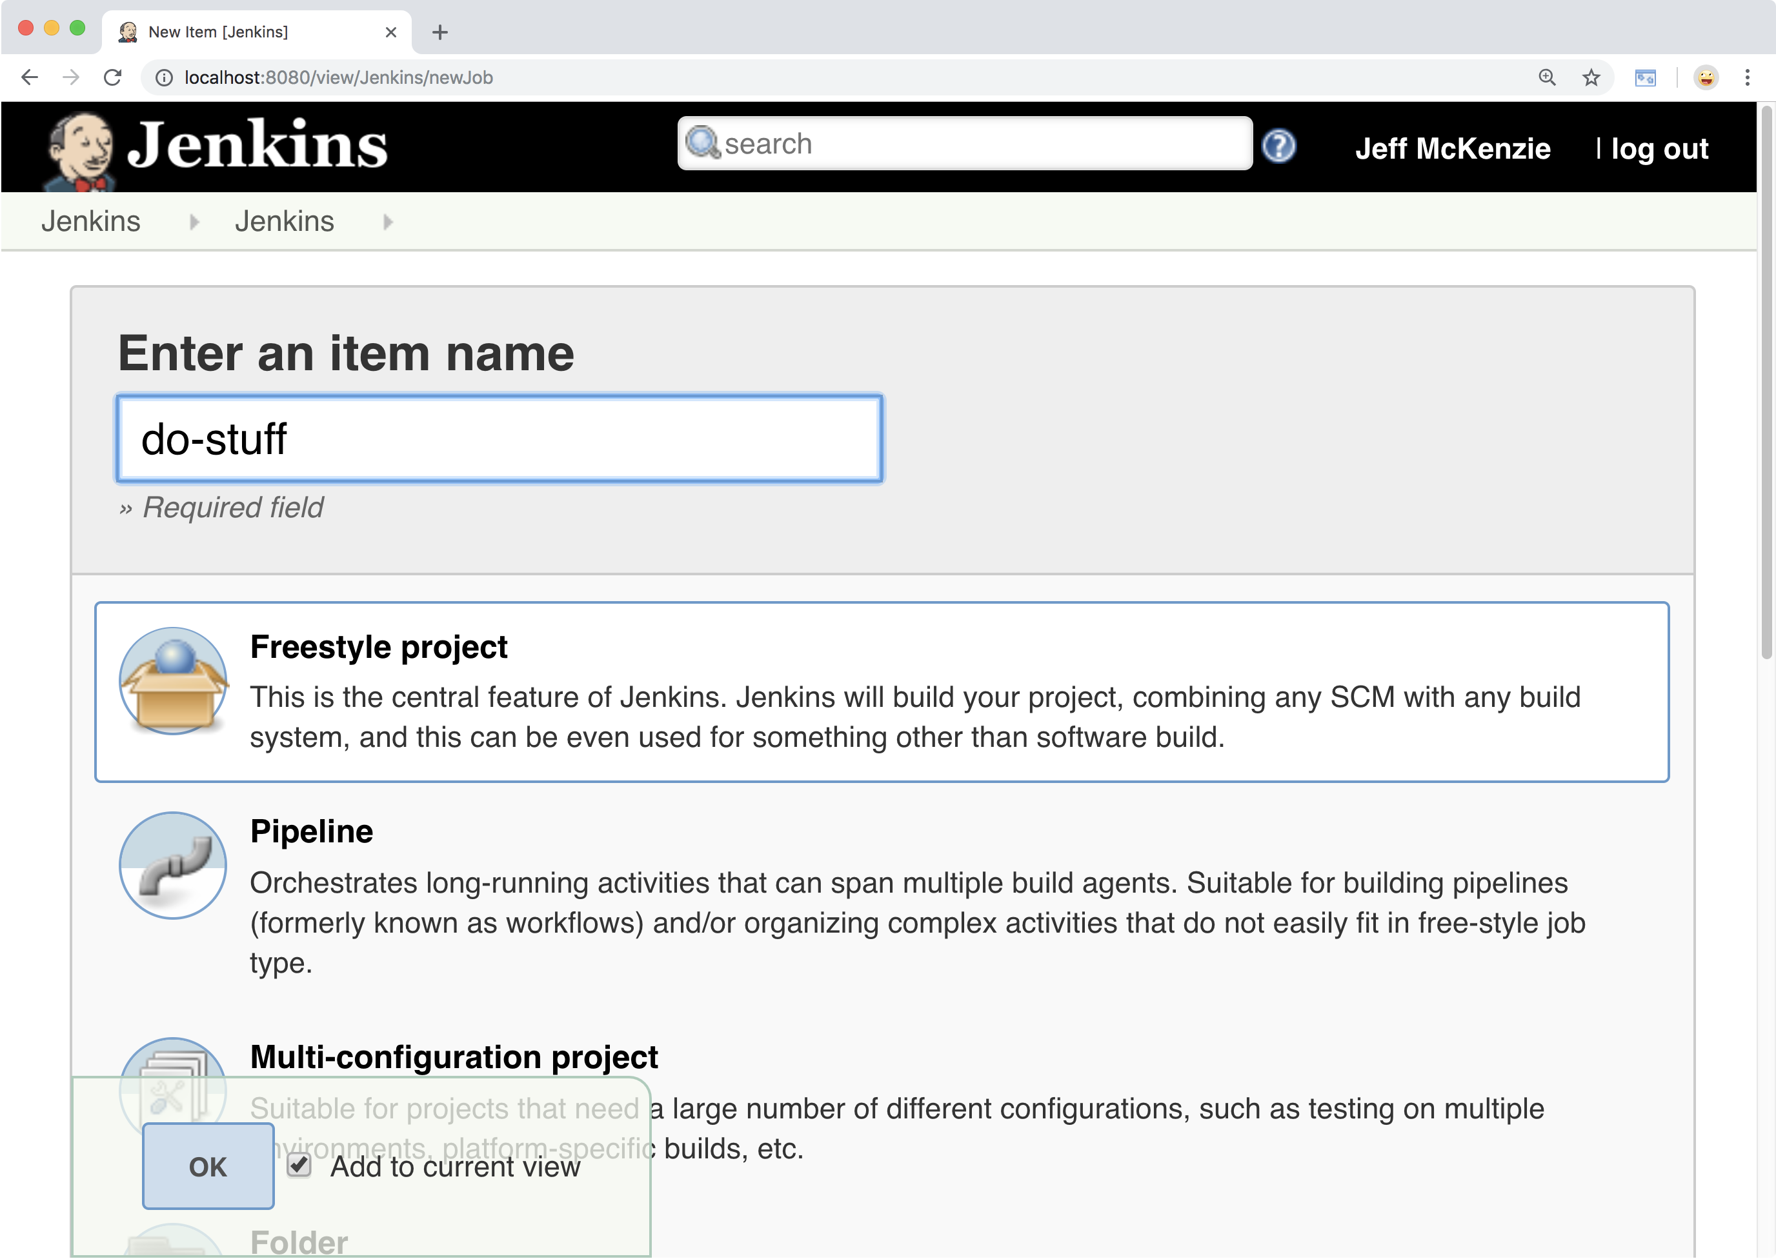
Notes:
-- new freestyle project, most basic
-- name, whatever u want

Slide 10
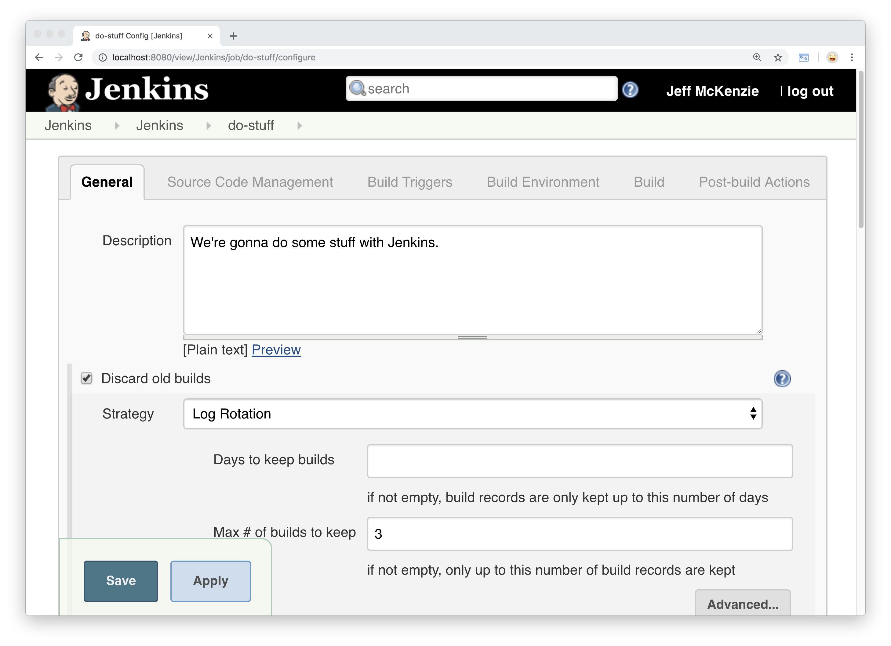
Notes:
-- first view/screen, what it looks like
-- description
-- build/log history

Slide 11
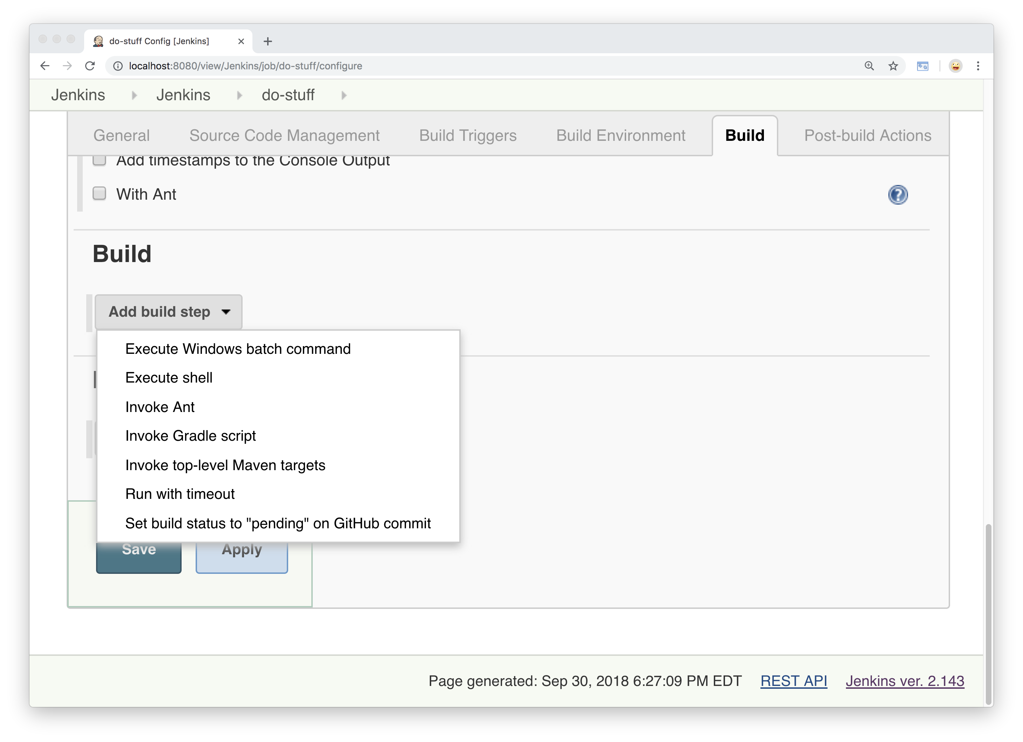
Notes:
-- jump down to build tab
--add build step
--what want Jenkins to actually do
-- select execute shell

Slide 12
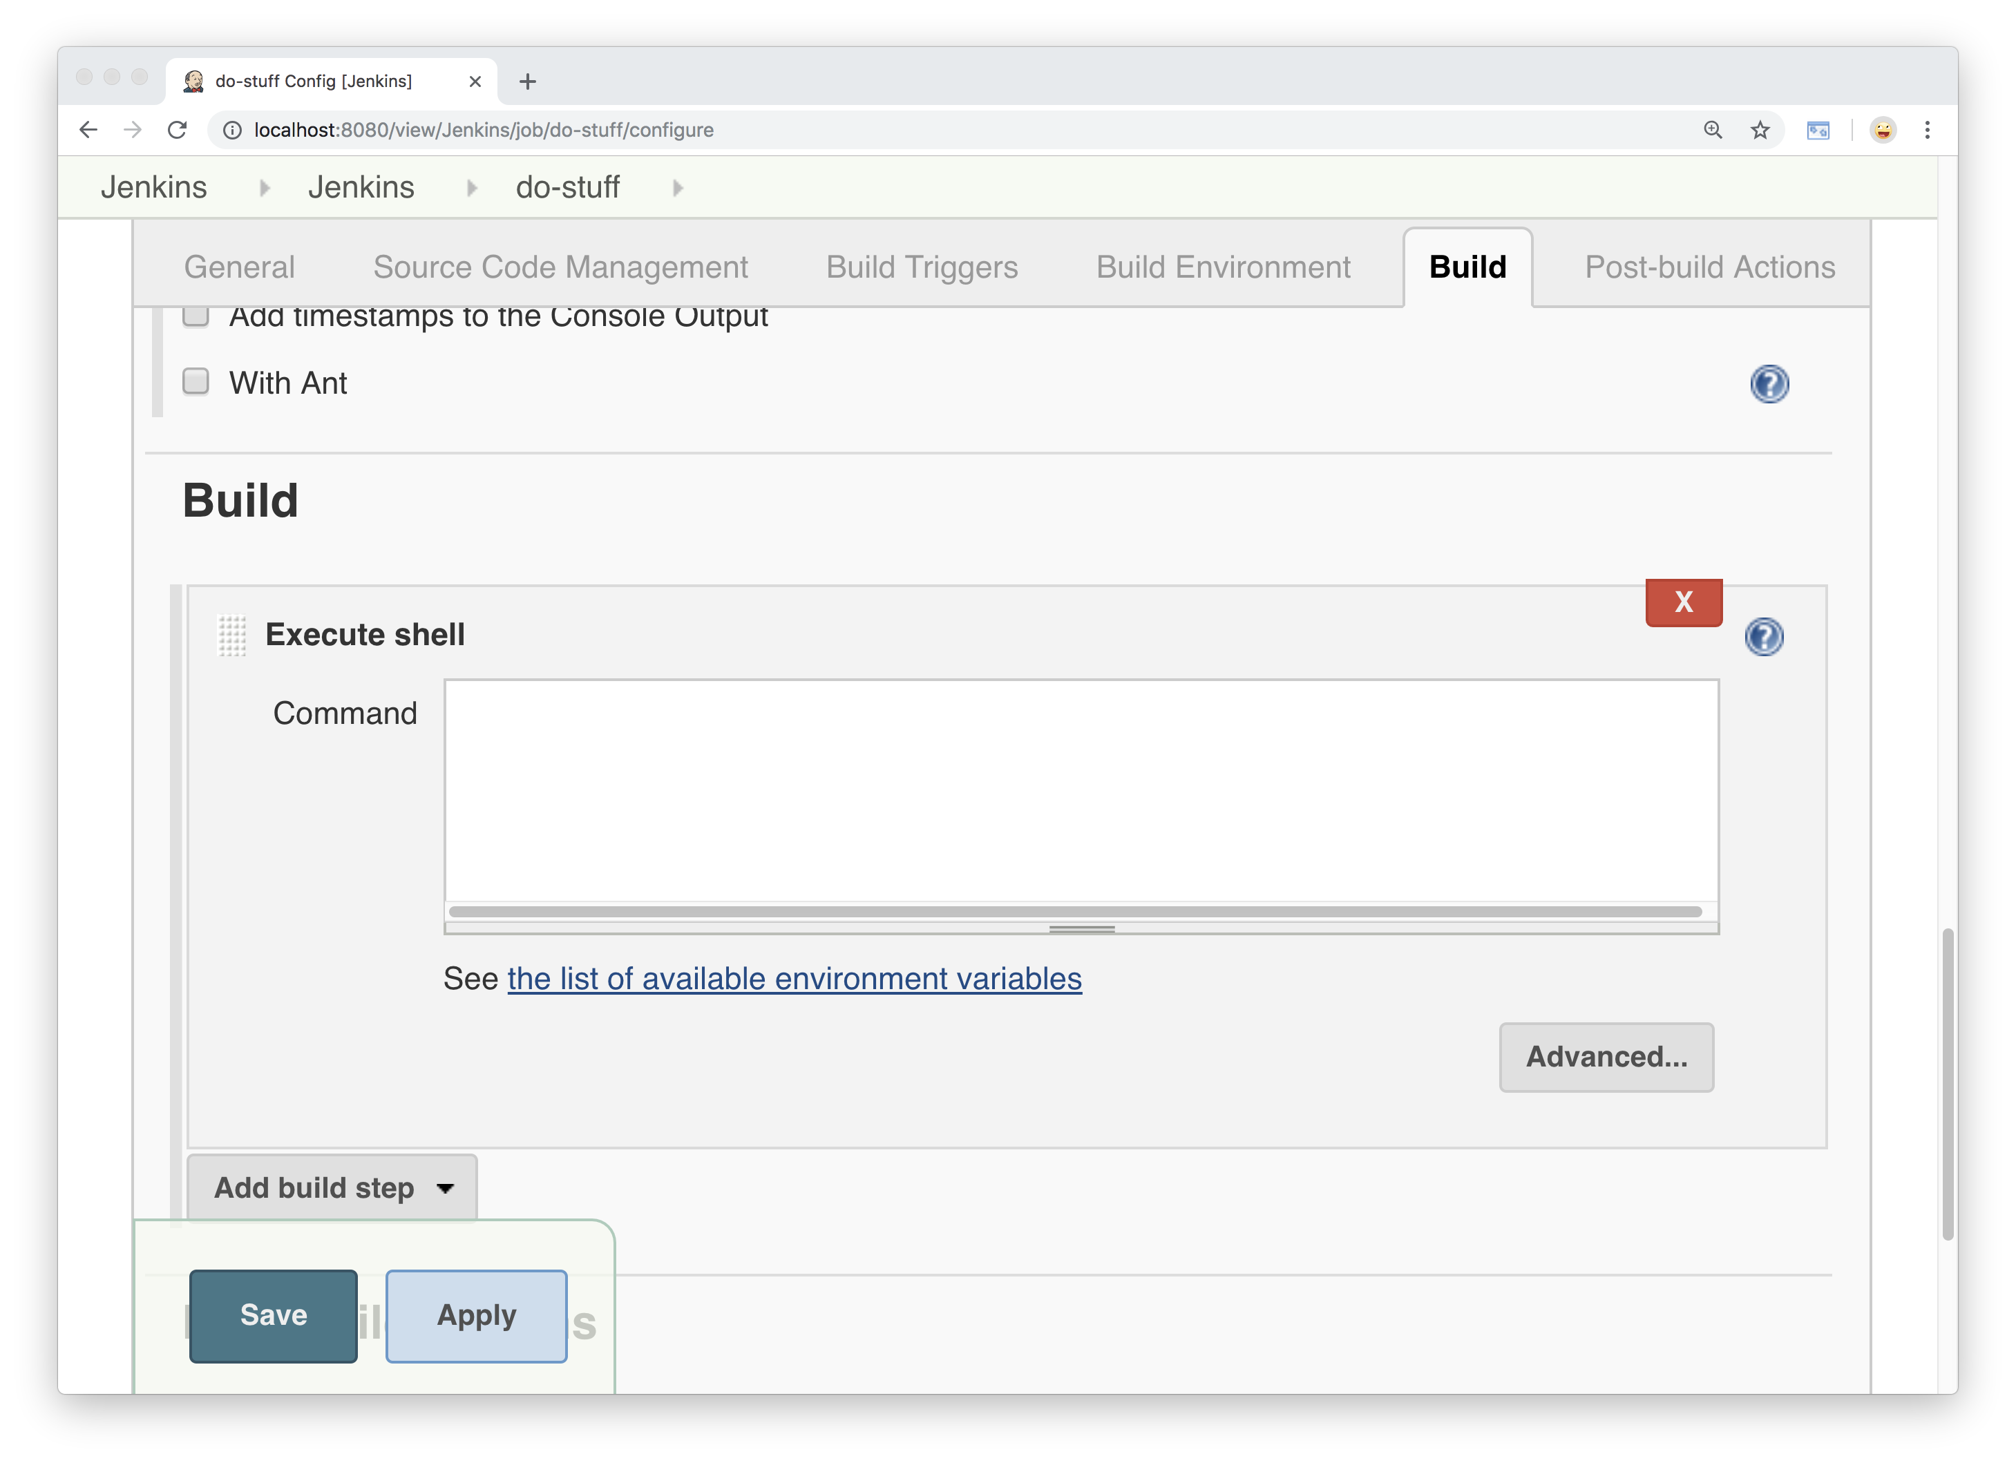
Notes:
There’s our single build step

Slide 13
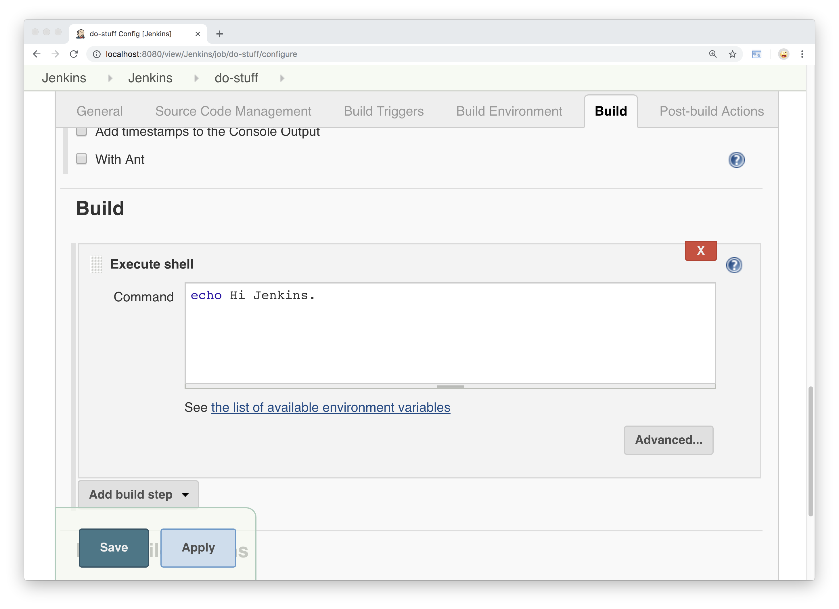
Notes:
Add a very simple command
Echo, which just means print to the screen
Say Hi Jenkins

Slide 14
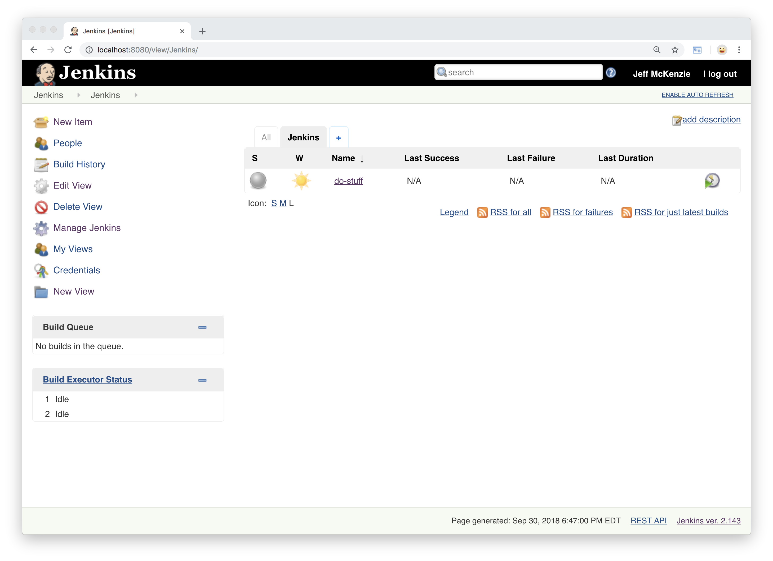
Notes:
-- go back to main view
-- hasn’t run yet
-- take a closer look

Slide 15
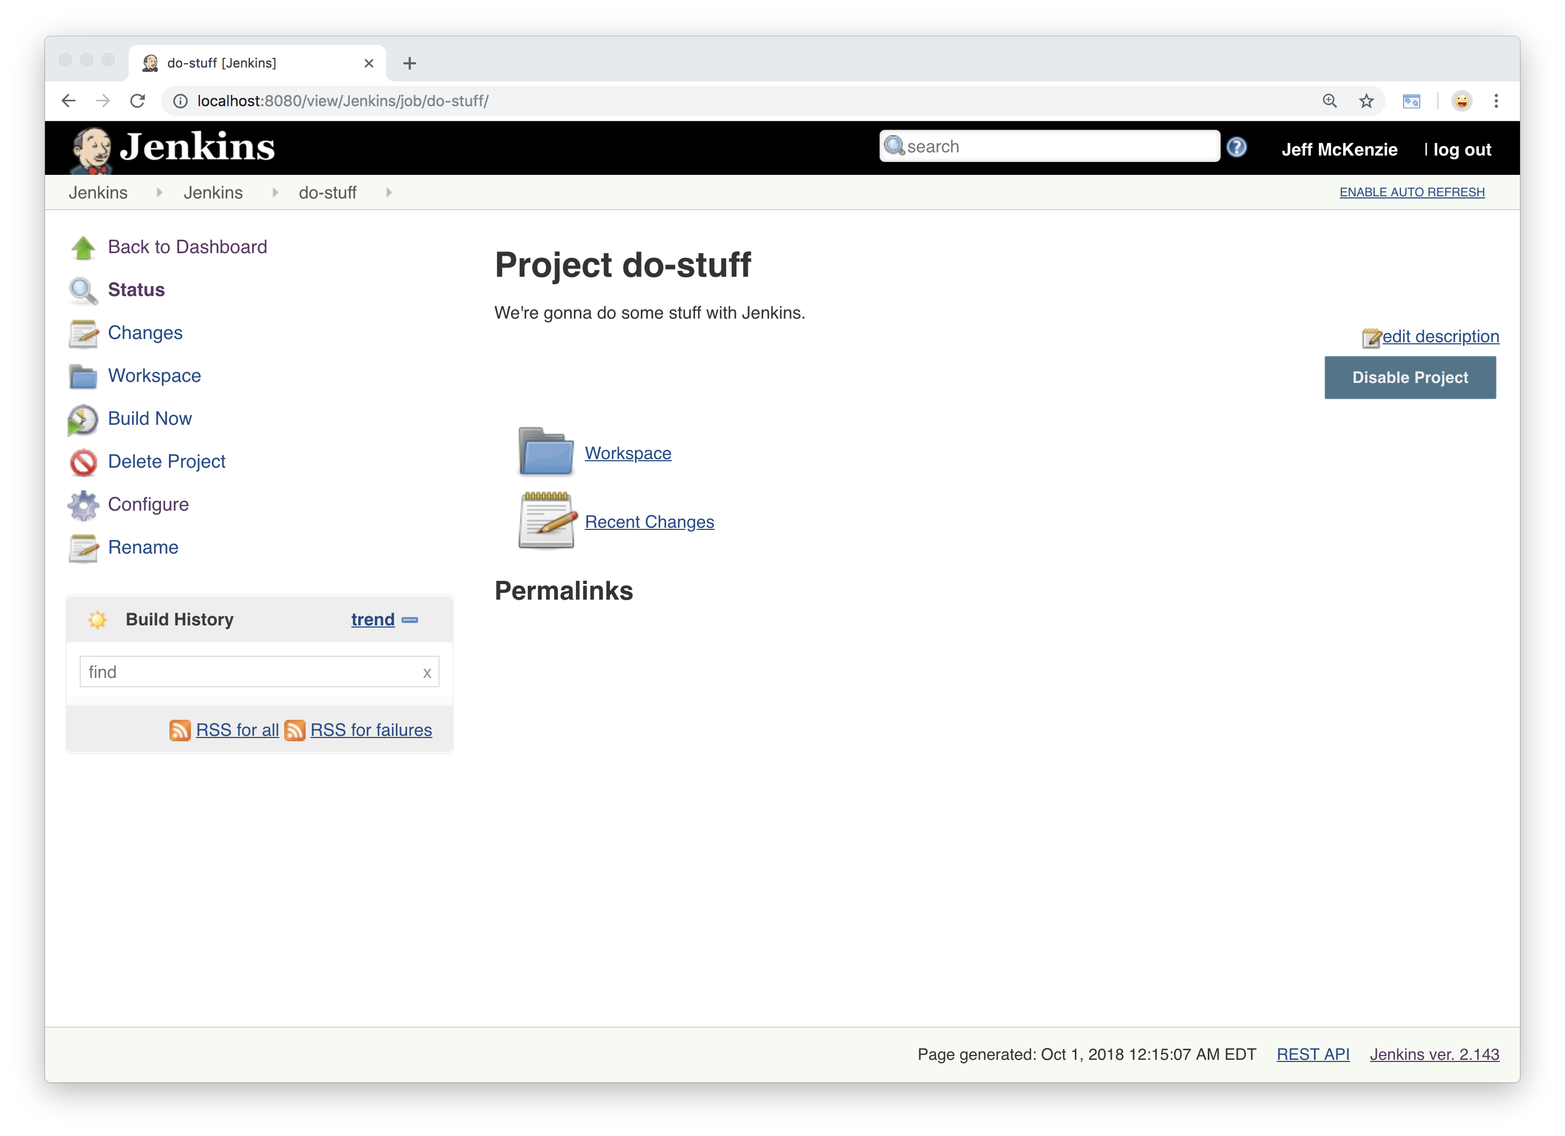
Notes:
Detailed look at our project
-- on the left, click Build now,
-- which kicks off our job

Slide 16
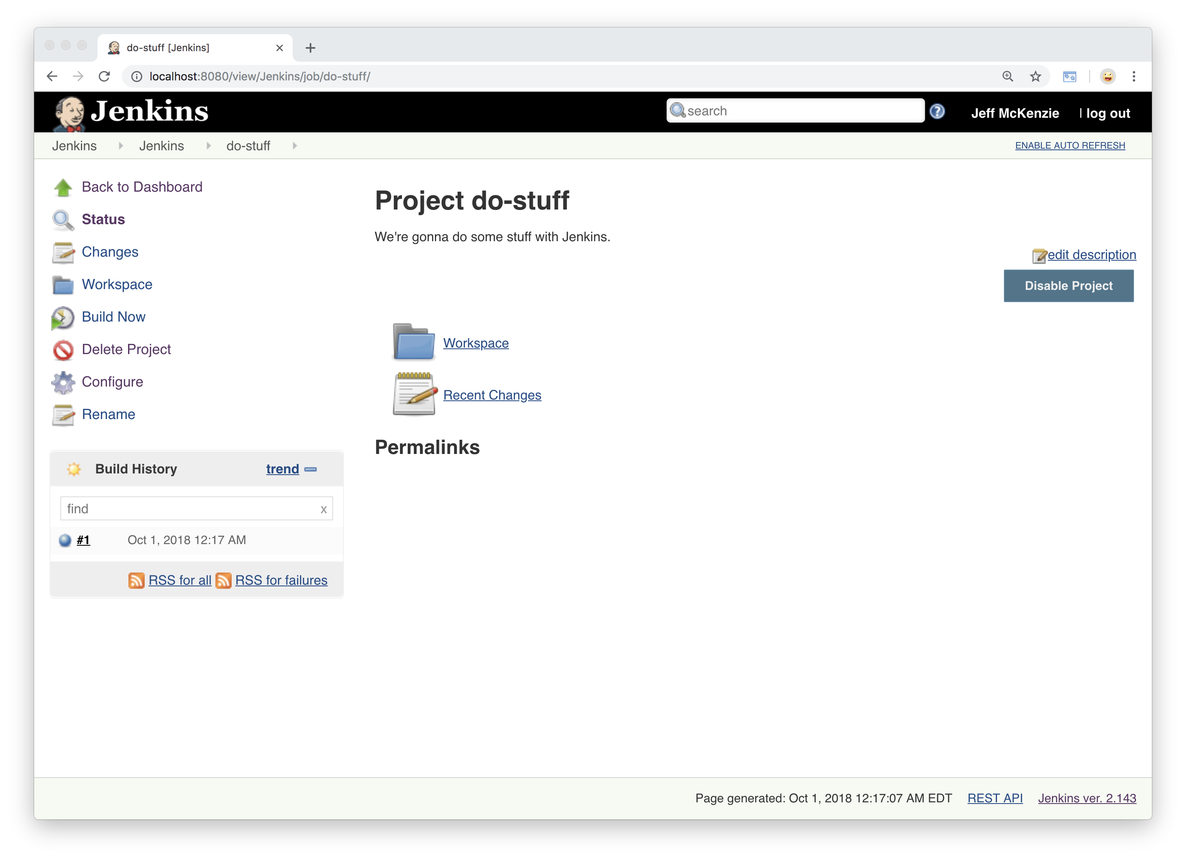
Notes:
-- and there we have it
-- you see that, bottom left
[back and forth]
-- might have missed it, tell us job is complete
To verify, can click on the build…

Slide 17
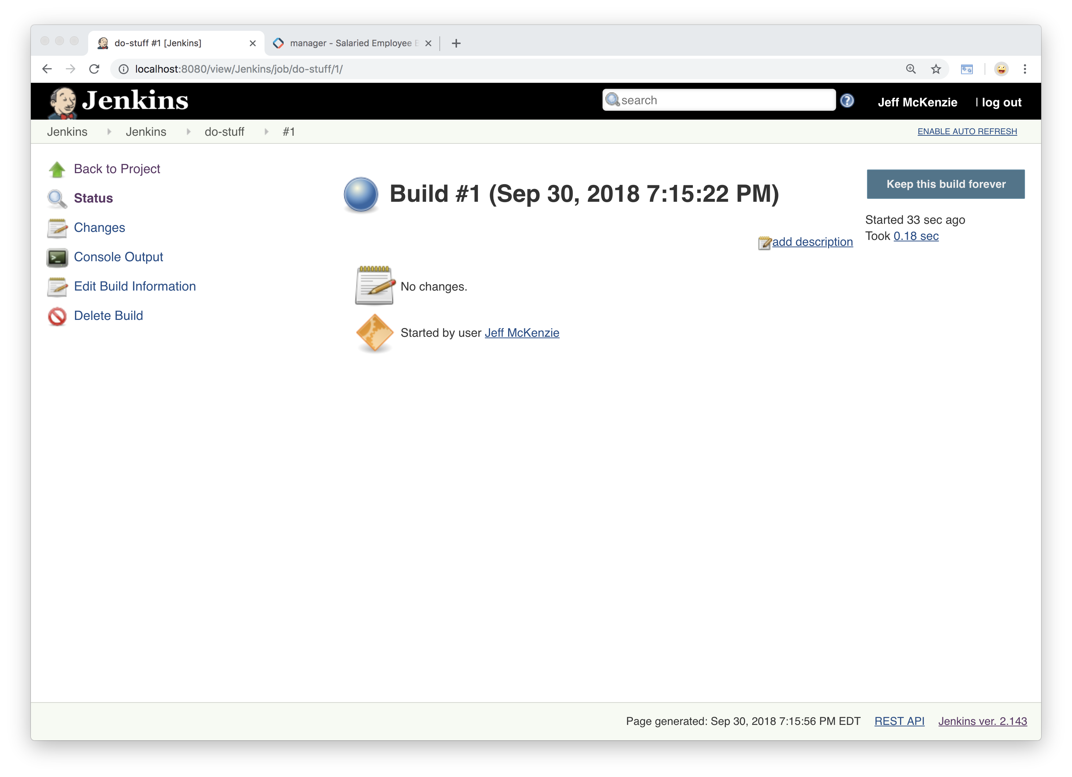
Notes:
Takes us to information about the result
…then on the left side
Console Input

Slide 18
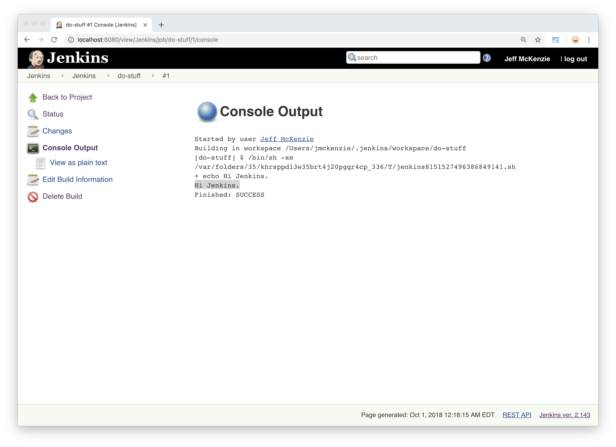
Notes:
… and there’s are result,
Showing Hi Jenkins in the output
…for a closer look….

Slide 19
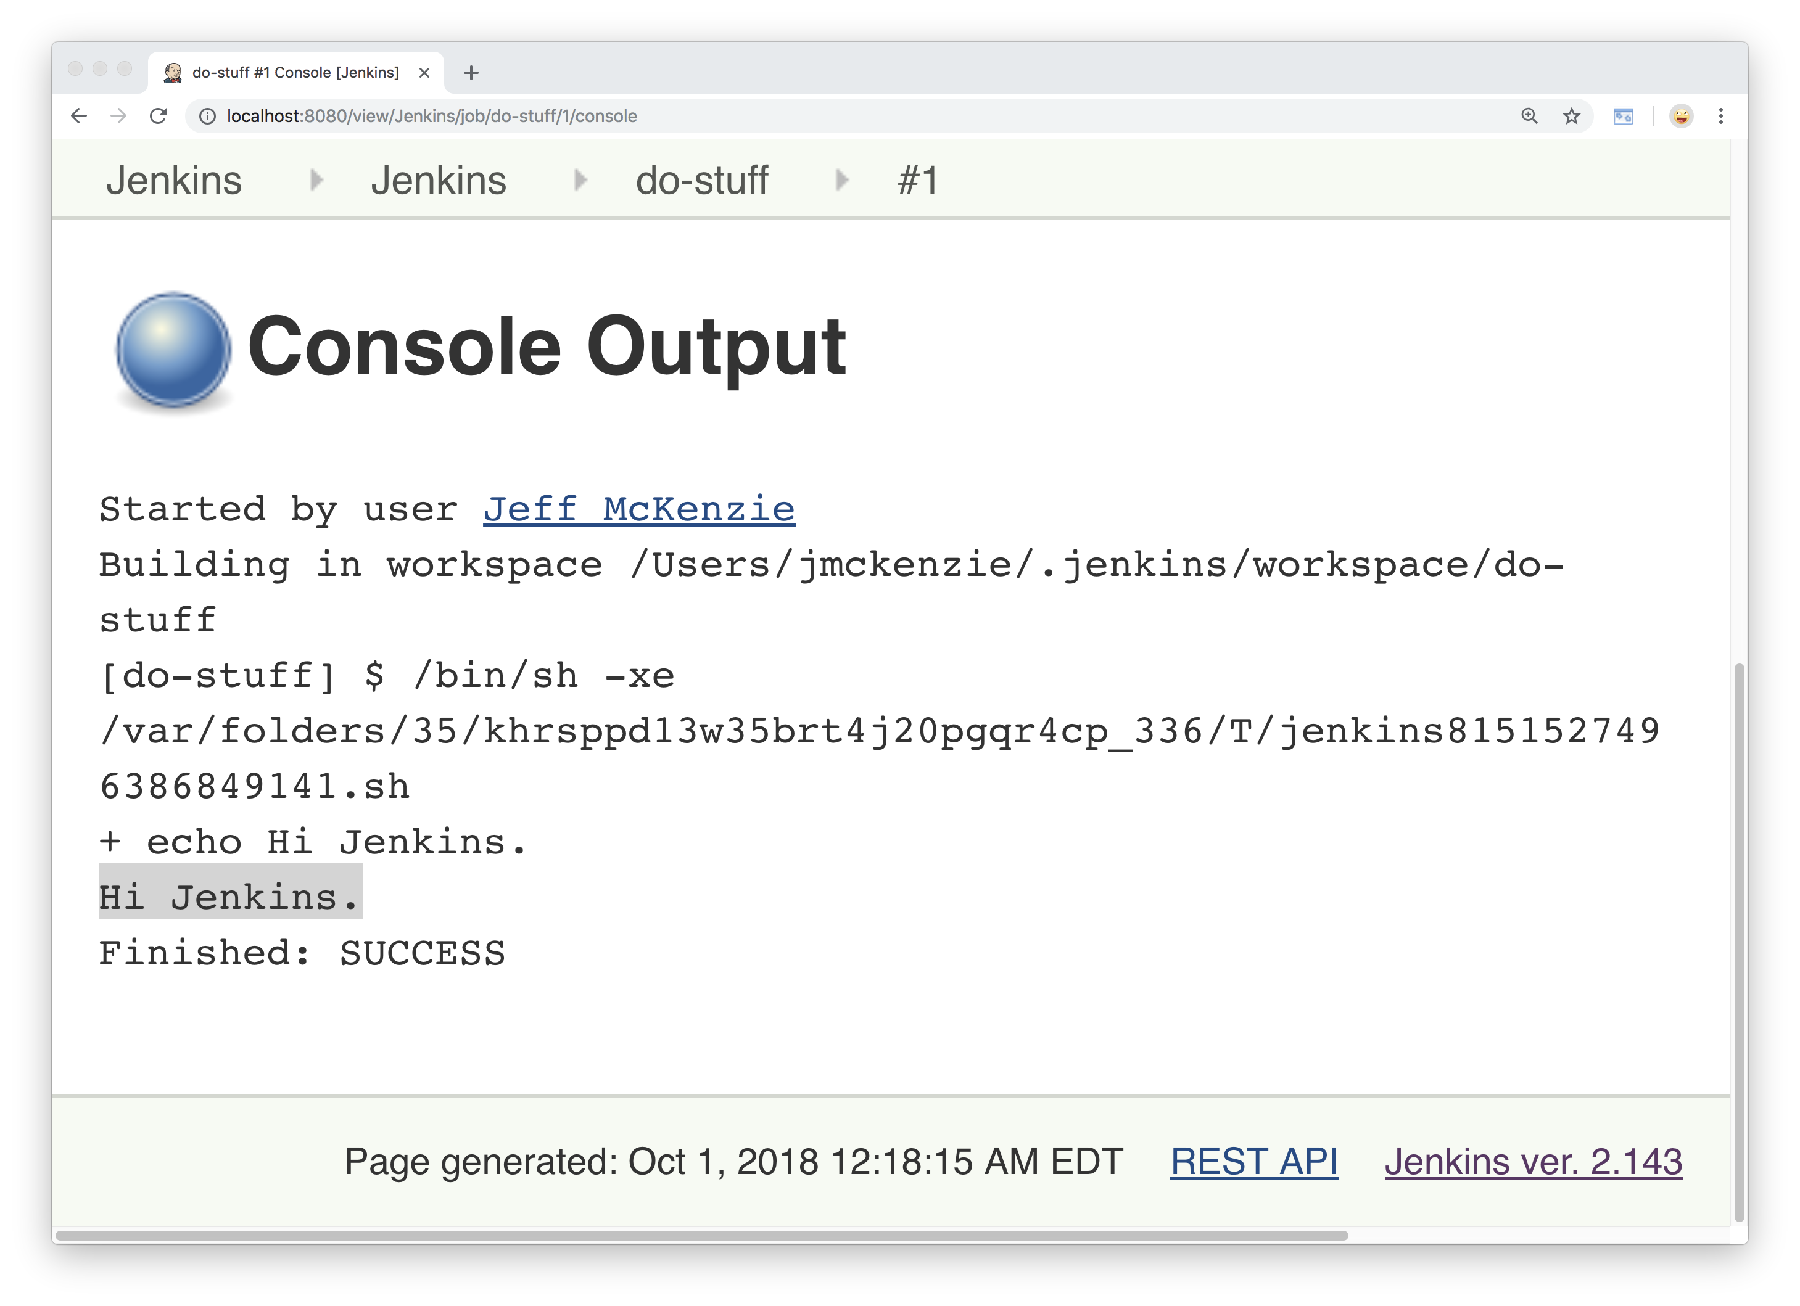
Notes:
…zoom in a little bit
Tells us that I started it
-- workspace: location on the server
-- shows the command: using shell to execute
…a temporary script it created from my command
-- shows the command
-- then in the highlighted portion shows the output
-- and shows us the result, which is SUCCESS
Did what supposed to do

Slide 20
Notes:
Now what if it had failed?
Let’s take a look at that.
Back on our project/job page
Click configure and go back to our build step

Slide 21
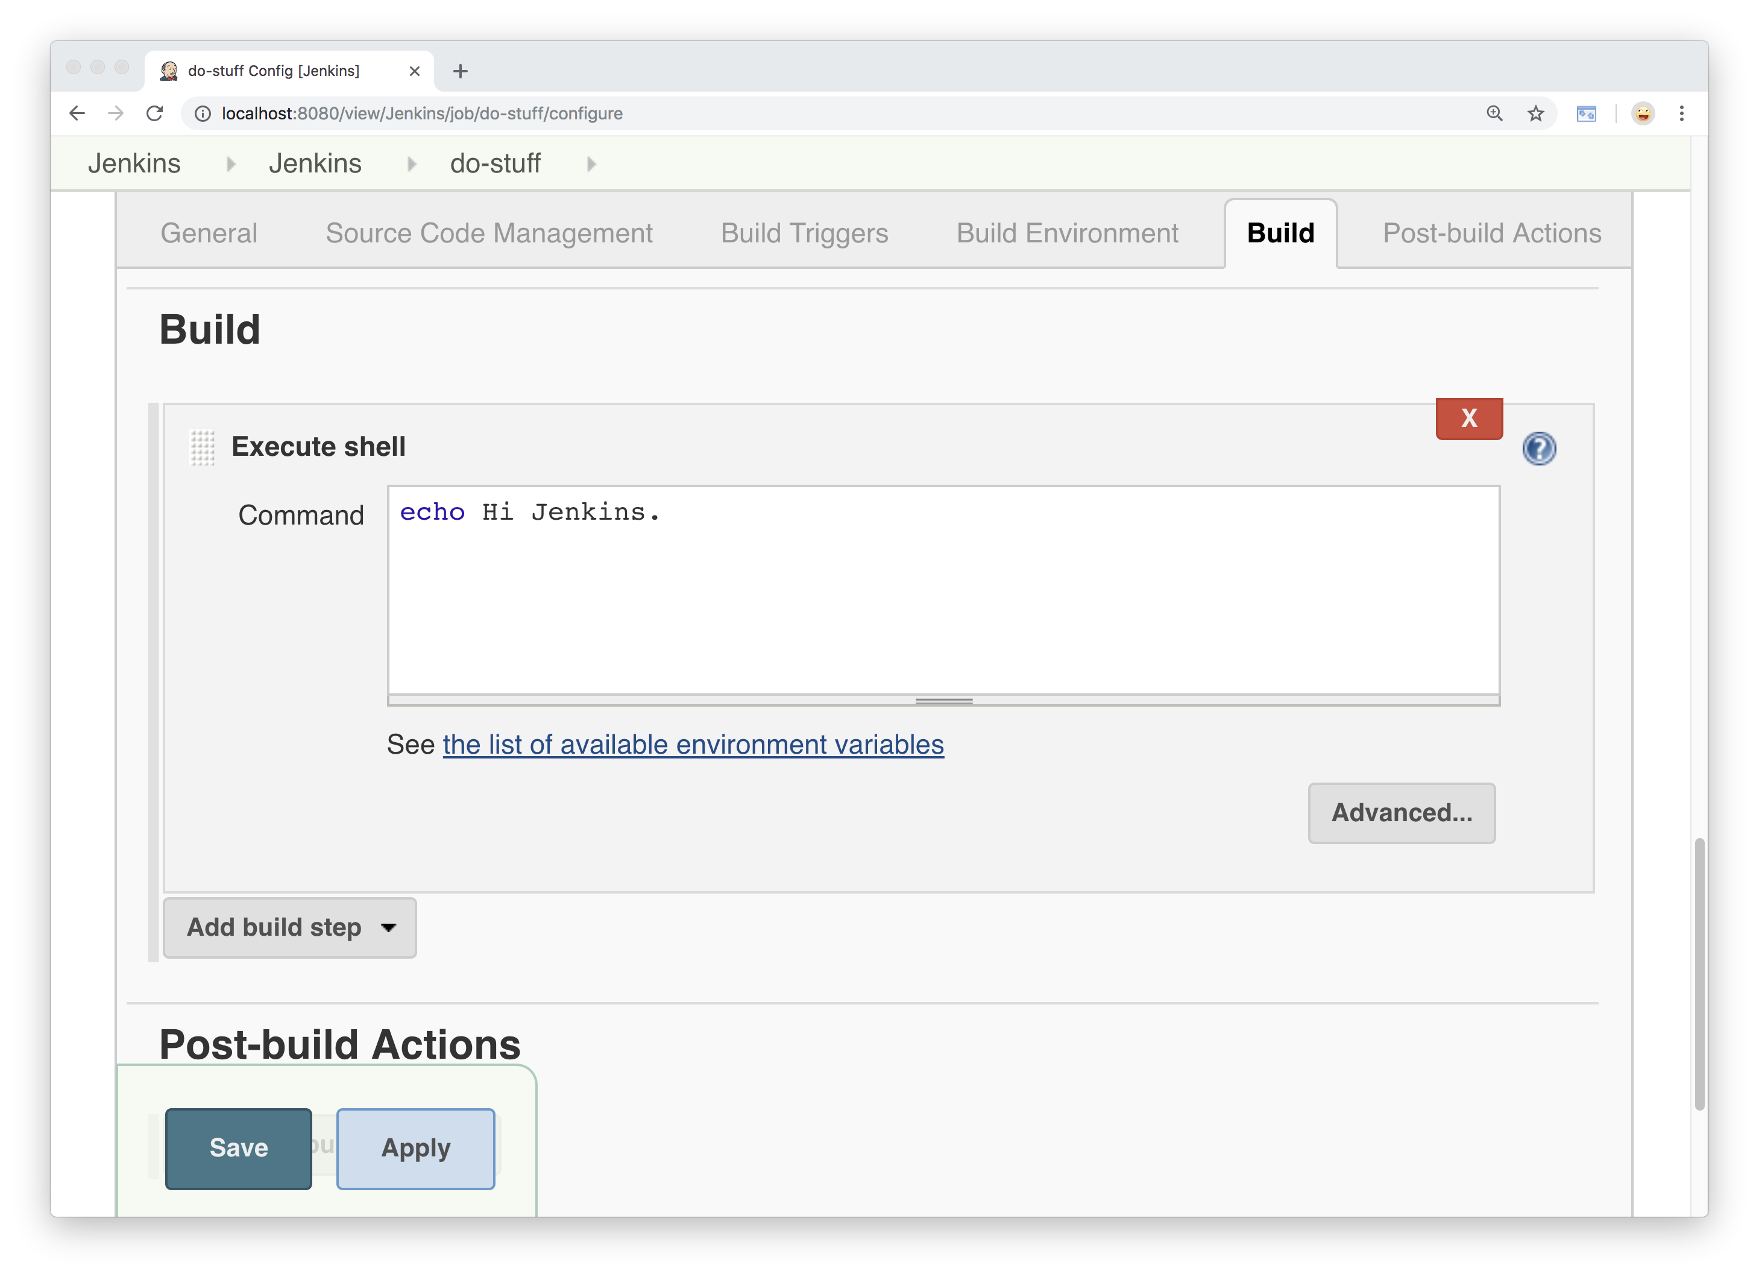
Notes:
Let’s remove the echo command from here
And see what happens

Slide 22

Notes:
Ok we’ve taken it out…
Let’s click save and go back to the main page

Slide 23
Notes:
Click “build now” again…

Slide 24
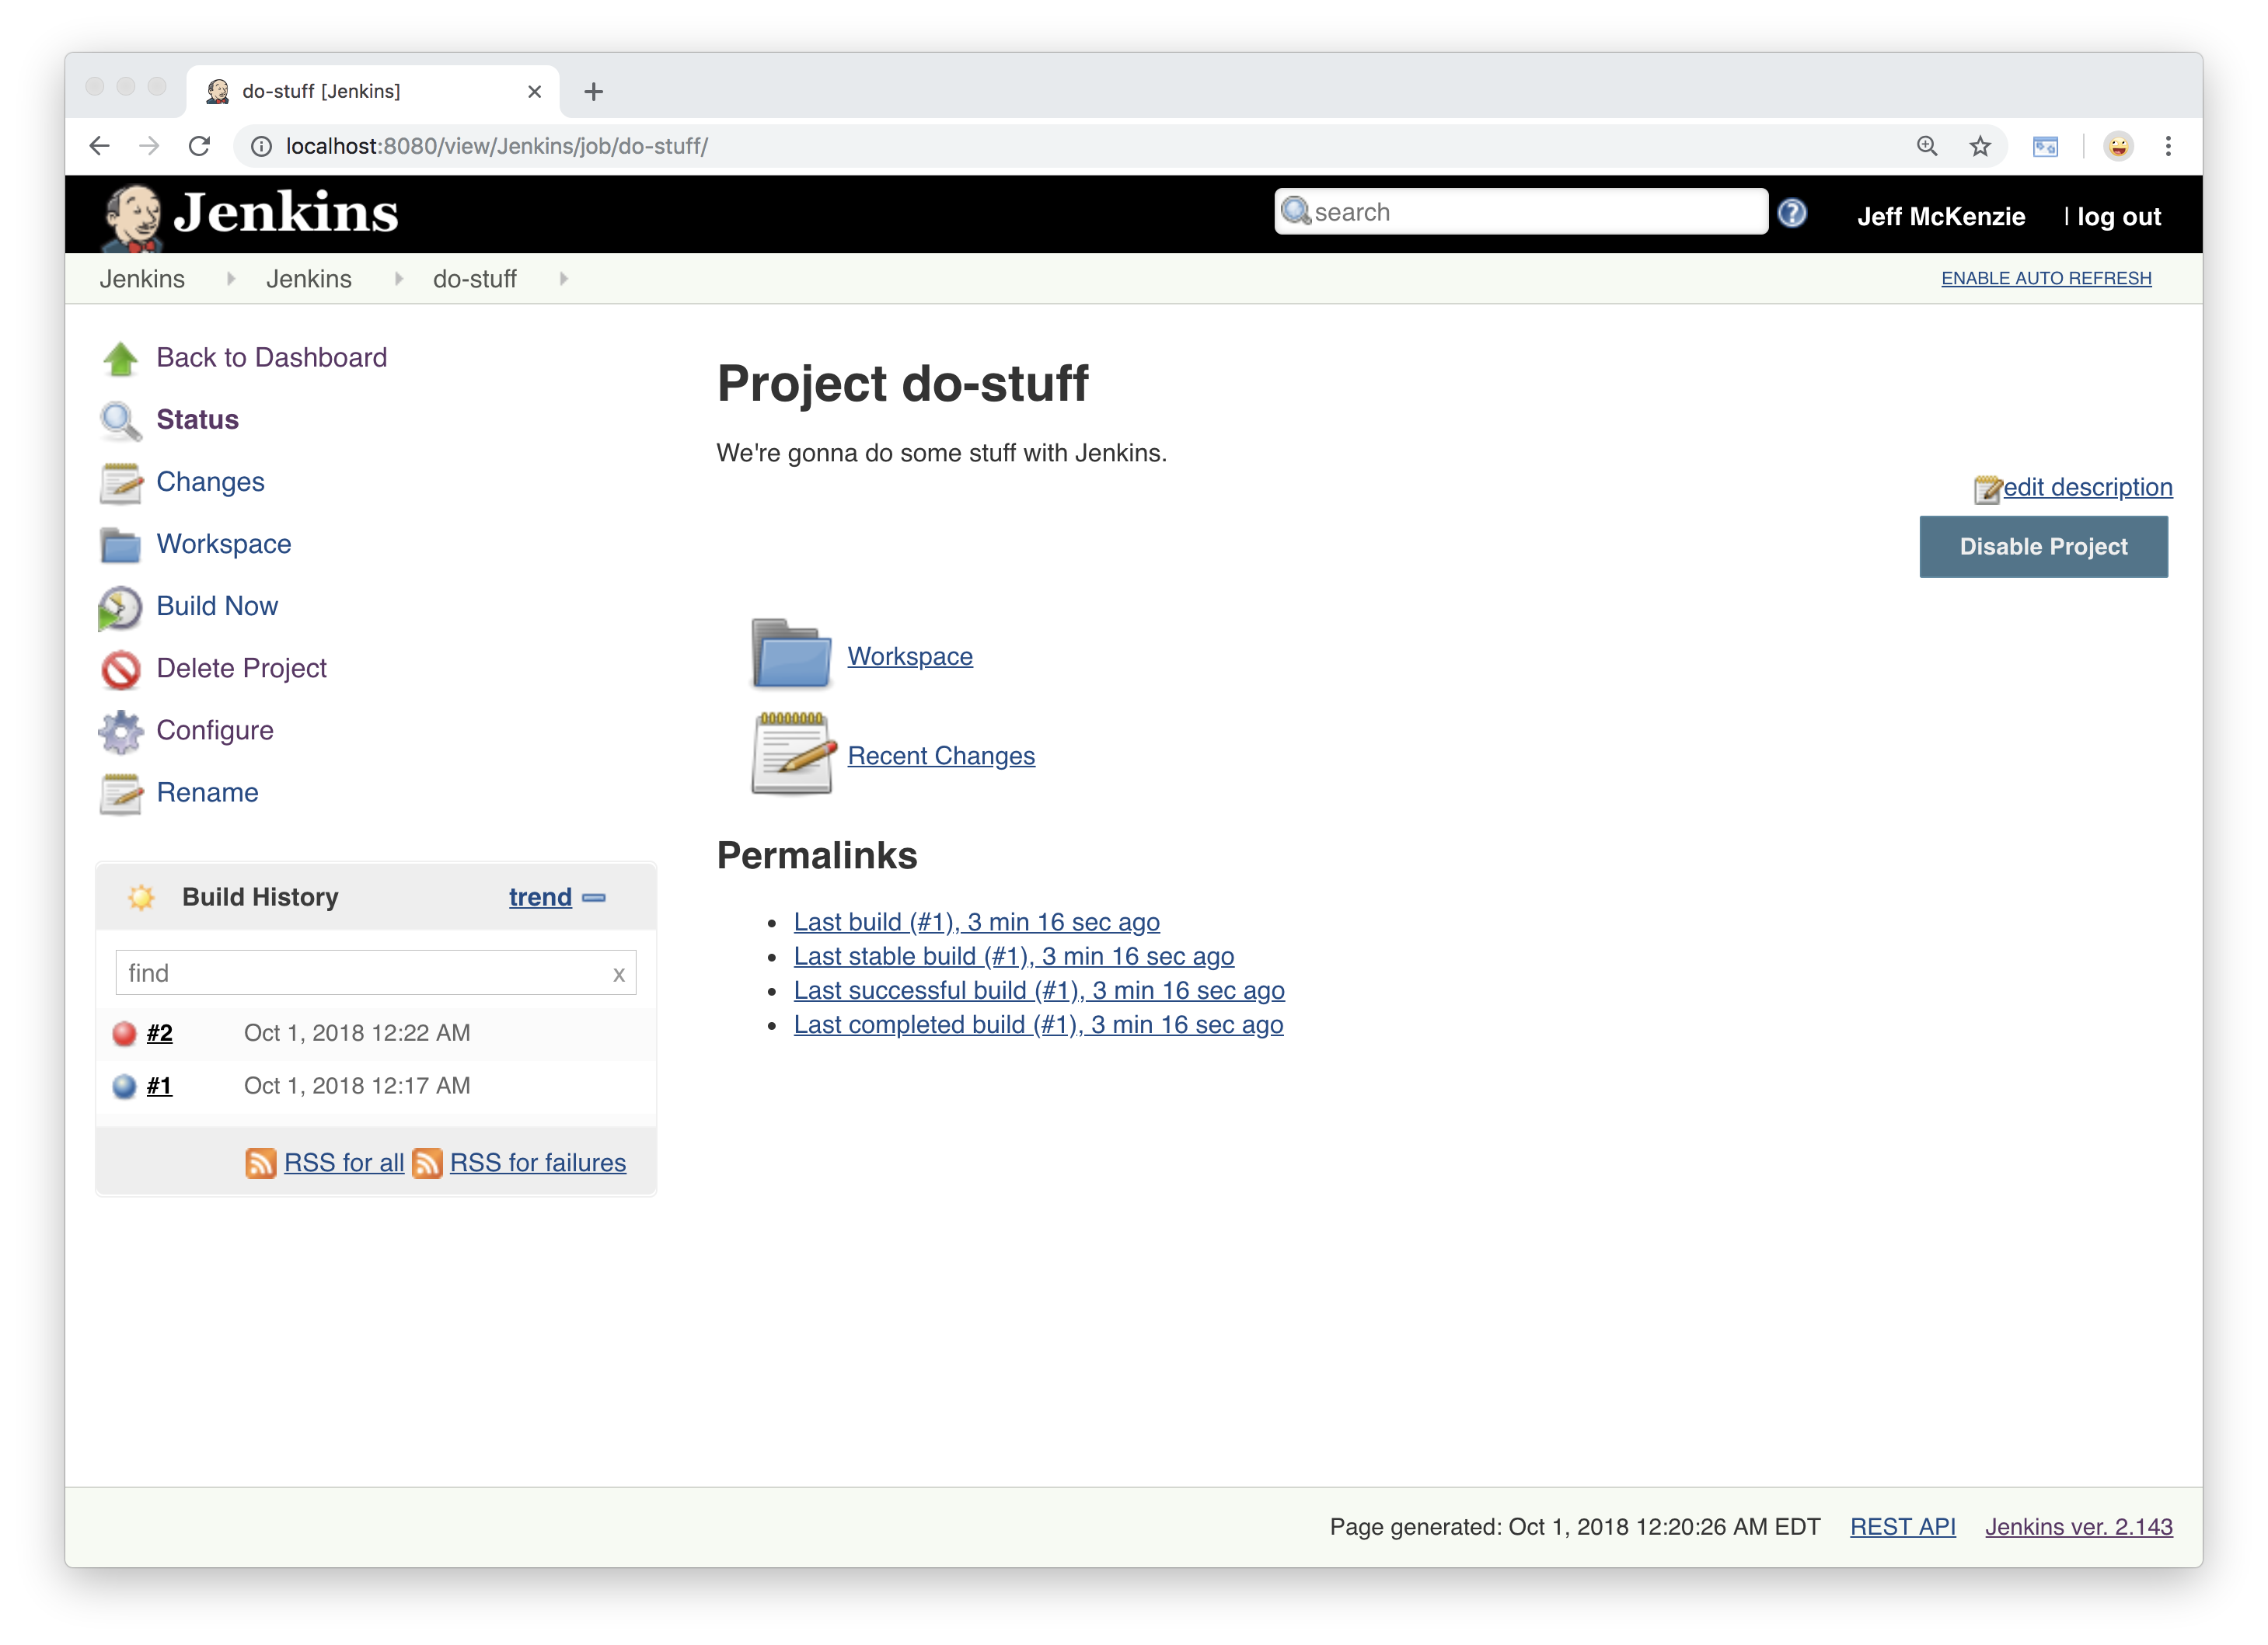
Notes:
And we’ve got a failure
Let’s go right to the console output

Slide 25
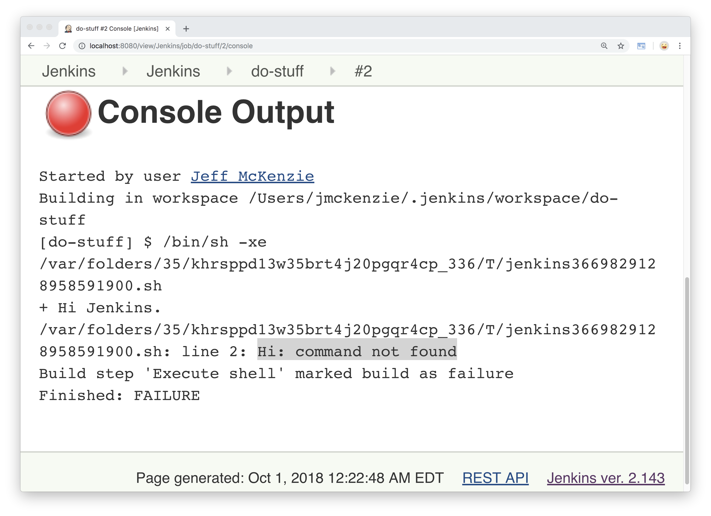
Notes:
And there’s our error –
There’s no command called “Hi”
So our greeting was being parsed as a command,
Which doesn’t exist.
So there we have a FAILURE

Slide 26
Notes:
So there we have Jenkins at its most basic level.
Jenkins jobs/projects can be run manually,
Or can be triggered by an external event.
If you’re interested in automation,
You want to interact with Jenkins as little as possible.
=========
Logo from https://jenkins.io/artwork

Slide 27
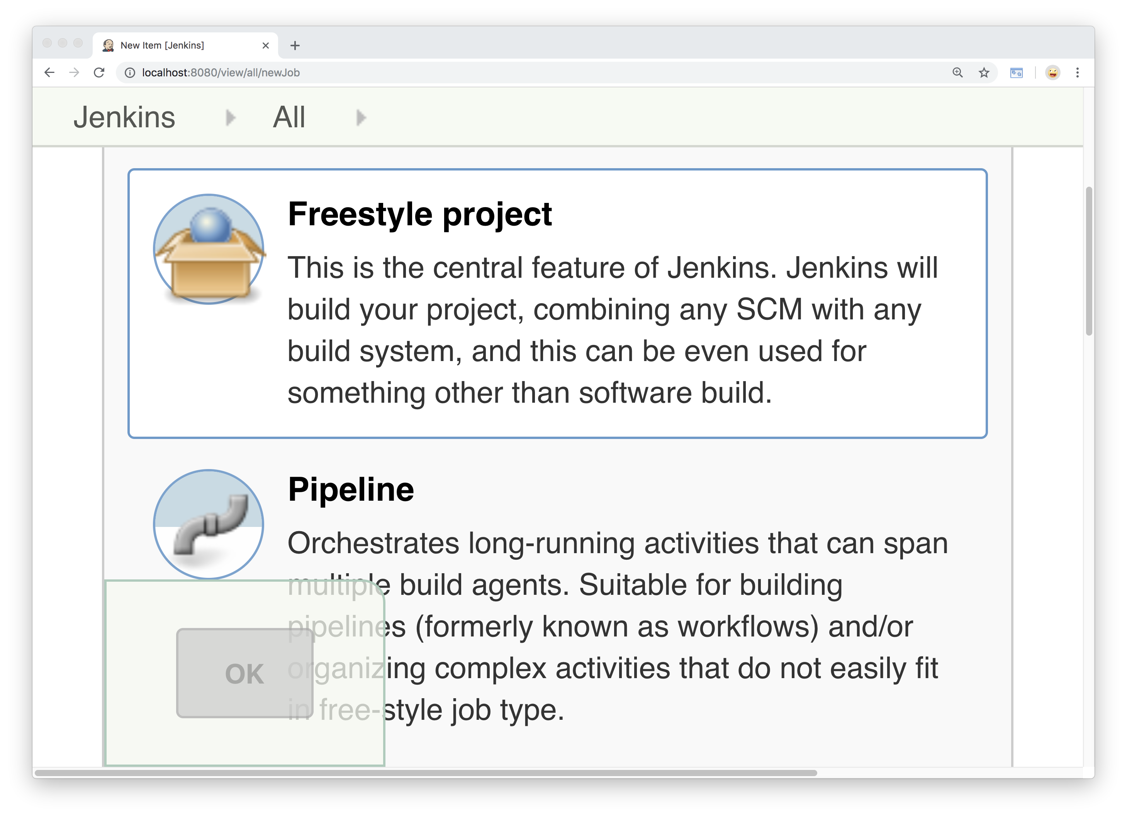
Notes:
-- Jenkins works great in the beginning, right…
When you are just getting started
But when you add more...
-- [copy] the classic way to scale….

Slide 28
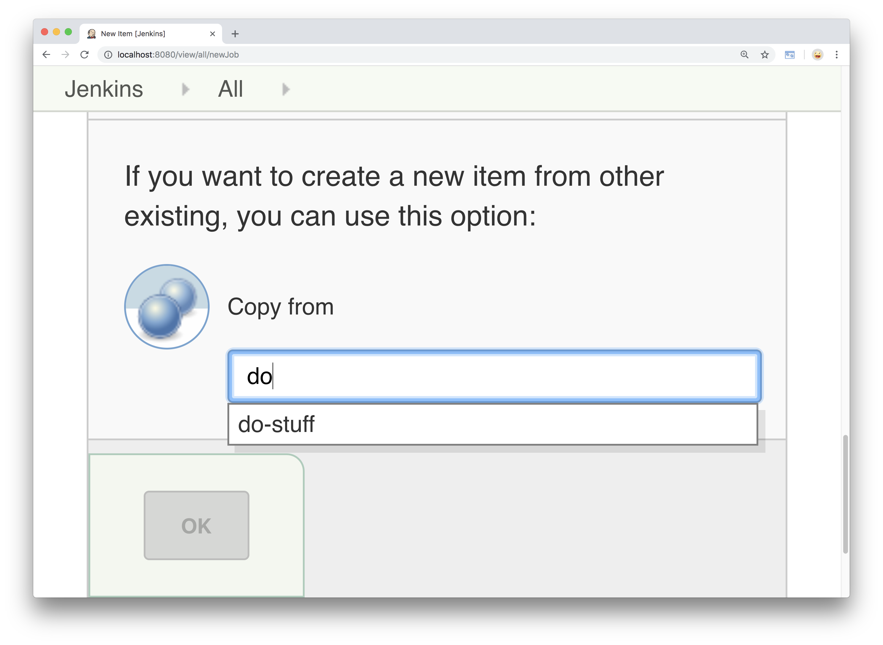
Notes:
Copy, right?
Who has used this scaling method?
It’s great, copies everything from an existing project into new
-- just like copy & paste code…

Slide 29

Notes:
You get spaghetti automation that ties your hands together.
================
https://commons.wikimedia.org/wiki/File:Homemade_fresh_pasta_(spaghetti)_by_Camille_(Unsplash).jpg
By davide ragusa davideragusa (https://unsplash.com/photos/FwiLgvi-2Do) [CC0], via Wikimedia Commons

Slide 30
Notes:
So let’s look at a real-life example we can use
To demonstrate ways we can scale Jenkins in a better way.
Imagine an enterprise company
=========
Logo from https://jenkins.io/artwork

Slide 31

Notes:
Not just a Fortune 500 company,
But arguably Fortune # 1.
Not in New York, London, or Beijing….
But somewhere a little farther north --

Slide 32

Notes:
Nobody knows quite exactly where it is,
Though people have tried looking…
============
https://commons.wikimedia.org/wiki/File:US_Navy_010605-N-0000X-002_Sailors_stationed_aboard_the_Los_Angeles-class_fast_attack_submarine_USS_Scranton_(SSN_756)_explore_the_Arctic_ice_surface.jpg
By U.S. Navy photo [Public domain], via Wikimedia Commons

Slide 33

Notes:
A very mysterious operation….
[anybody know what company I’m talking about?]
========
https://commons.wikimedia.org/wiki/File:Ever_wonder_what%27s_actually_at_the_North_Pole%3F_Wonder_no_more._(19676111656).jpg
https://upload.wikimedia.org/wikipedia/commons/d/d3/Ever_wonder_what%27s_actually_at_the_North_Pole%3F_Wonder_no_more._%2819676111656%29.jpg

Slide 34

Notes:
Yes, Santa Claus incorporated,
The man himself…
You want to talk about someone who needs to scale…
This is the case study of all case studies.
===================
https://commons.wikimedia.org/wiki/File:Flickr_-_The_U.S._Army_-_www.Army.mil_(144).jpg
By The U.S. Army (www.Army.mil) [Public domain], via Wikimedia Commons

Slide 35
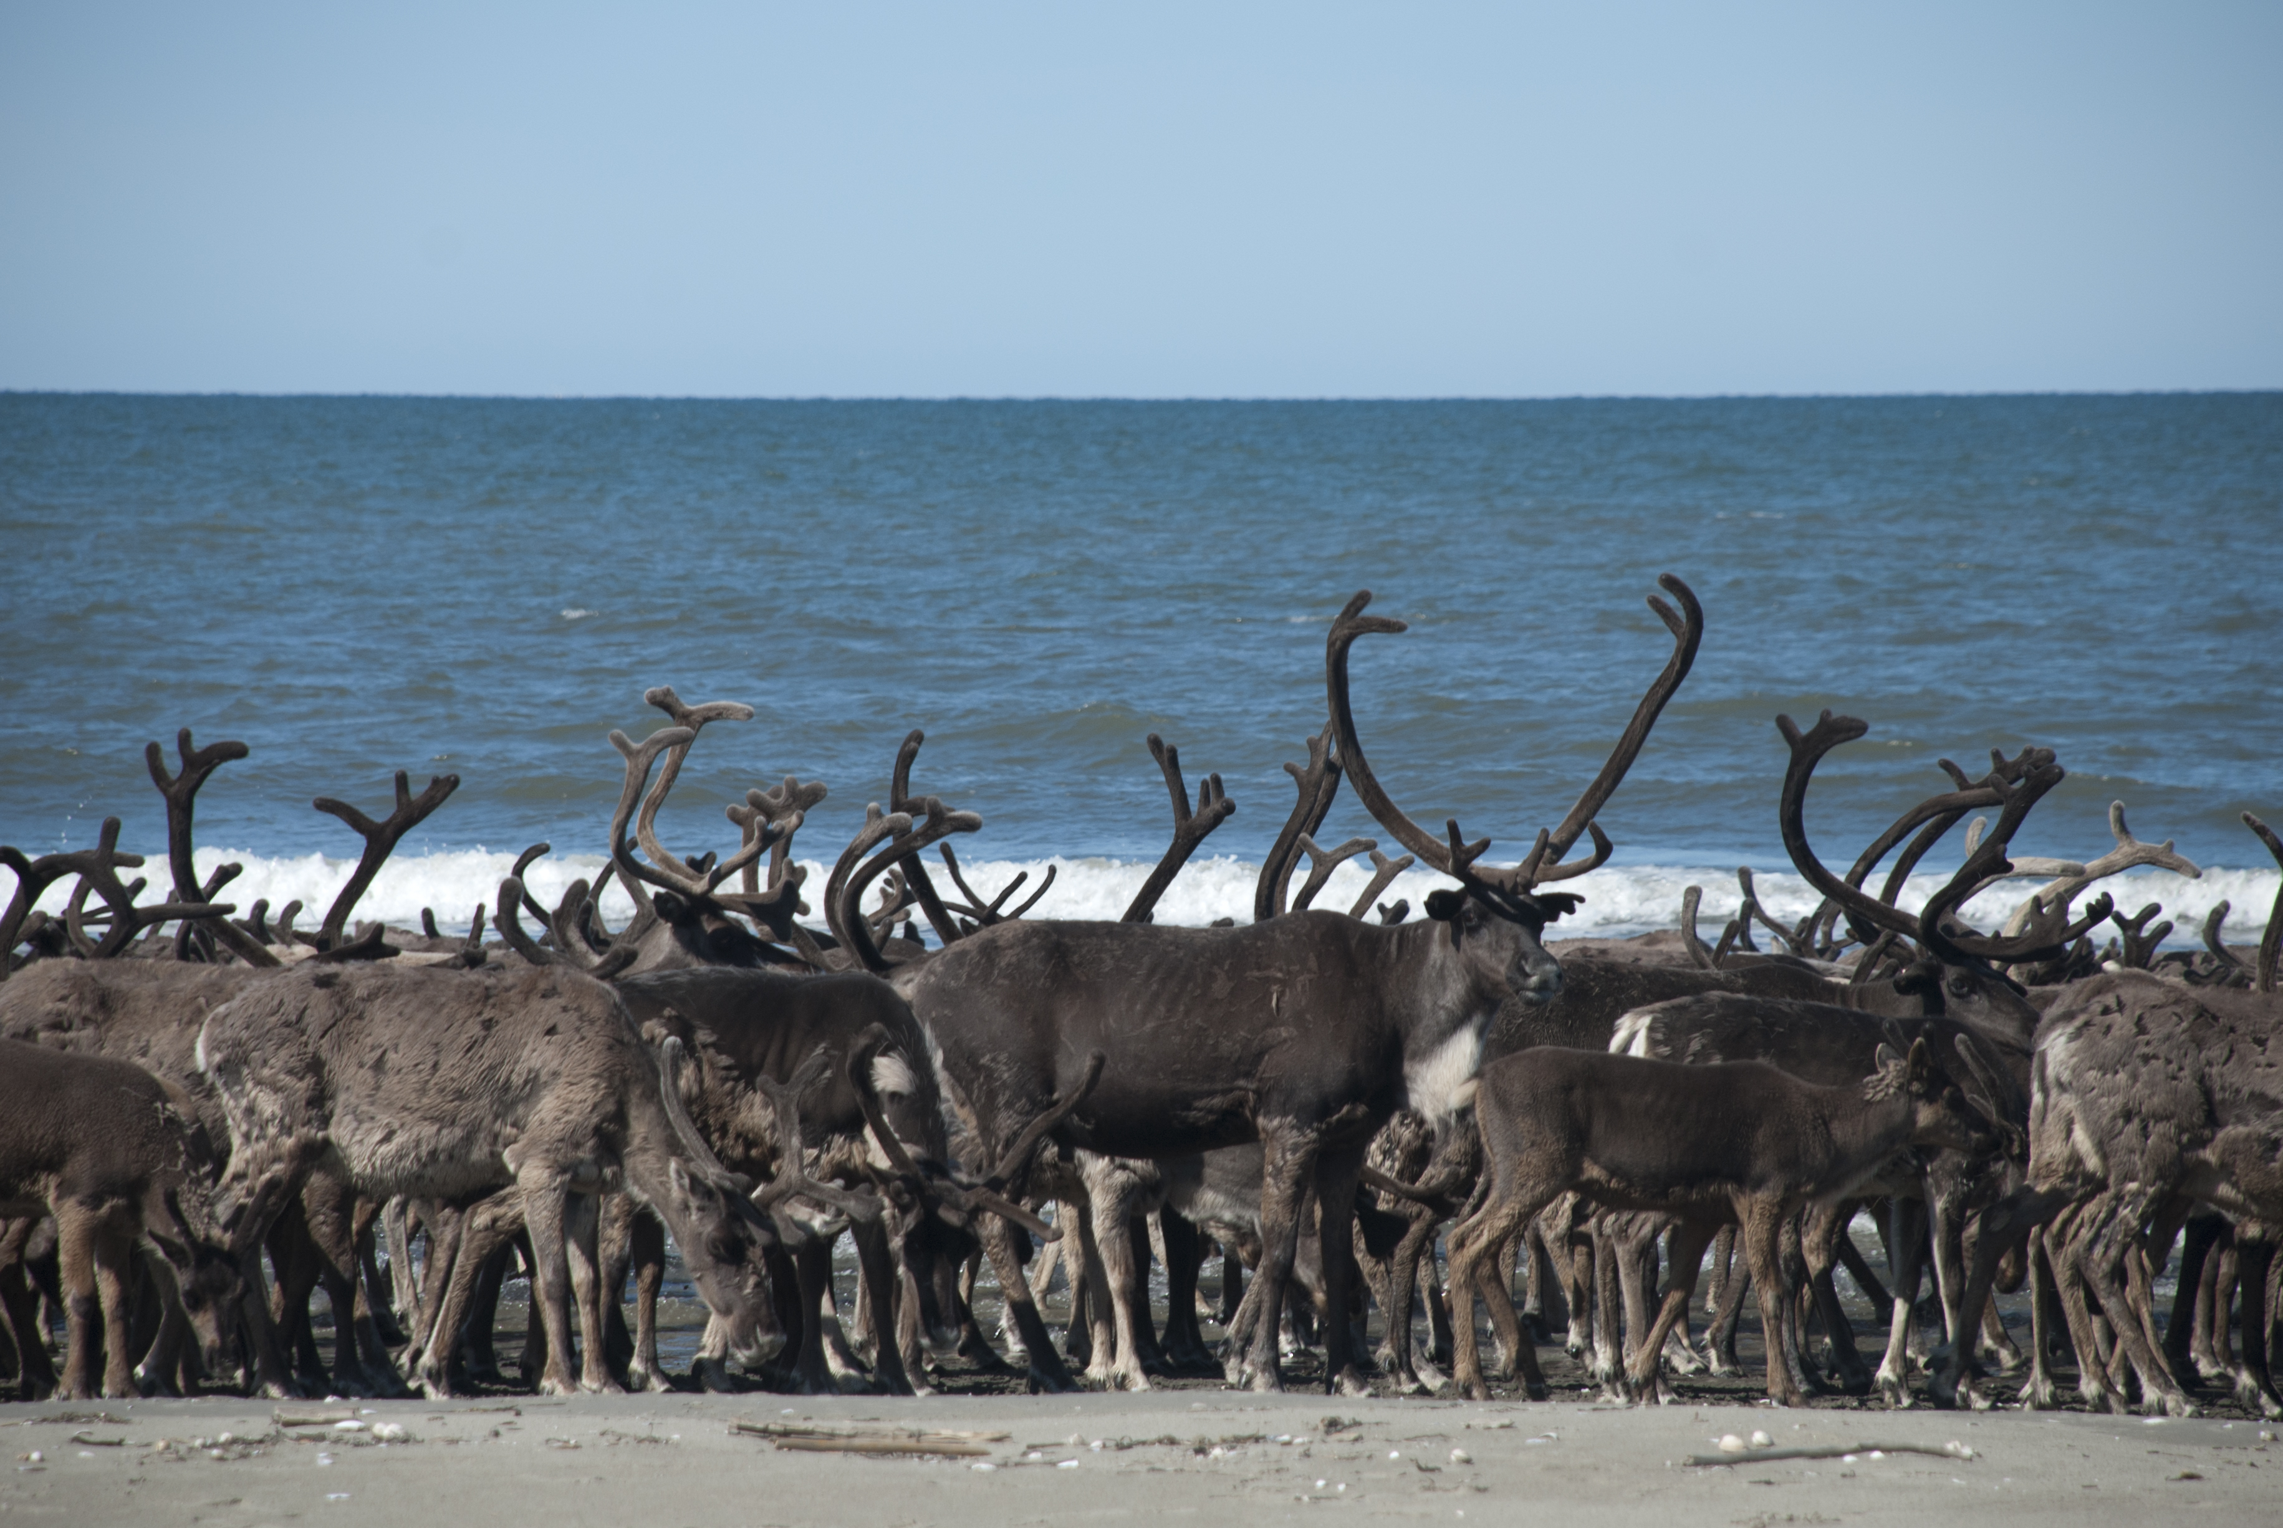
Did you know…
Notes:
Did you know…
Santa employs over 7.2 million reindeer that help him
Distribute all of those gifts on Christmas eve,
================
https://commons.wikimedia.org/wiki/File:Reindeer_on_Ikpek_Beach_(7726653378).jpg
By Bering Land Bridge National Preserve (Reindeer on Ikpek Beach) [CC BY 2.0 (https://creativecommons.org/licenses/by/2.0)], via Wikimedia Commons

Slide 36

Notes:
Santa himself is getting up there,
He’s about 1700 years old now.
He used to know all of the reindeers by heart,
Which is important….
===========
https://commons.wikimedia.org/wiki/File:Saint_Nicholas_Catholic_Church_(Zanesville,_Ohio)_-_stained_glass,_St._Nicholas_-_detail,_closeup.jpg
By Nheyob [CC BY-SA 4.0 (https://creativecommons.org/licenses/by-sa/4.0)], from Wikimedia Commons

Slide 37

Notes:
For keeping in contact with all
Of the reindeer and elves,
Keeping everything coordinated
=================
https://commons.wikimedia.org/wiki/File:Kadena_celebrates_holidays_with_Tinsel_Town_151212-F-ZC102-550.jpg
By Senior Airman Omari Bernard [Public domain], via Wikimedia Commons

Slide 38
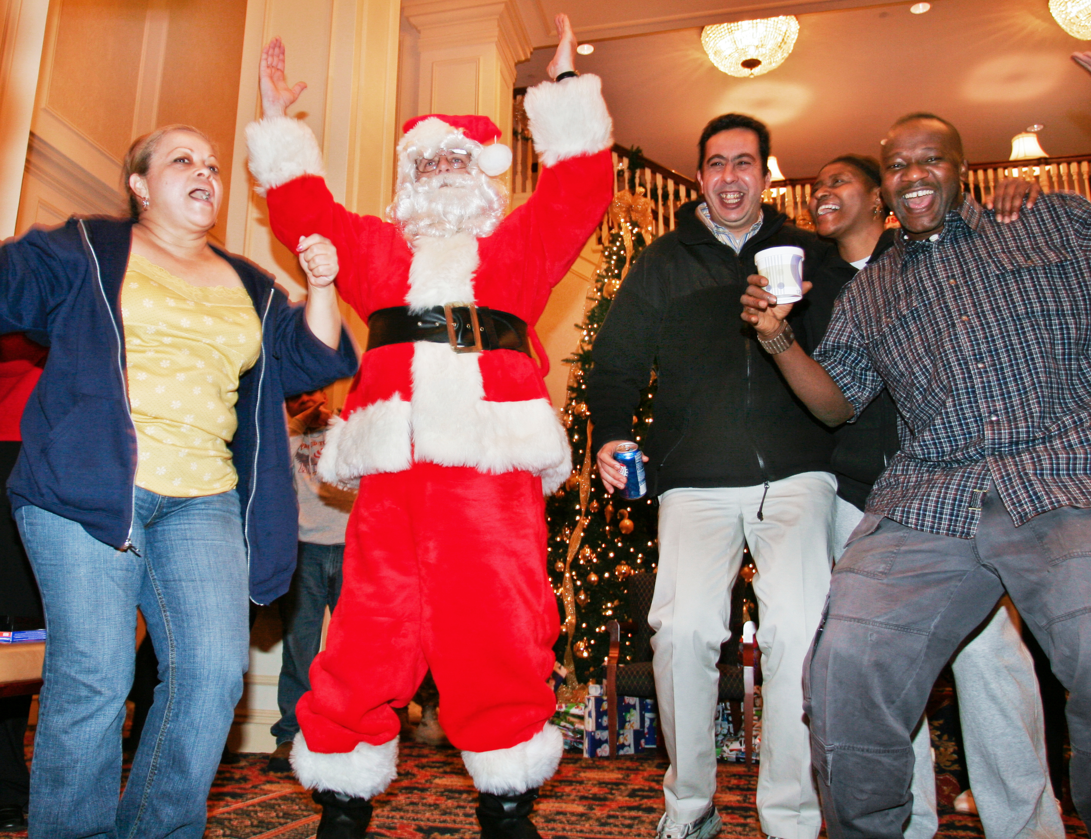
Notes:
For the night of the Big Dance
On December 24.
So what does Santa do?
⁼⁼⁼⁼⁼⁼⁼⁼⁼⁼⁼⁼⁼⁼⁼⁼⁼
https://commons.wikimedia.org/wiki/File:Defense.gov_photo_essay_071203-D-0653H-234.jpg
By English: Linda Hosek [Public domain], via Wikimedia Commons

Slide 39

Notes:
He uses Jenkins, of course.
So let’s look at an example of what Santa’s going to do here.
-- create new freestyle job called Rudolph…
=========
Logo from https://jenkins.io/artwork
Created by https://twitter.com/ks_nenasheva

Slide 40
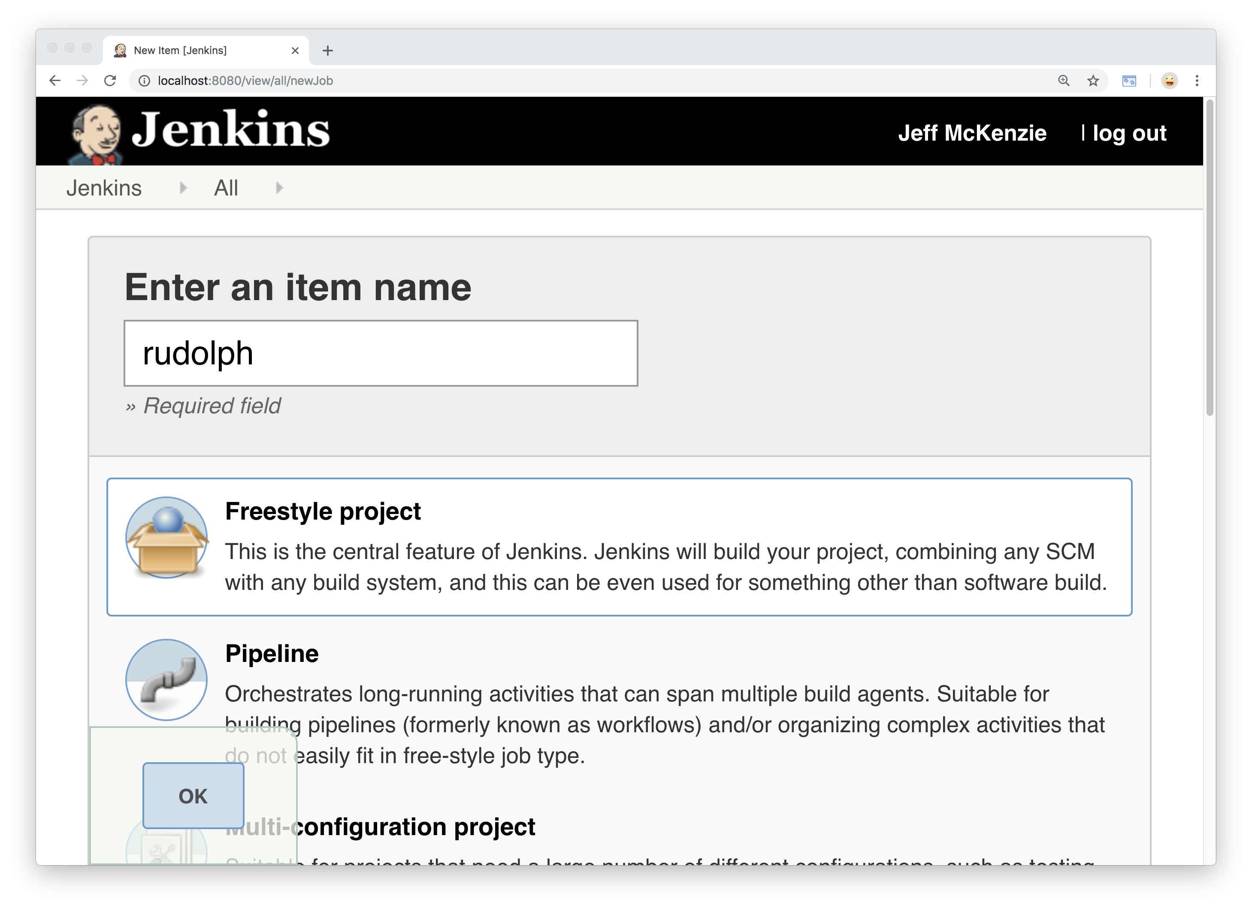
Notes:
Click OK…

Slide 41
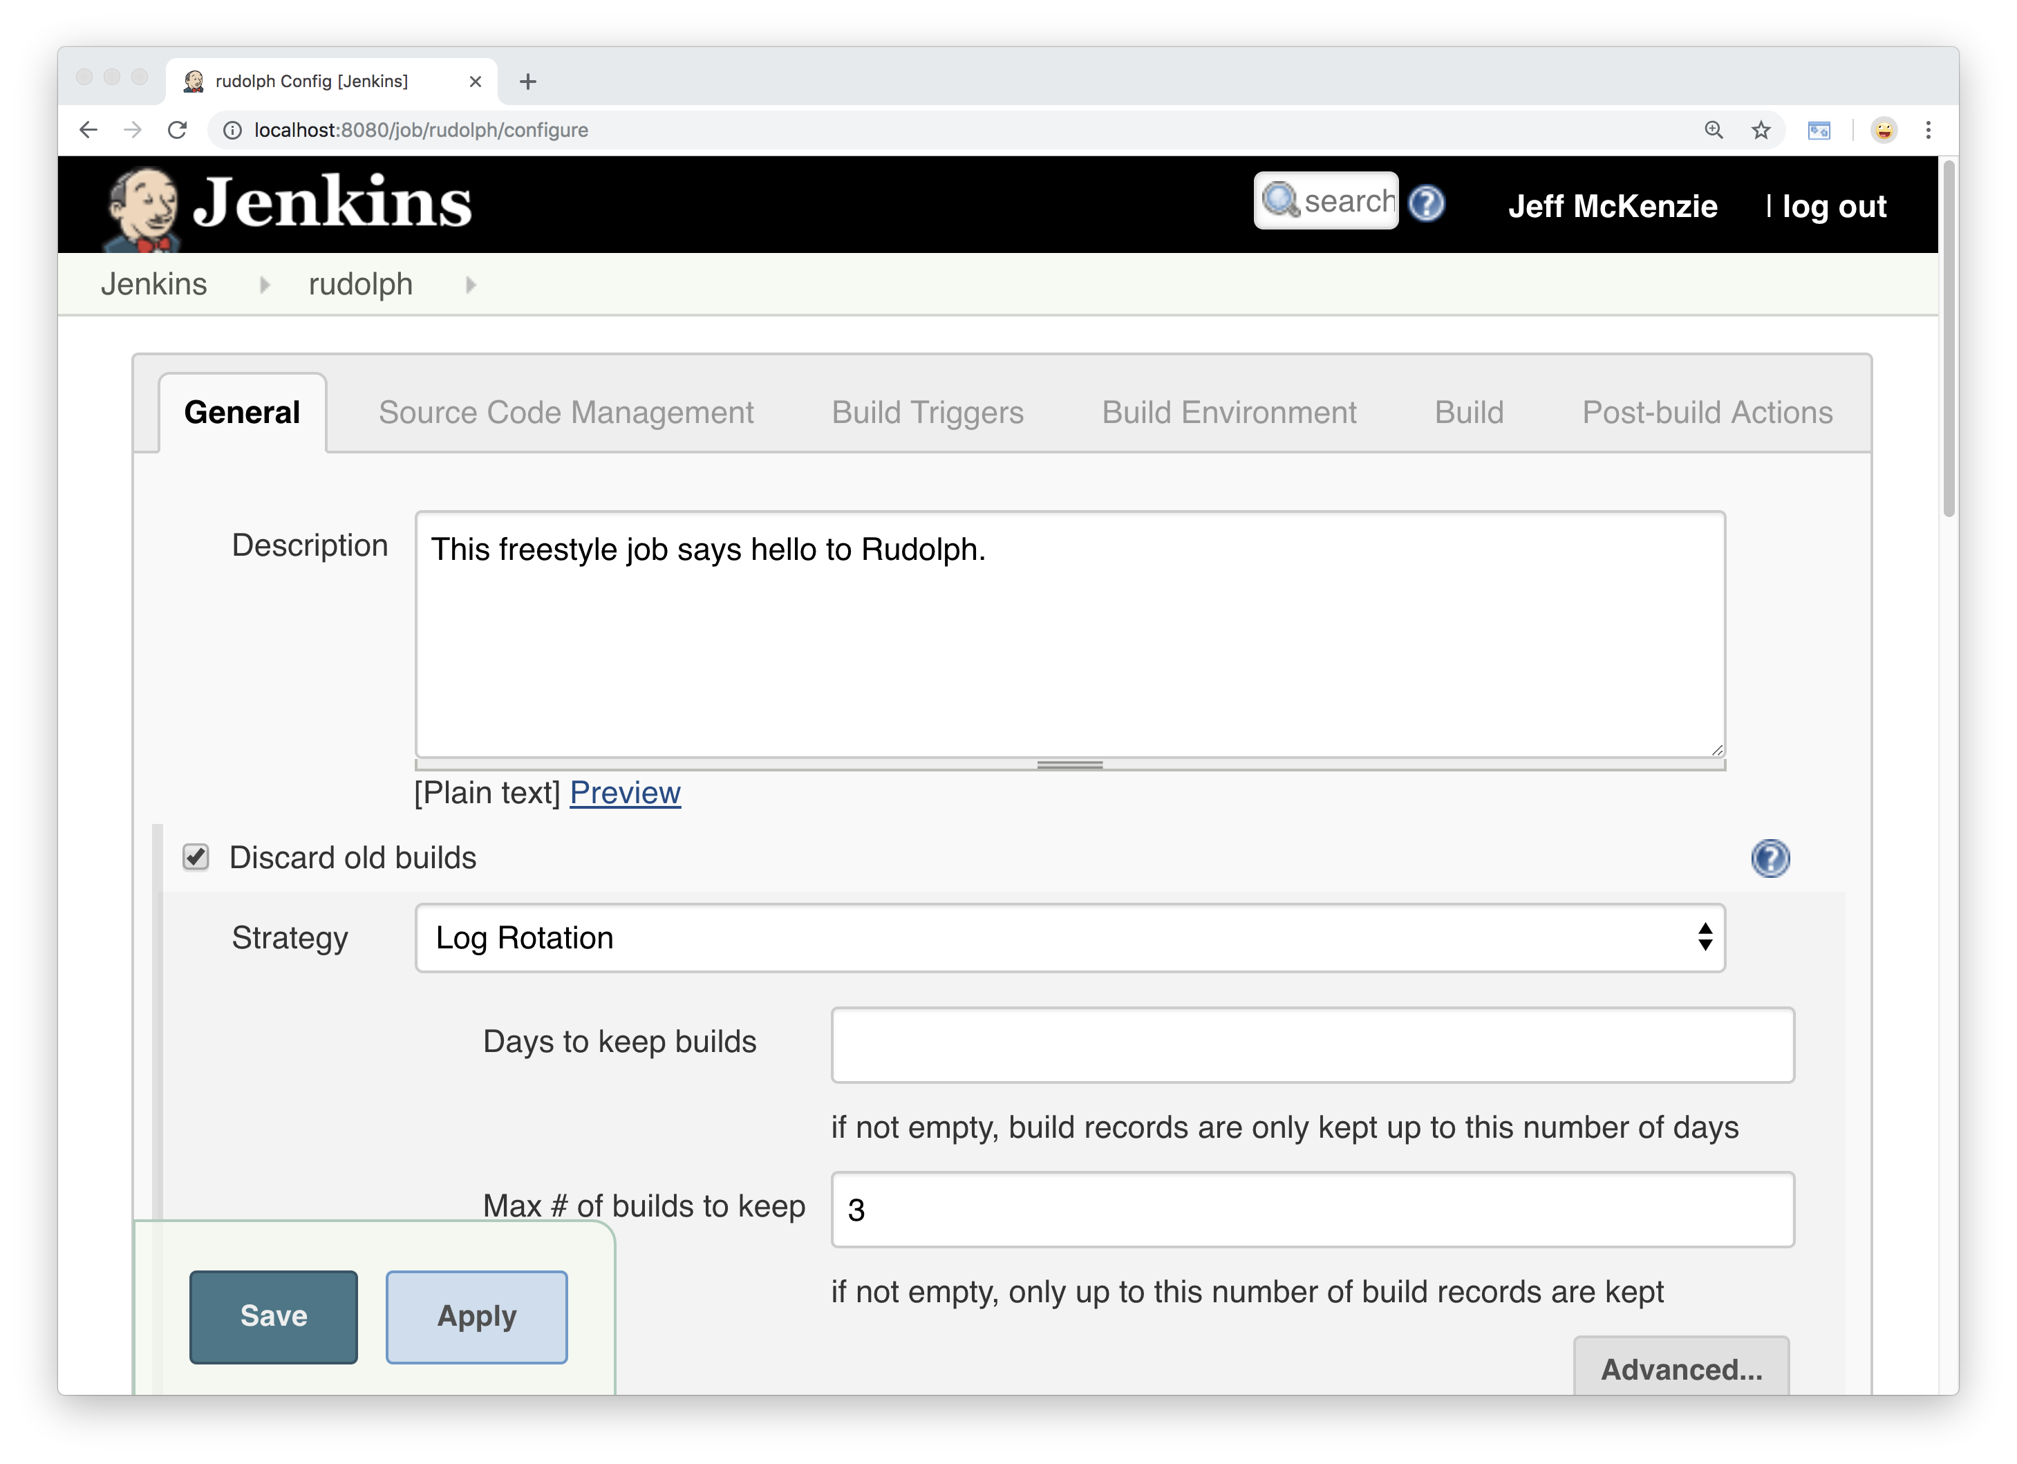
Notes:
-- description, says hello to Rudolph
-- keep last 3 builds

Slide 42
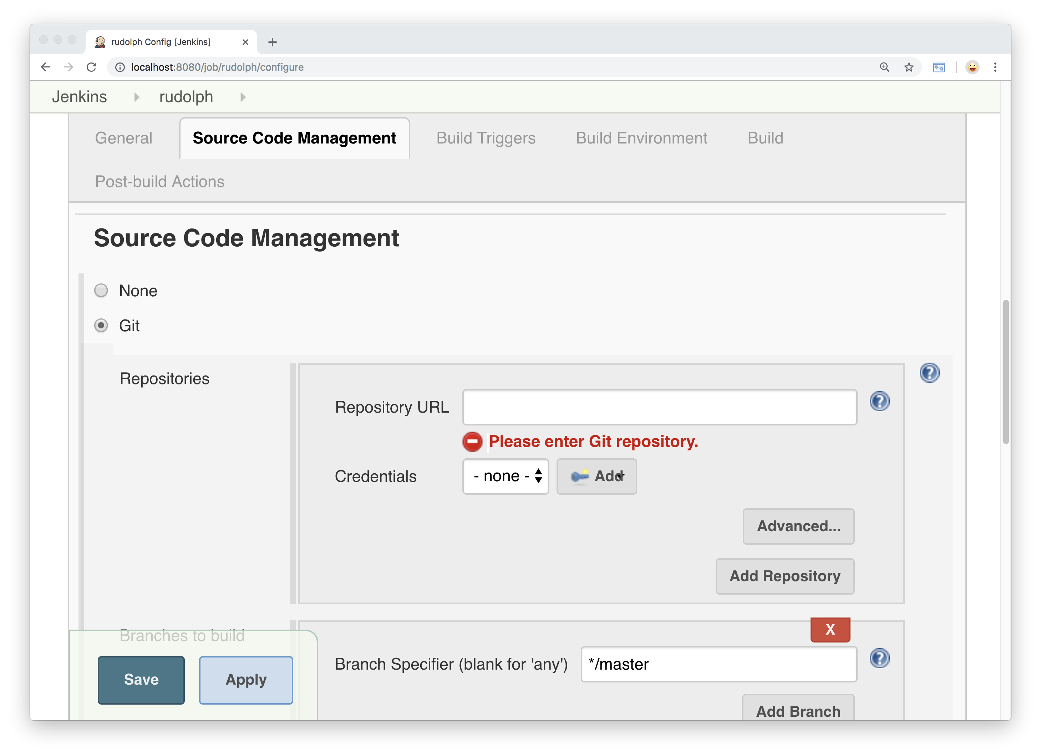
Notes:
Under the source code management tab, select Git

Slide 43
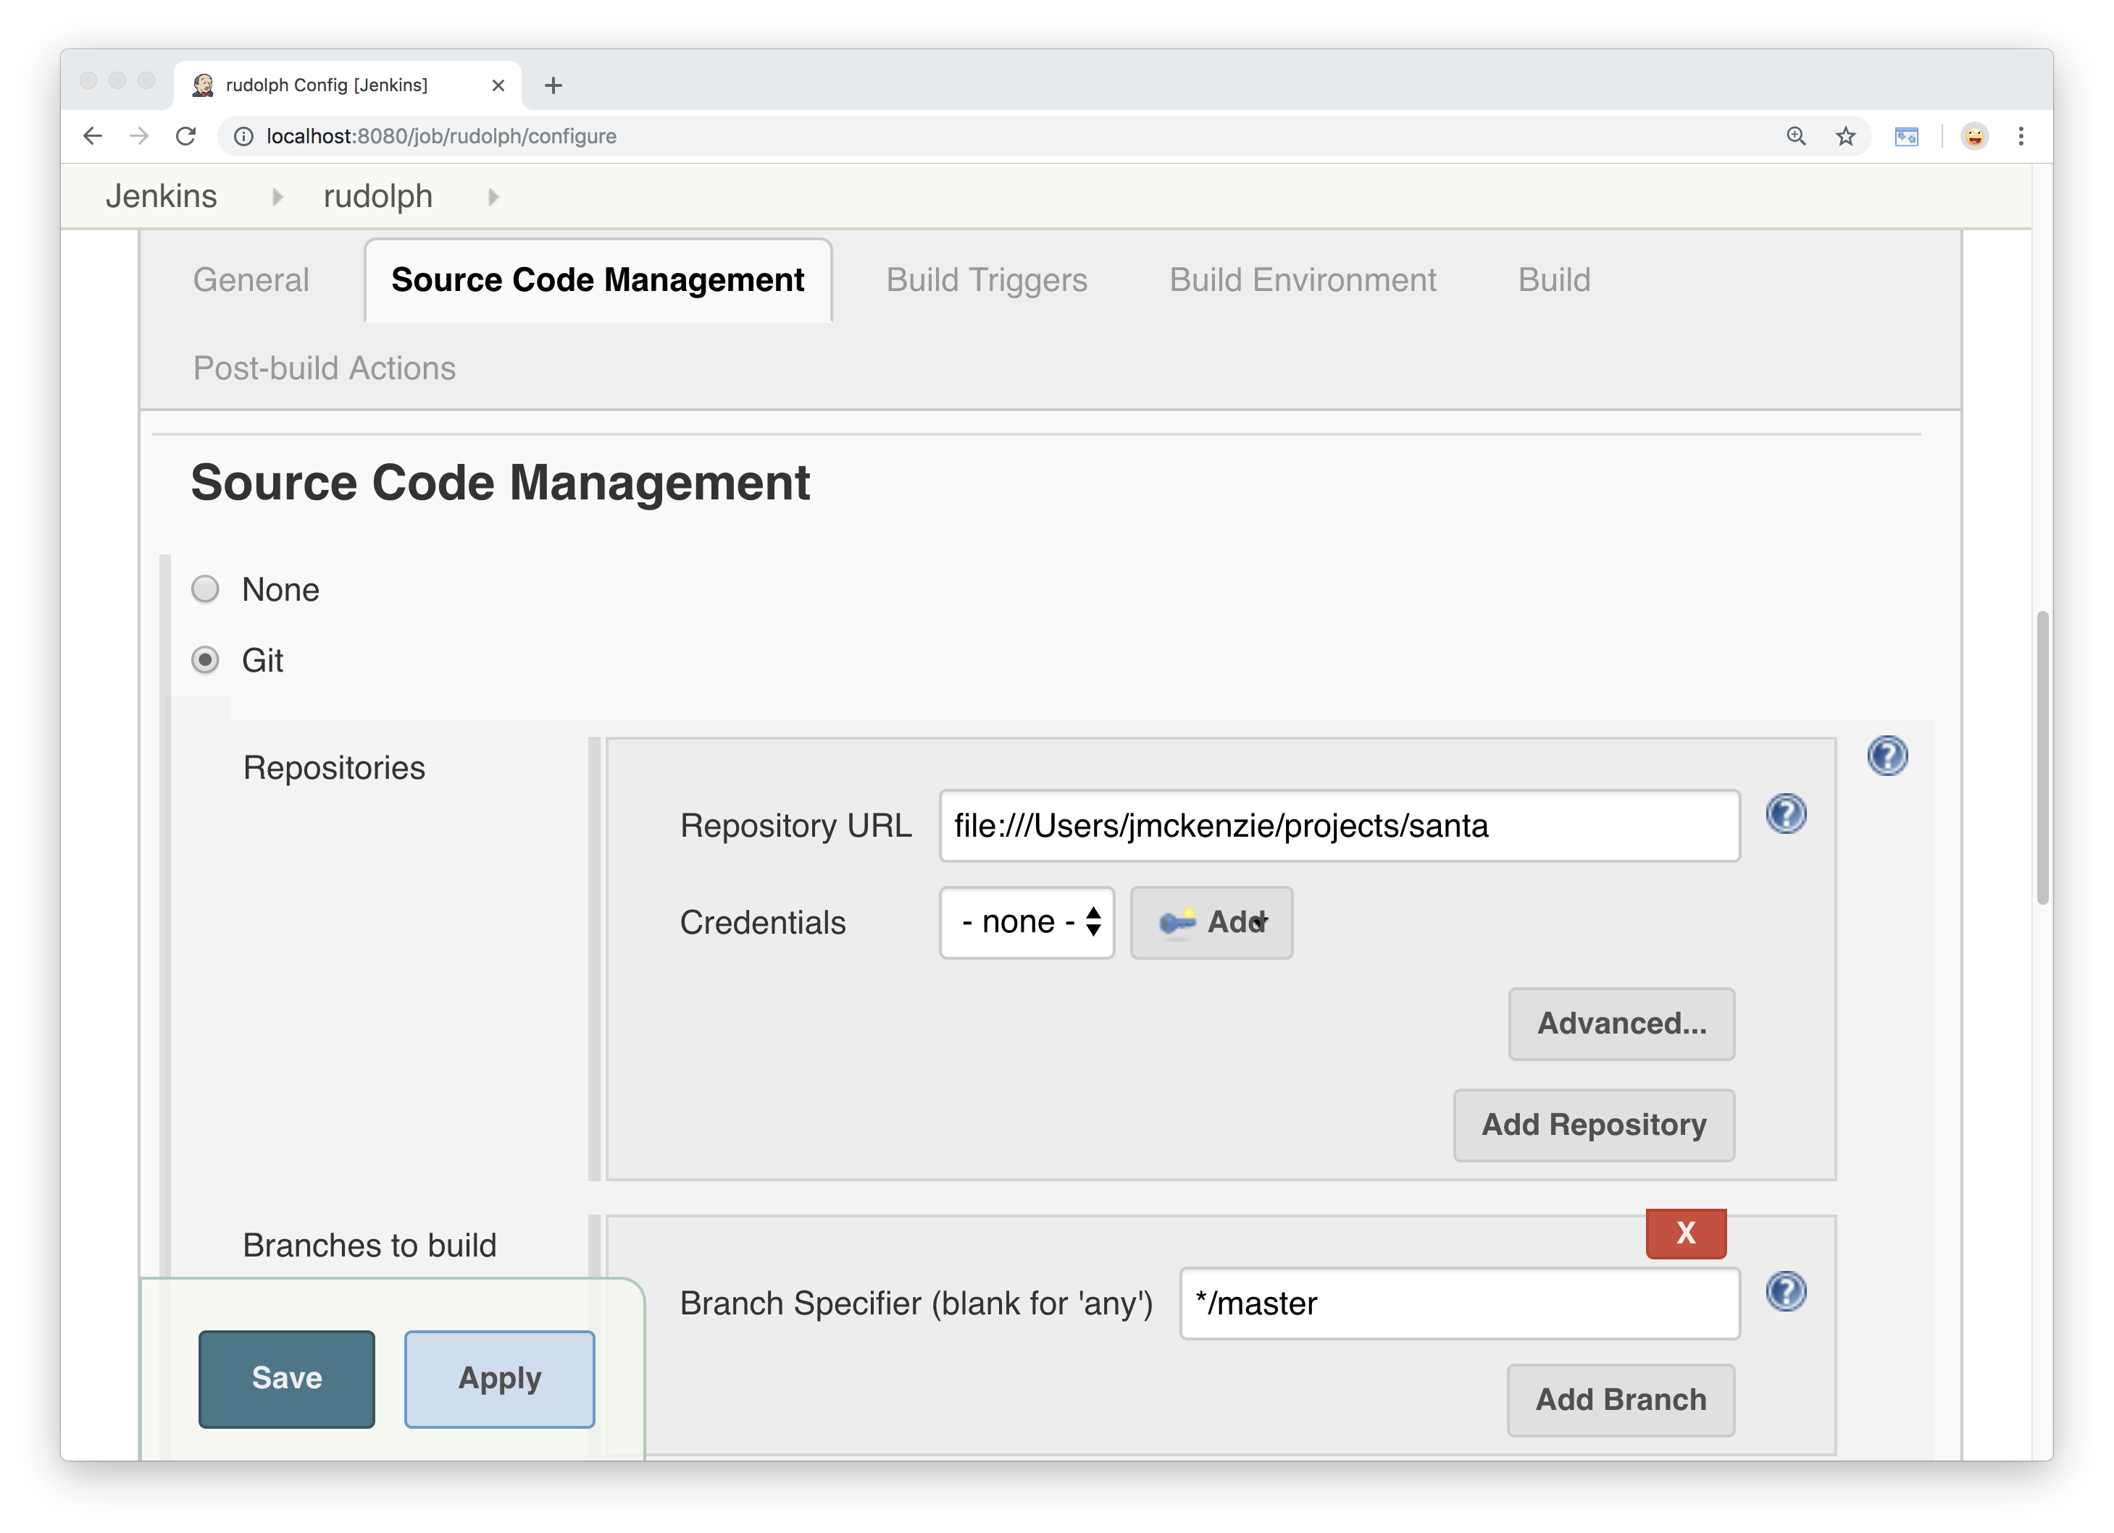
Notes:
I’m just going to point this to a local git repo
That I have in my home directory
And it’s pulling from the master branch
[Git users here?]

Slide 44
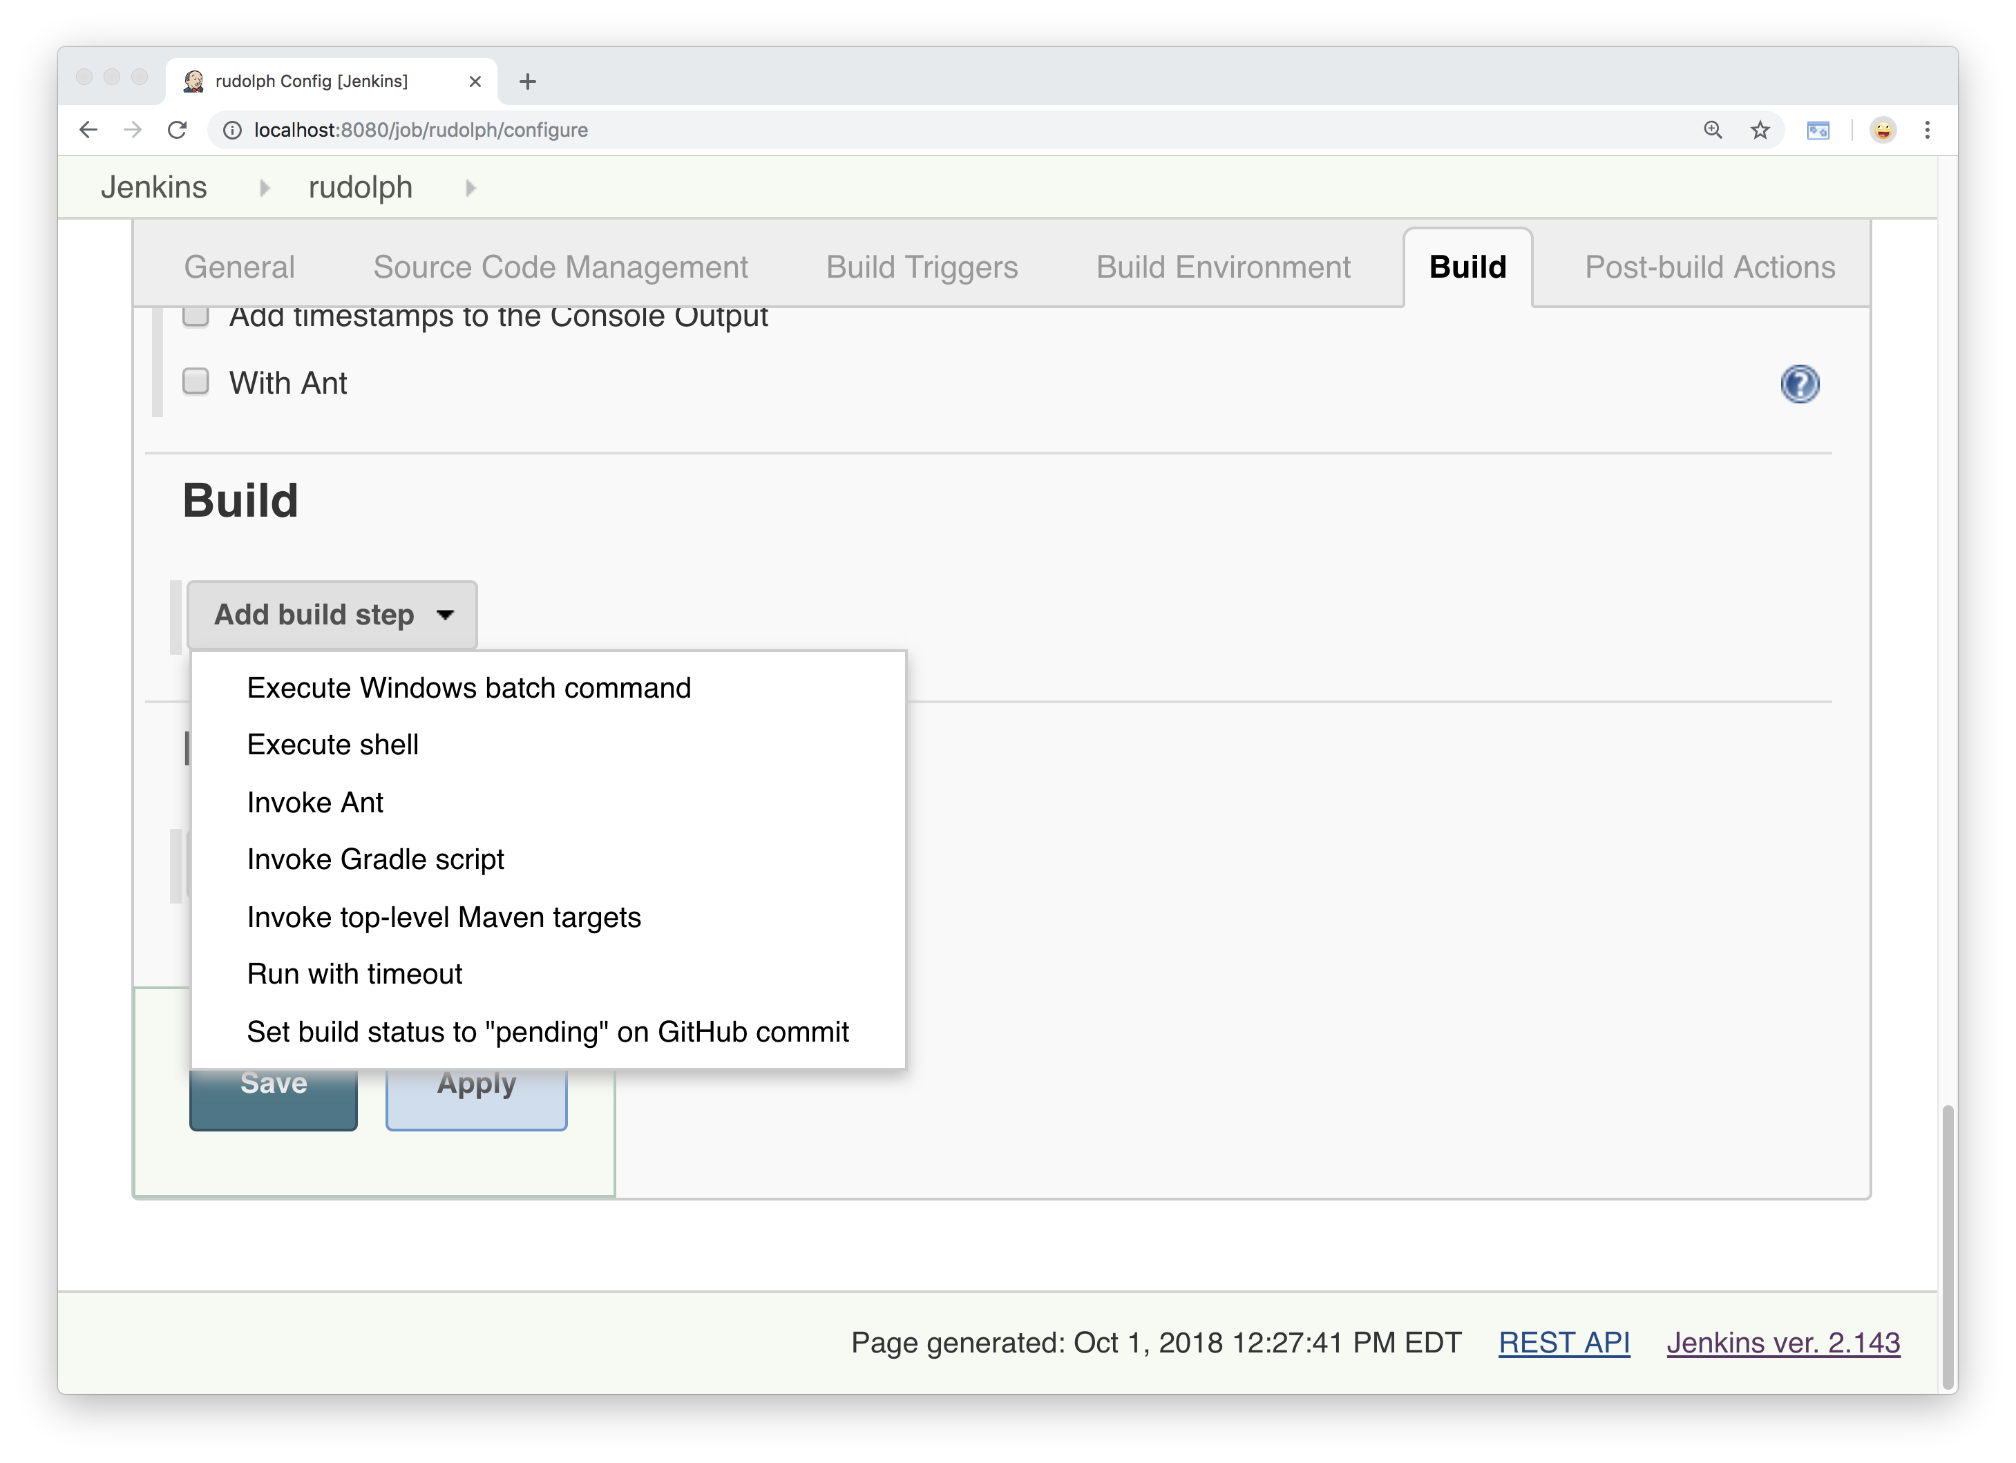
Notes:
On the build tab, again I’m going to choose
The Execute shell build step…

Slide 45
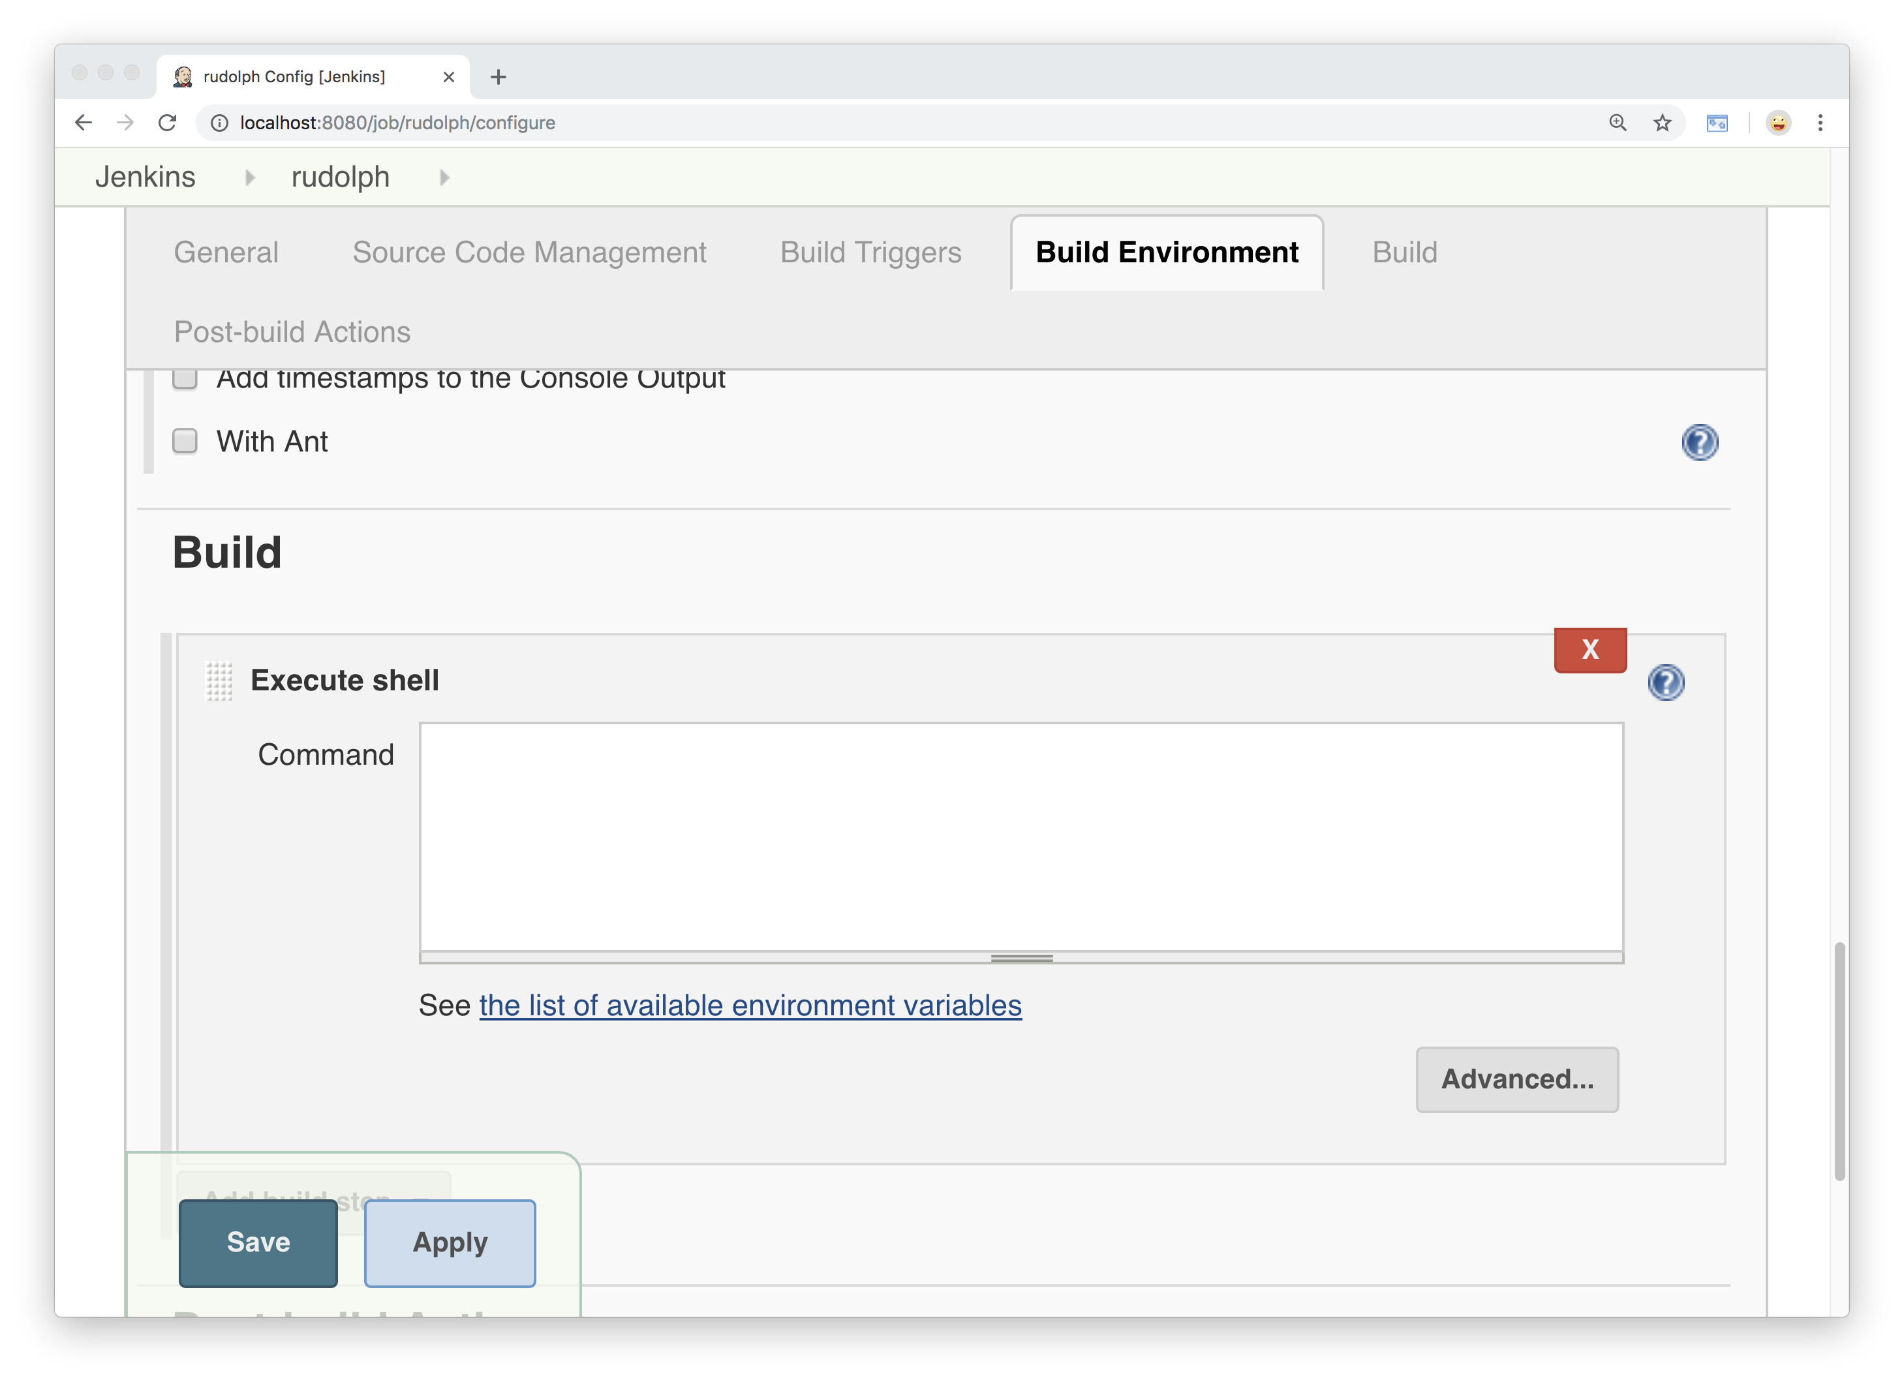

Slide 46
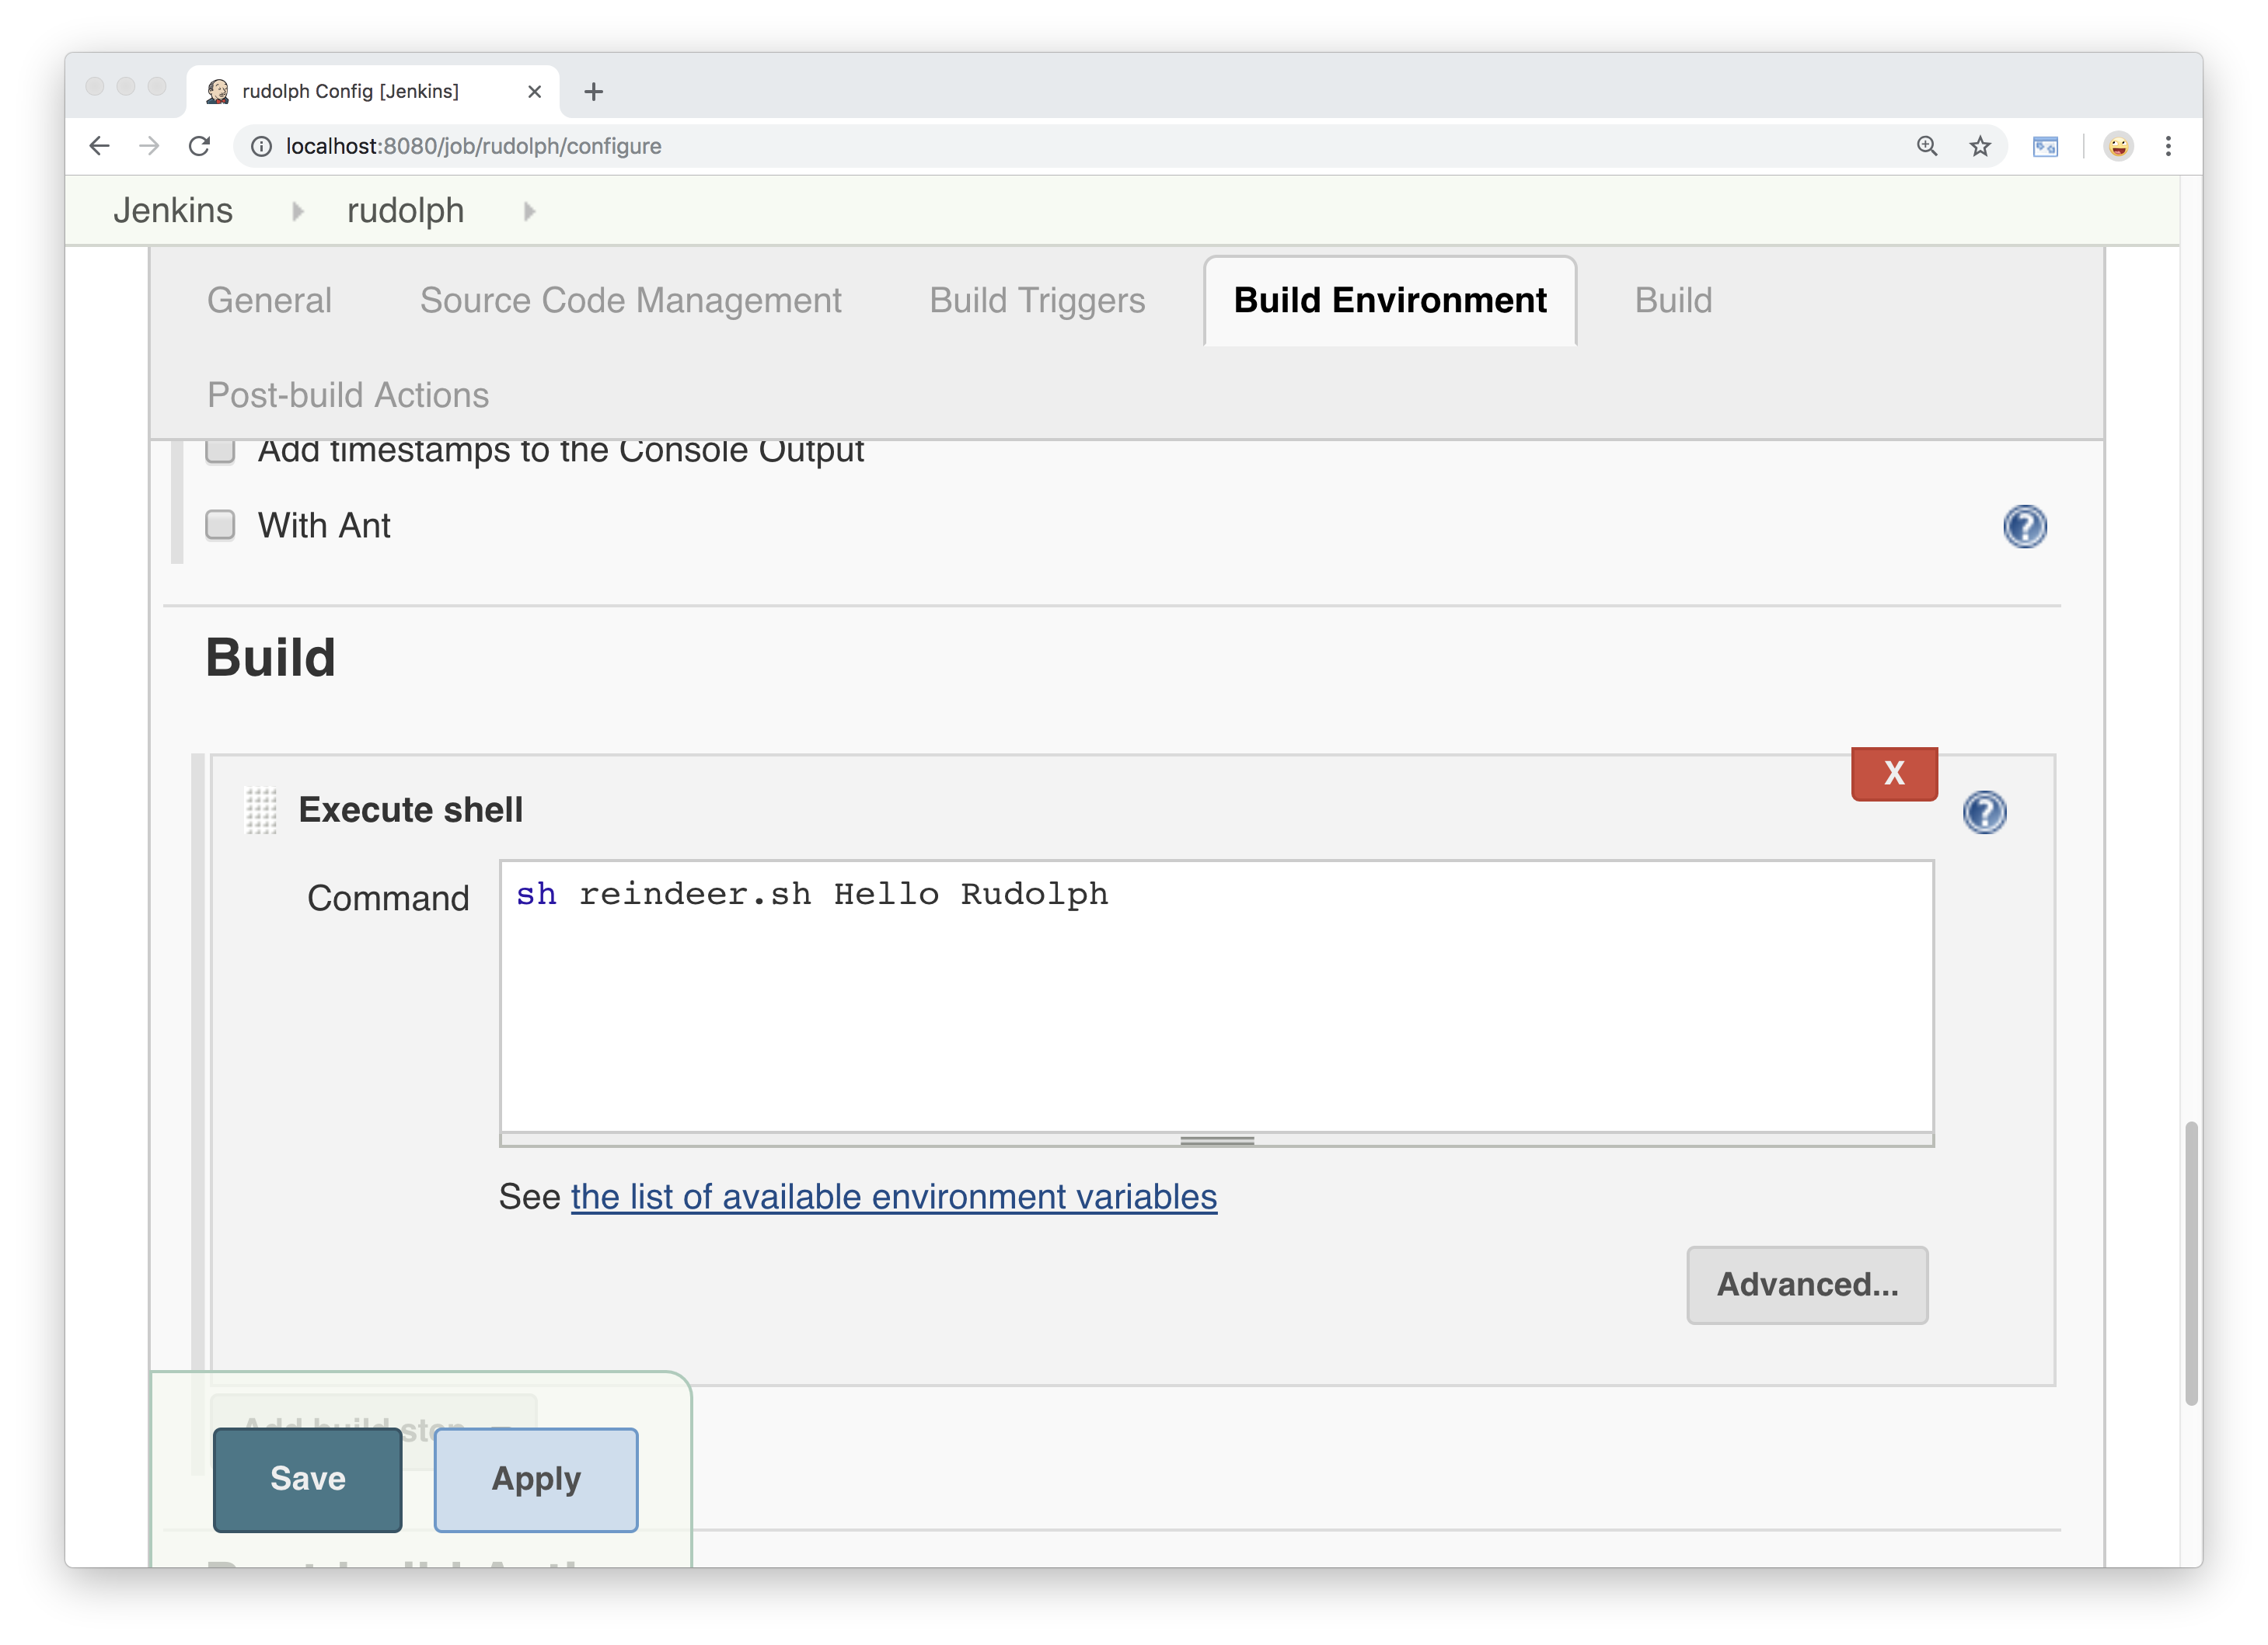
Notes:
And put the following command in there…
Sh Reindeer.sh Hello Rudolph.
This tells Jenkins to run a shell script called reindeer.sh
That’s in my git repo, so let’s take a look at that real quick.

Slide 47
#!/bin/bash greeting="$1"
reindeer_name="$2" if [ -z "$greeting" ]
then
greeting="Hi"
fi
if [ -z "$reindeer_name" ]
then
reindeer_name="Reindeer"
fi
echo ================================
echo =
echo = ${greeting} ${reindeer_name}!
echo =
echo ================================
Notes:
So this sets two variables –
Greeting, and reindeer name,
Which get passed in from Jenkins.
If nothing gets passed in for either variable,
Then the script sets defaults.
Then the result gets written as output.
---
So we will save this, go back to the project screen

Slide 48

Notes:
And click “build Now”

Slide 49
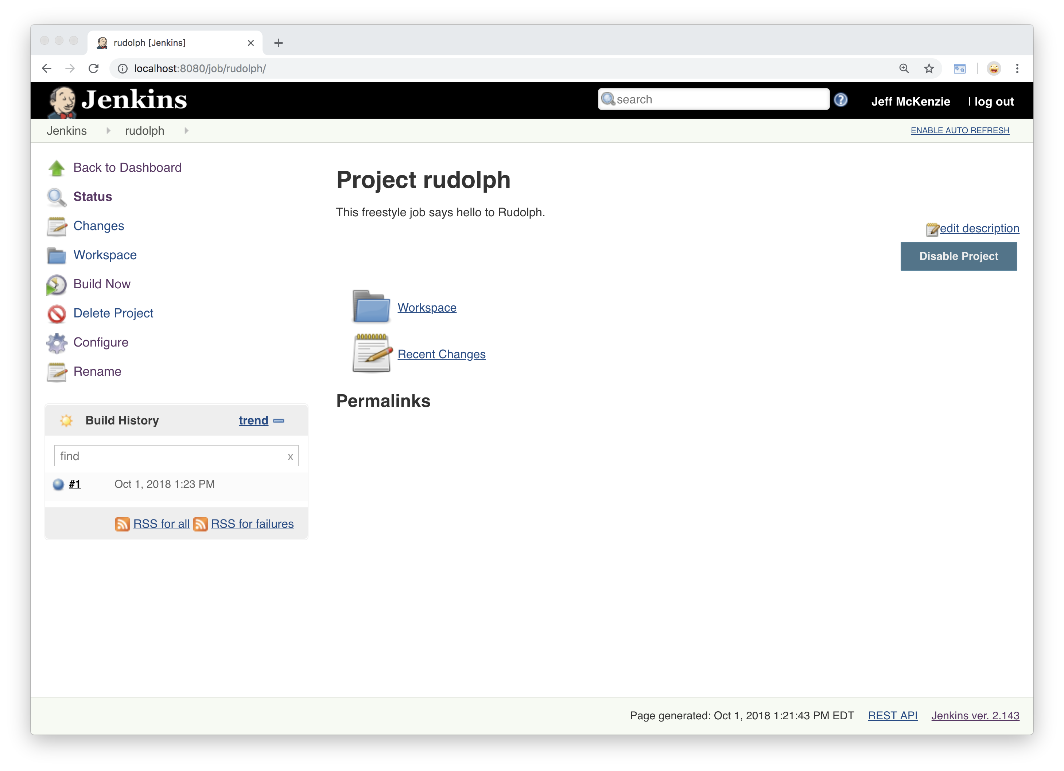
Notes:
And we have a success – let’s look at the output.

Slide 50
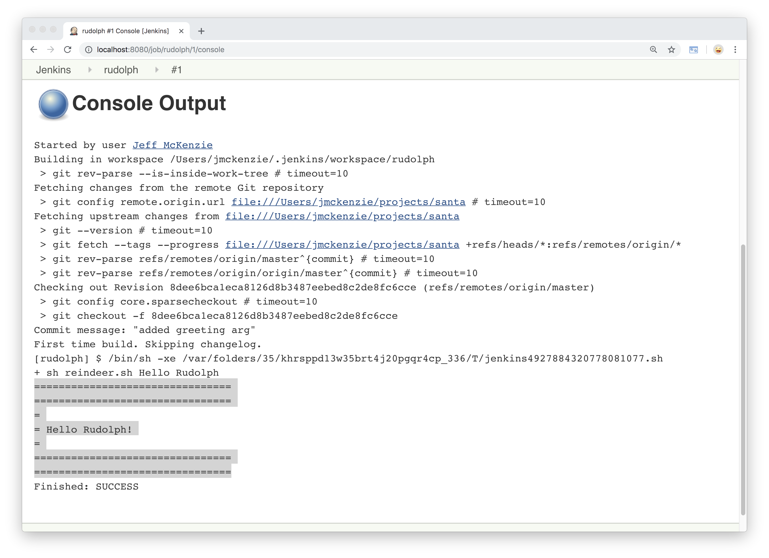
Notes:
There we have the result of the script as it’s run.
So there’s one job for one reindeer.
-- contrived example, but basic
-- does have the basic elements:
pulling code from source control
and doing something with it
--not concerned as much with what it does as
how to scale and manage these types of jobs

Slide 51
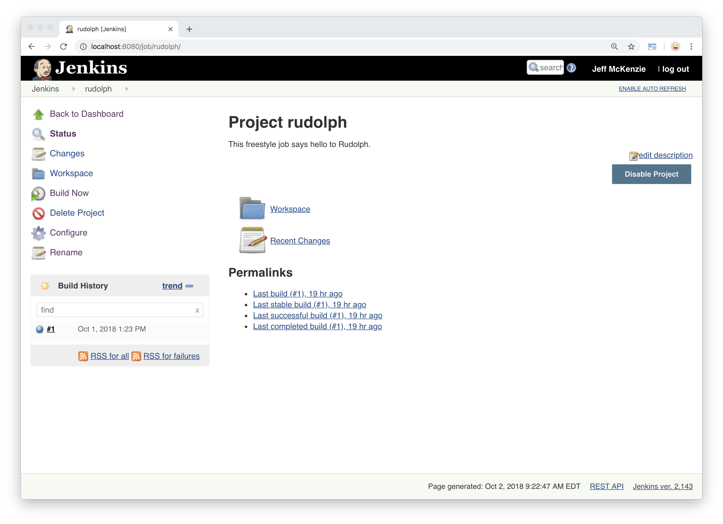
Notes:
Here’s our Rudolph project.
Let’s say we copy this job 9 times for a total of 10 reindeer,
And we want this to say something other than Hello as a greeting?
[change each one individually….]
There’s a better way to do this….

Slide 52
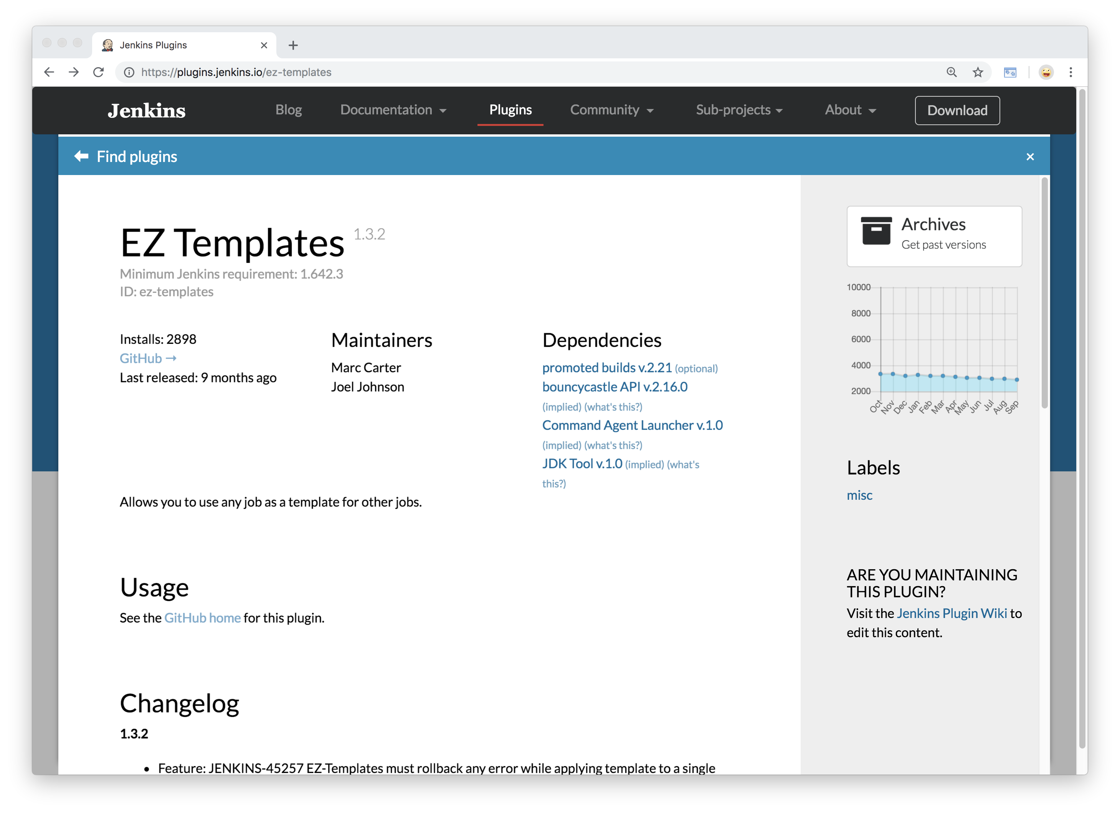
Notes:
And one way is to use a plugin called EZ Templates
Here’s the official plugin page for it,
There’s also a git repo for it
the plugin itself is available in the Manage Plugins
section of Jenkins

Slide 53
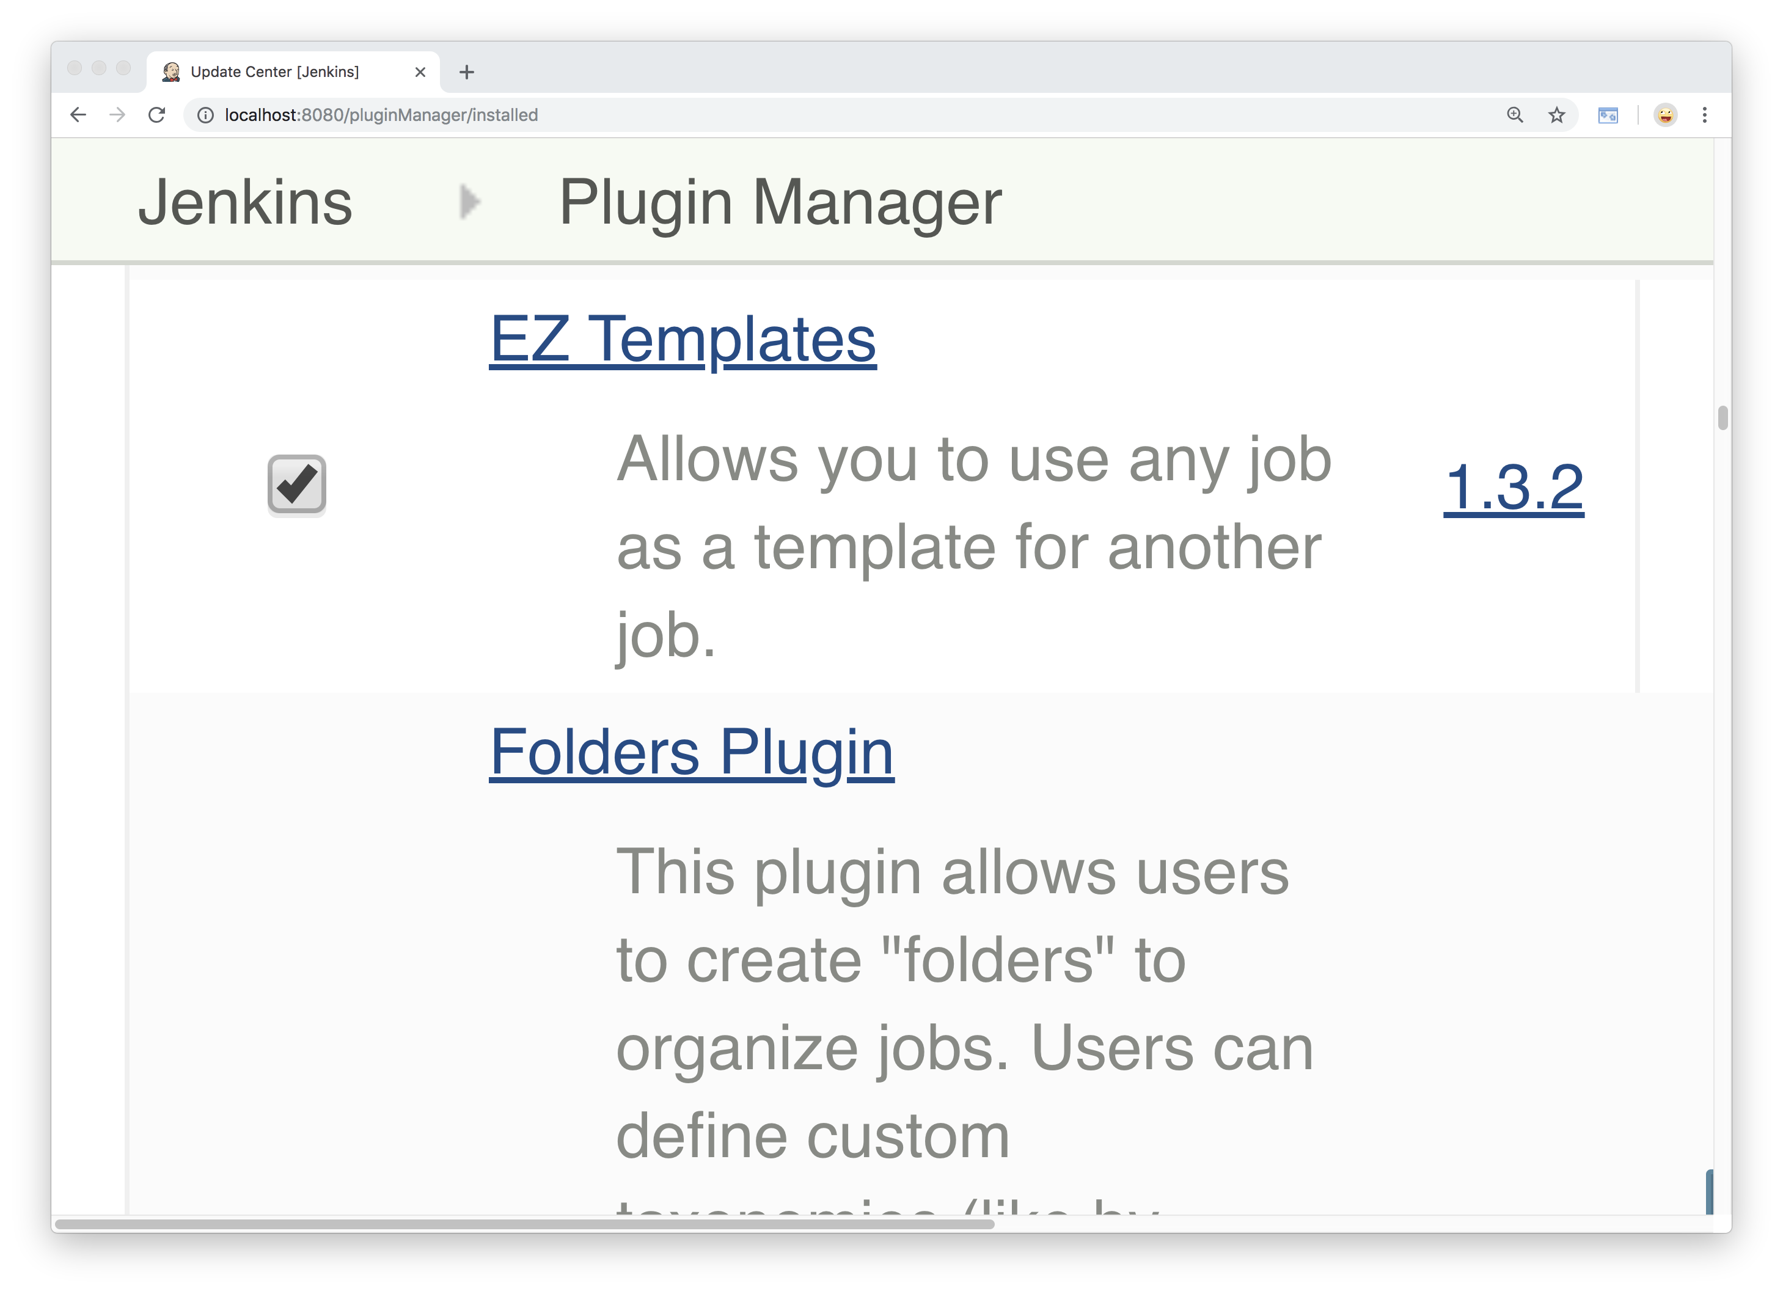
Notes:
Like a lot of plugins, this was originally developed by a third party
And then merged into the Jenkins project
So you just need to select and install it
As it describes, this allows you to take any job
And use it as a template for other jobs.
Let’s take a look at how it might help us scale in this instance.

Slide 54
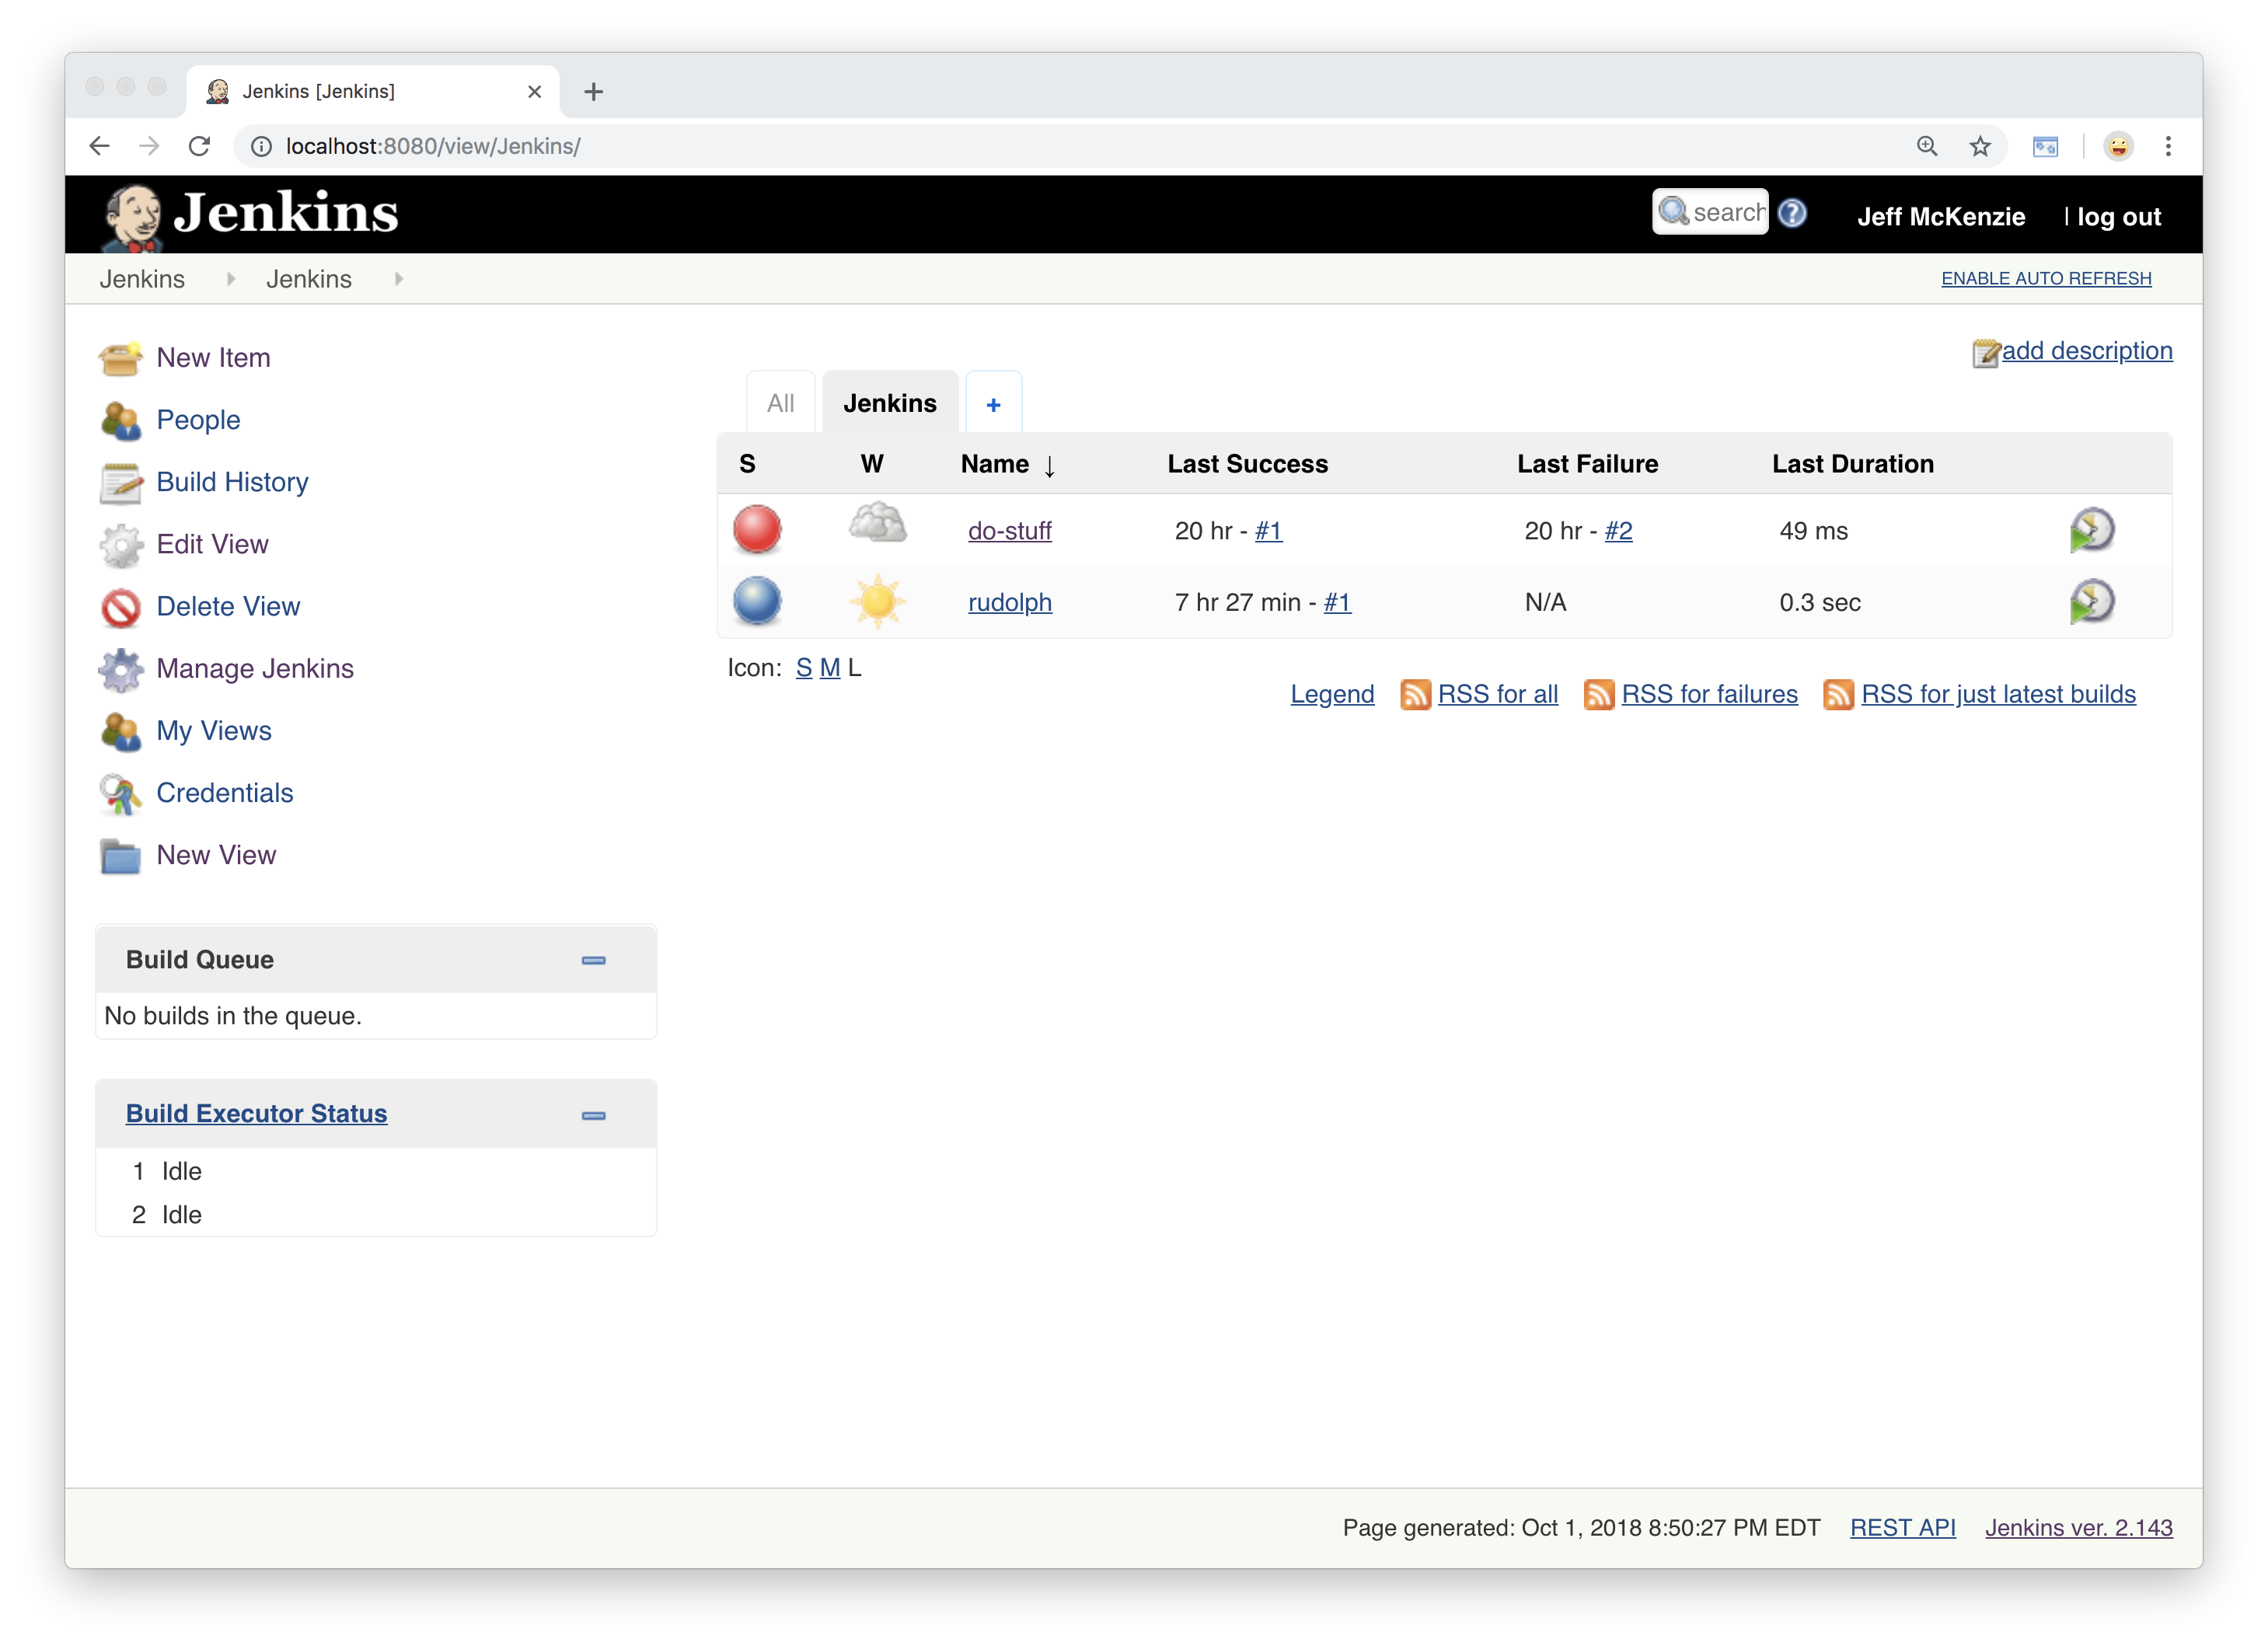
Notes:
So far we have our “do stuff” project,
And our Rudolph project.
Let’s create our template.

Slide 55
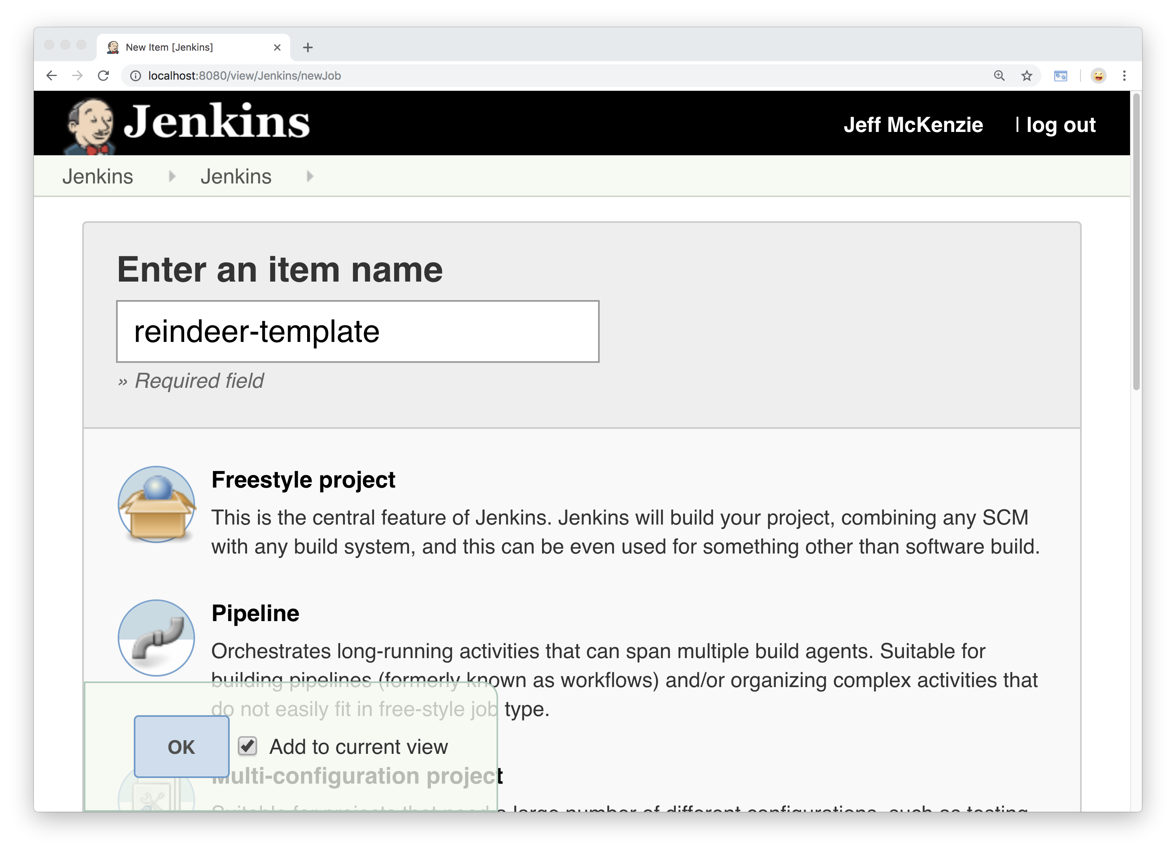
Notes:
Let’s call it Reindeer Template…

Slide 56
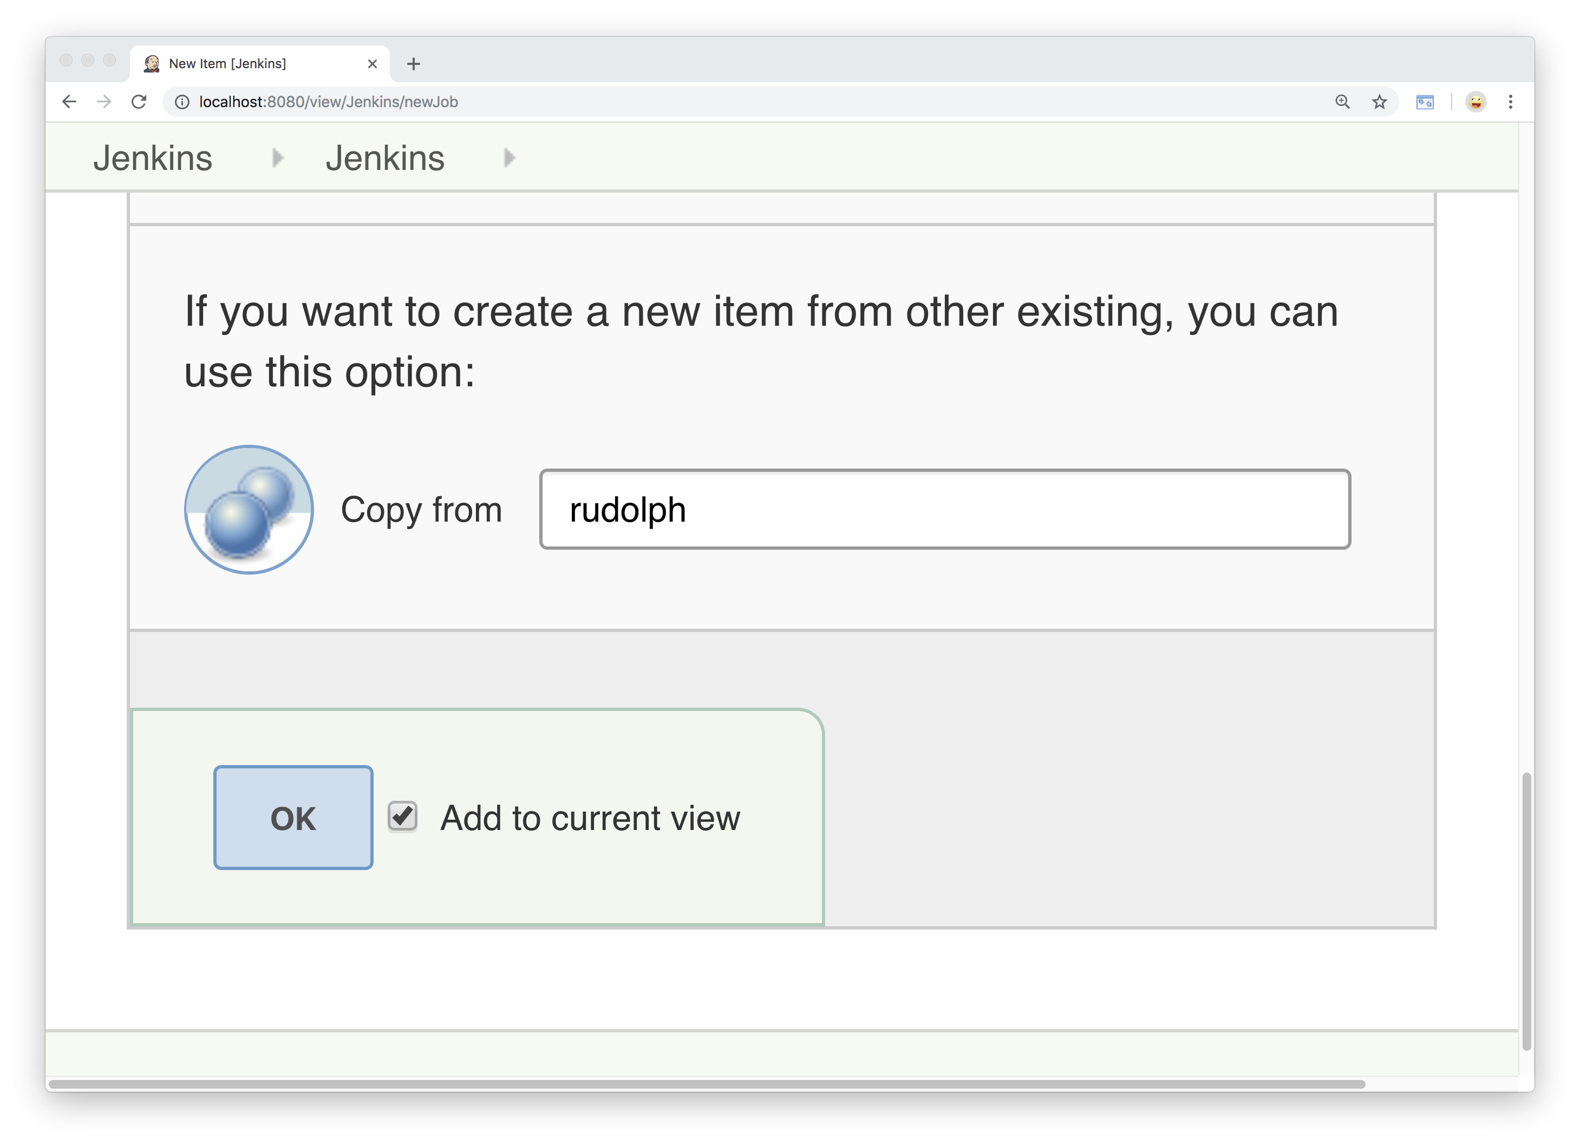
Notes:
And we will create it as a copy of Rudolph
So we can use that as a starting point.

Slide 57
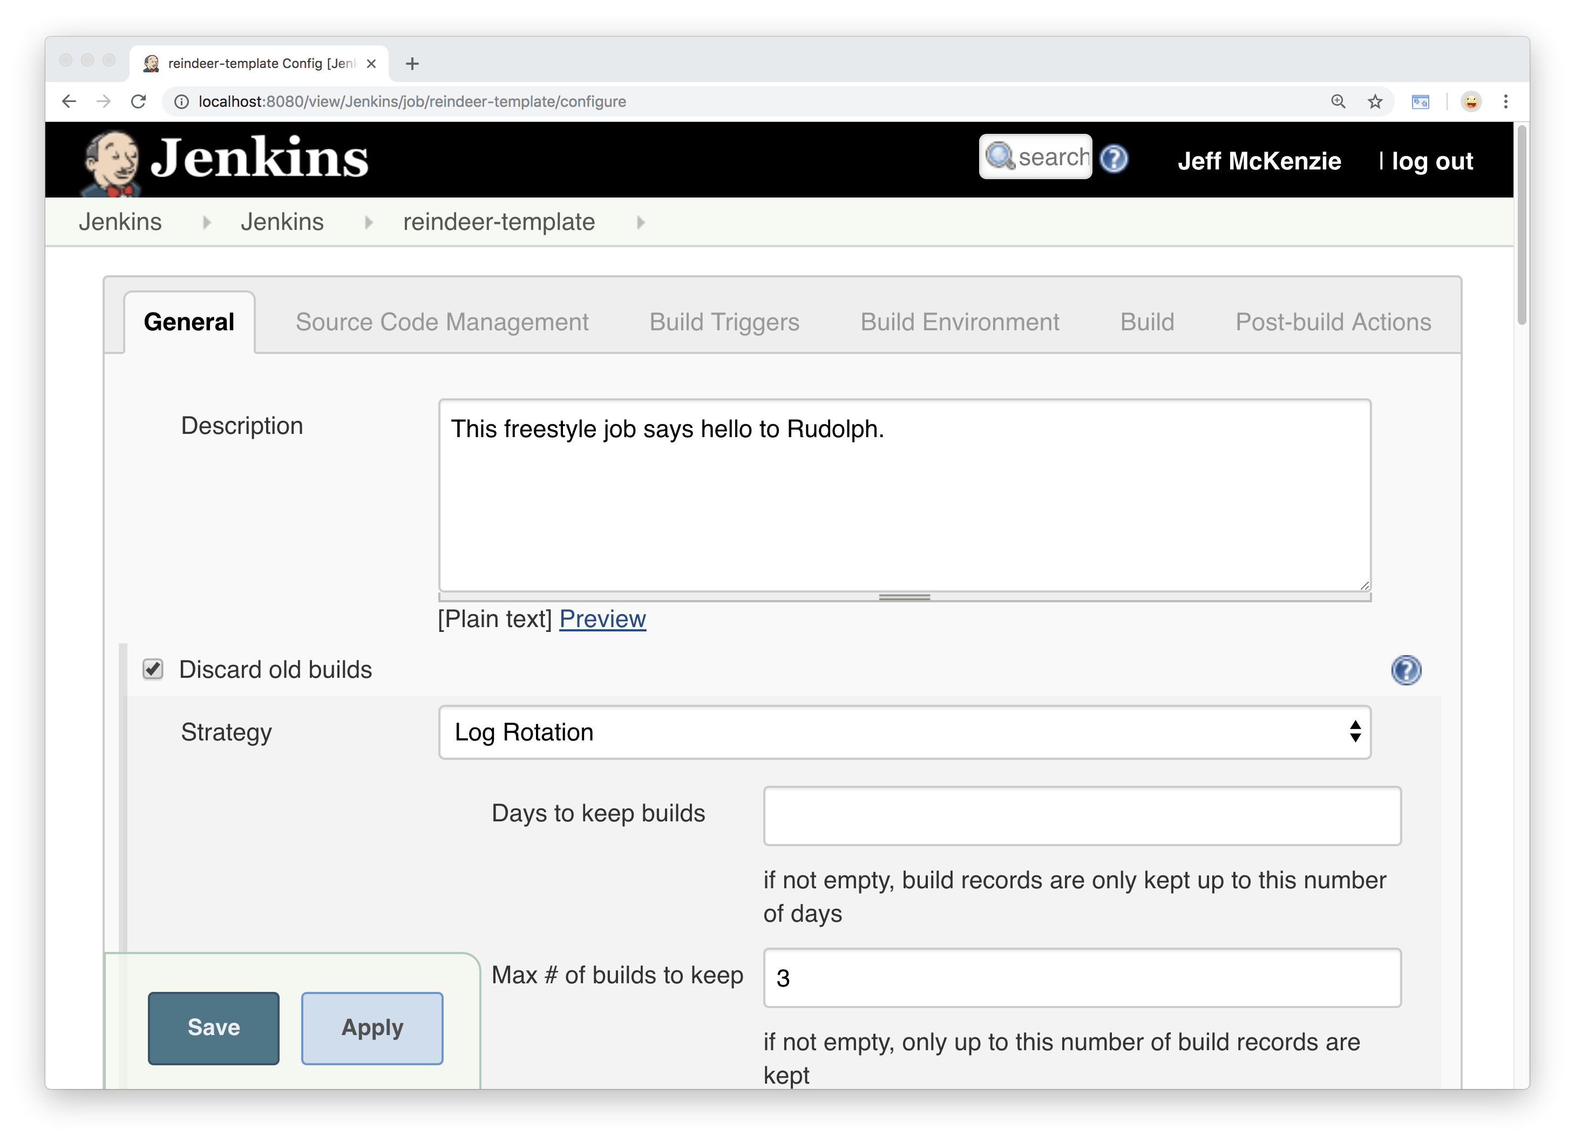
Notes:
Let’s go ahead and change the description
So it makes sense as a template

Slide 58

Notes:
“Serves as a template for the reindeer jobs”

Slide 59
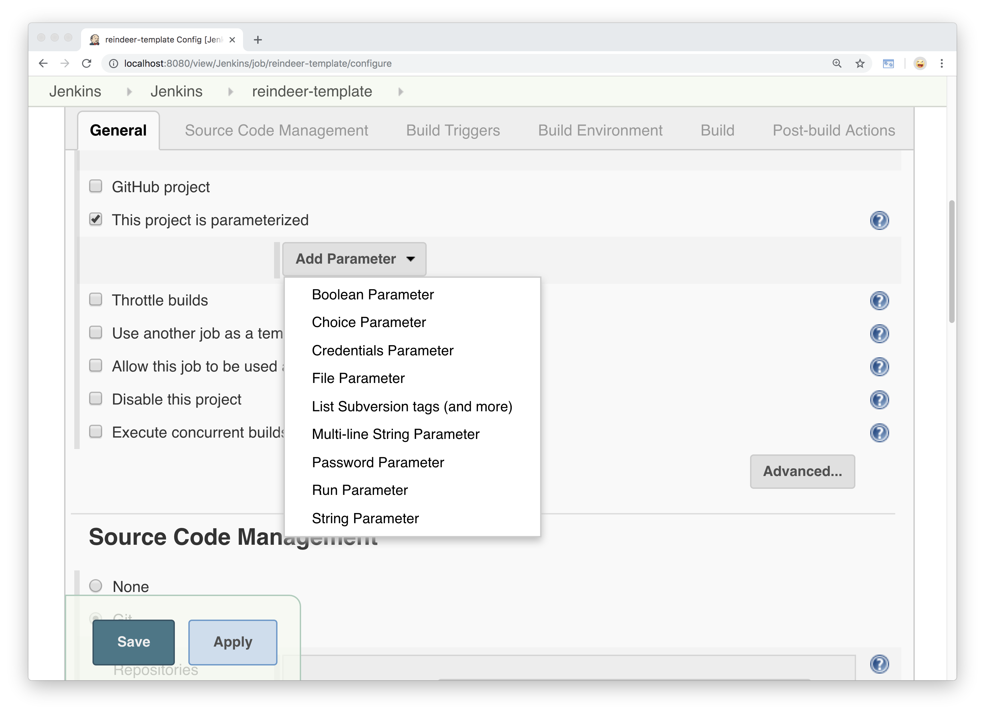
Notes:
We are also going to add a couple of parameters (variables)
So Santa can personalize his reindeer greeting –
Check box for “project is parameterized”
And we will select the string parameter

Slide 60
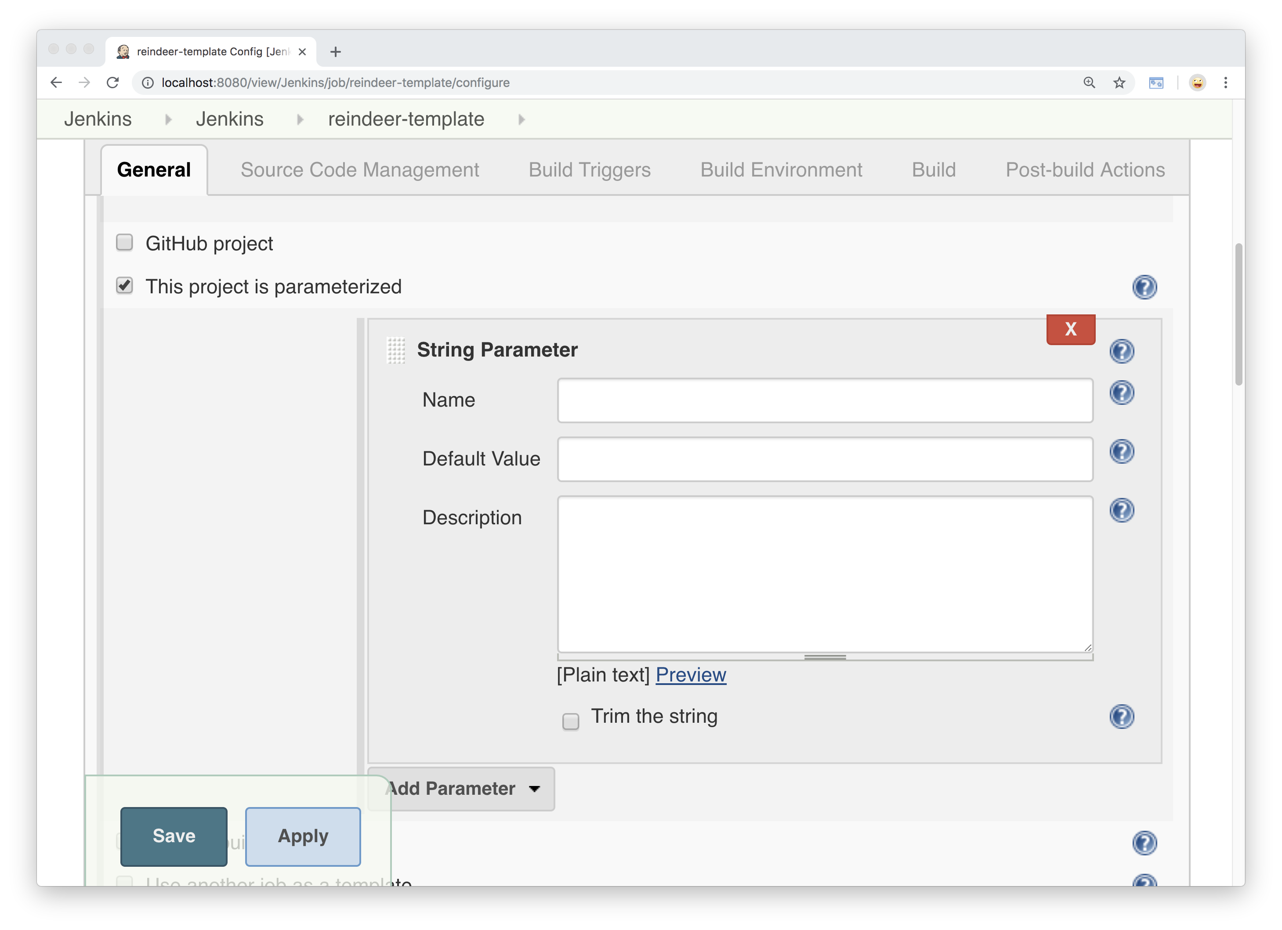
Notes:
Let’s enter our values…

Slide 61
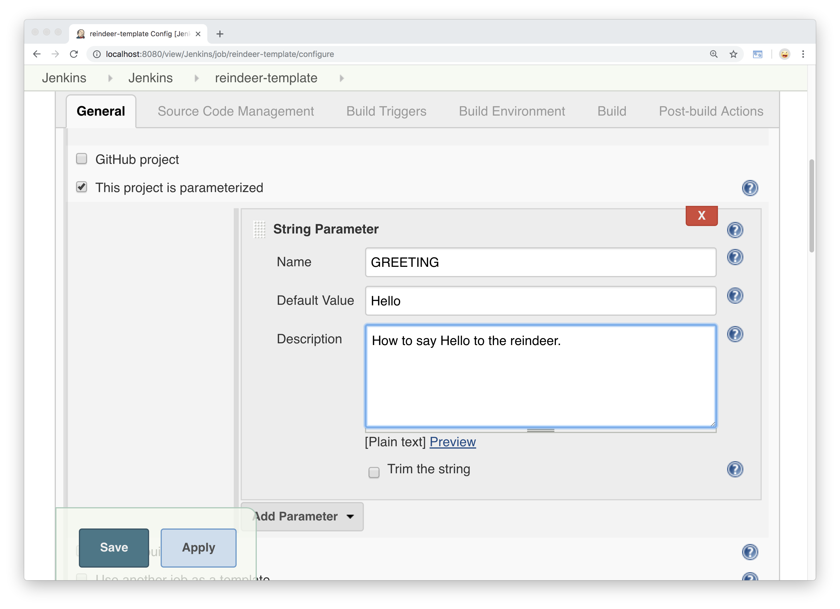
Notes:
We’ll call this parameter GREETING
With a default value of Hello
And also give it a description.

Slide 62
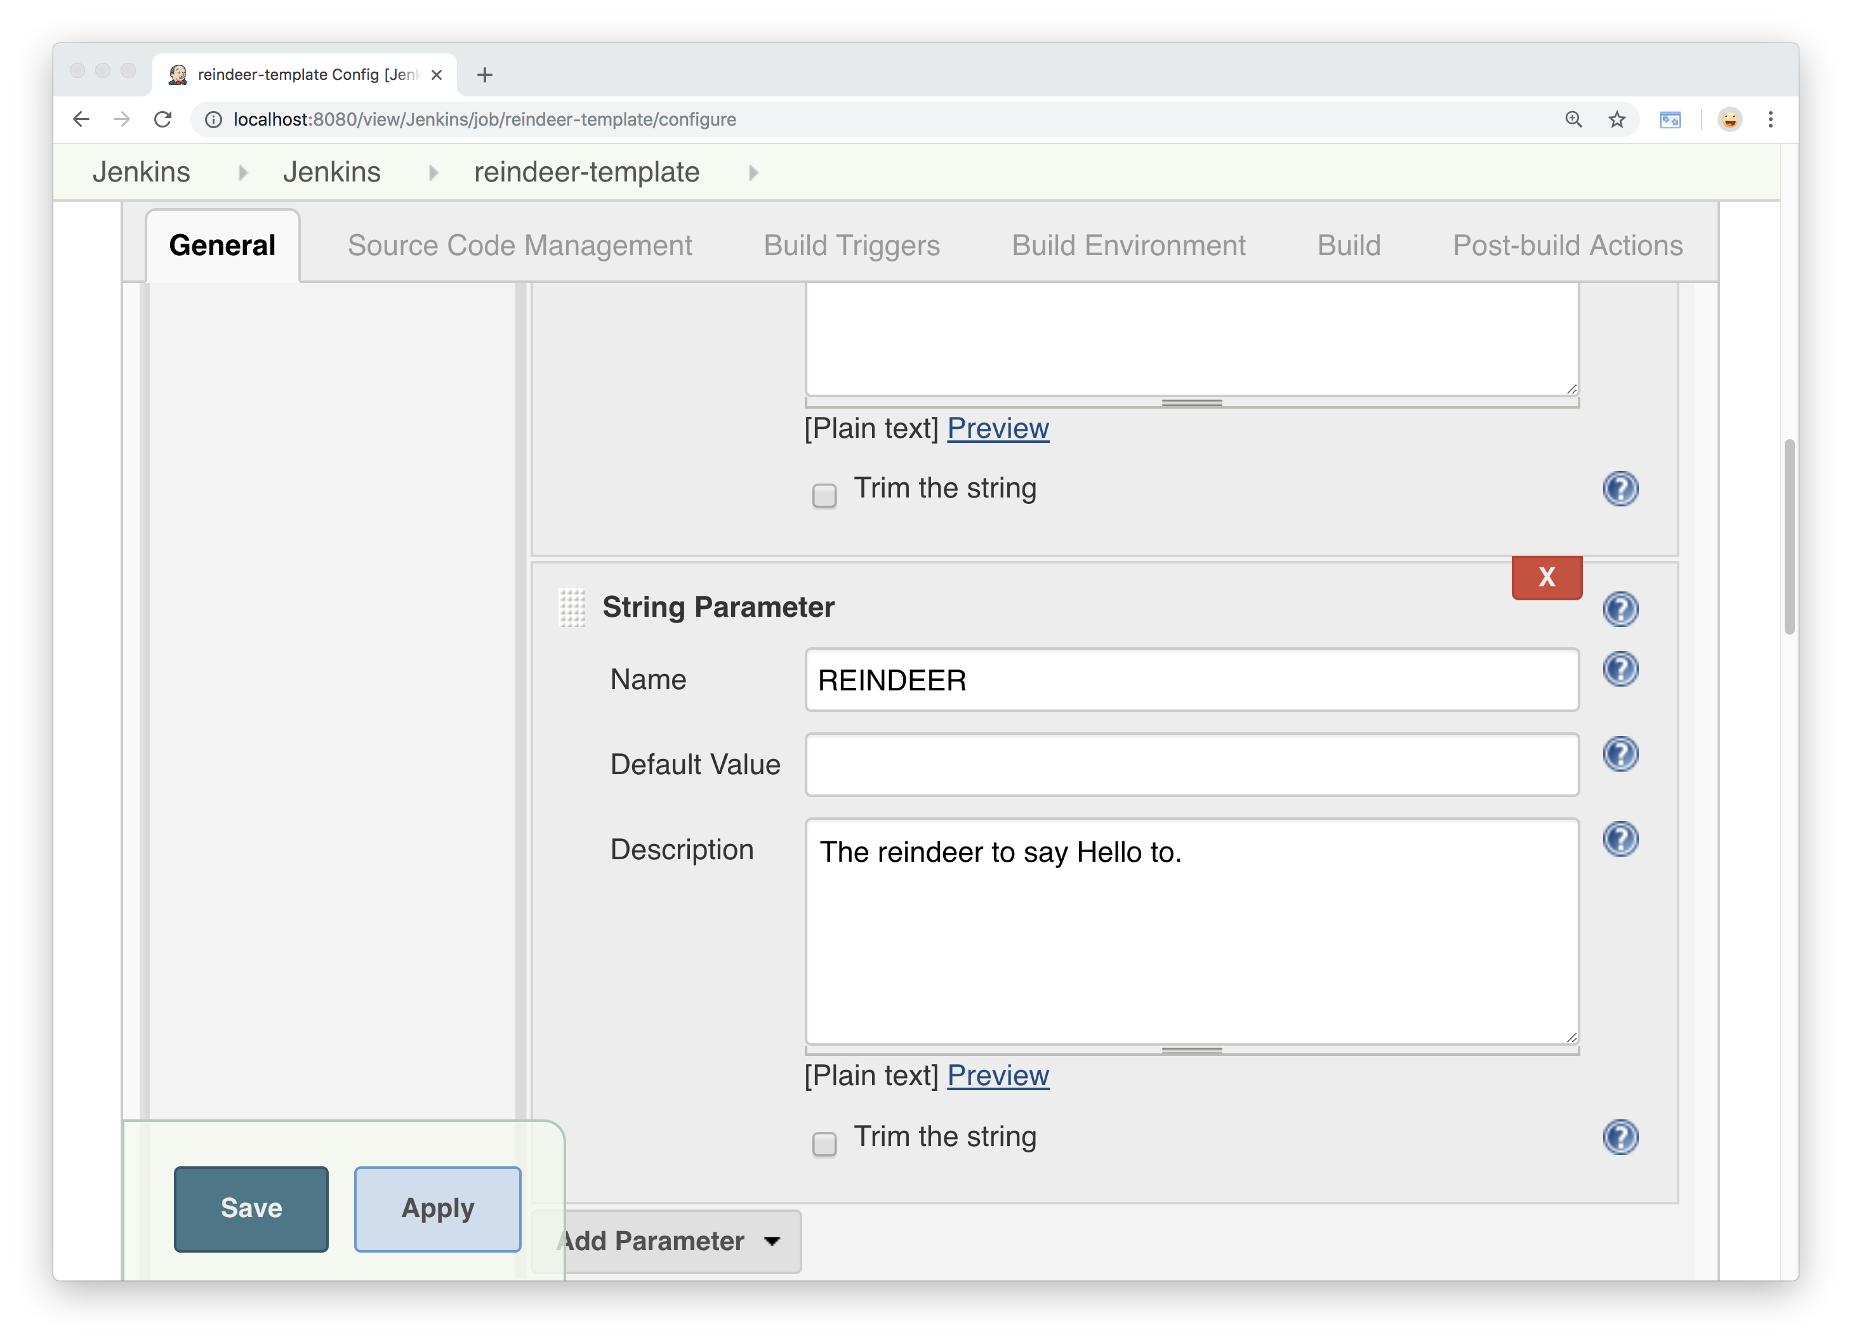
Notes:
Next we will add parameter REINDEER
With no default value
And also give it a description –
“The reindeer to say hello to”

Slide 63
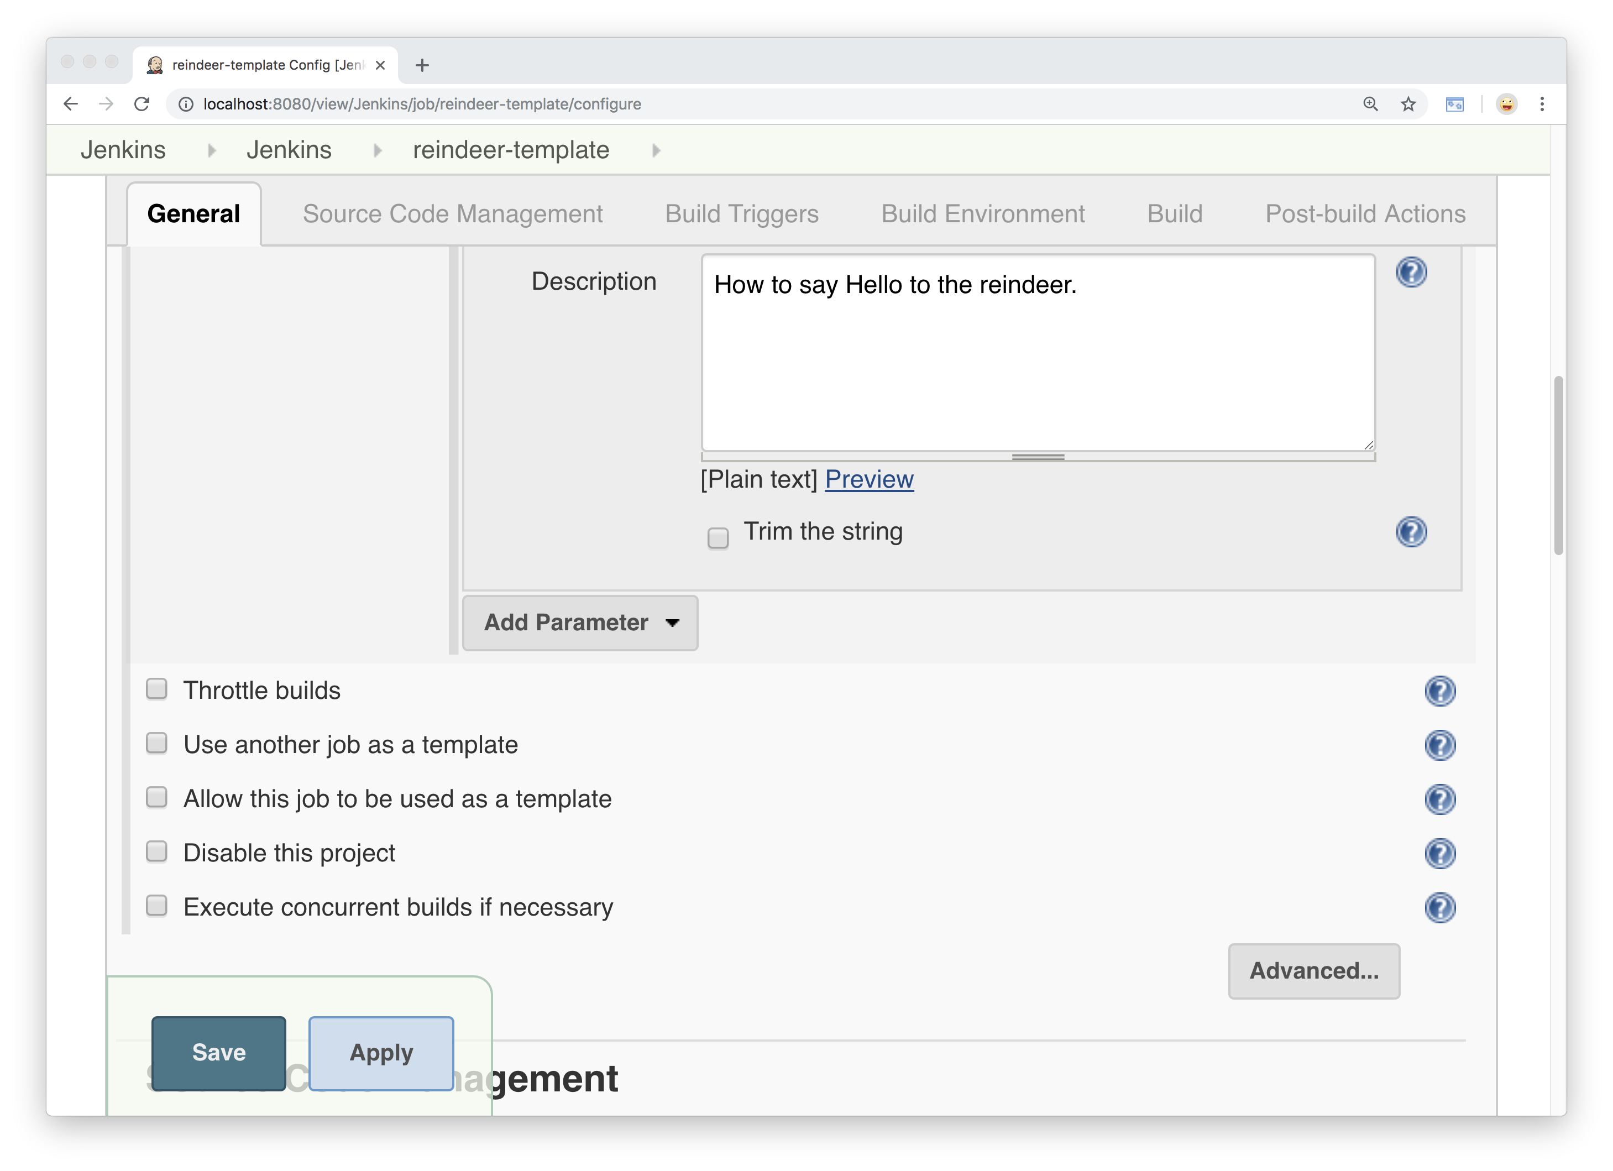
Notes:
Next we will scroll down to the checkbox that says
“Allow this job to be used as a template”
[you see this option only if you have EZ Templates installed]

Slide 64
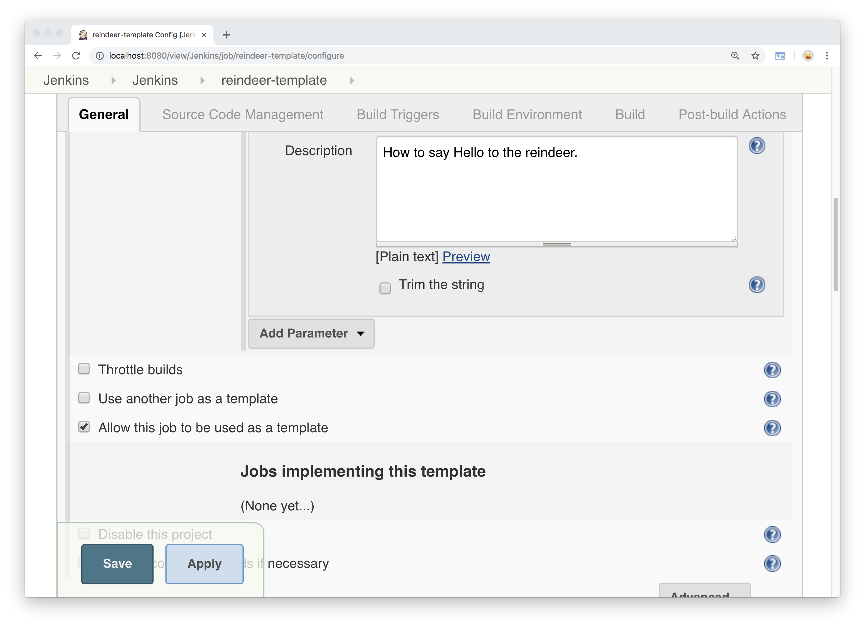
Notes:
When you check the box, you see a list
Of jobs using the template
(none yet since we just created it)

Slide 65
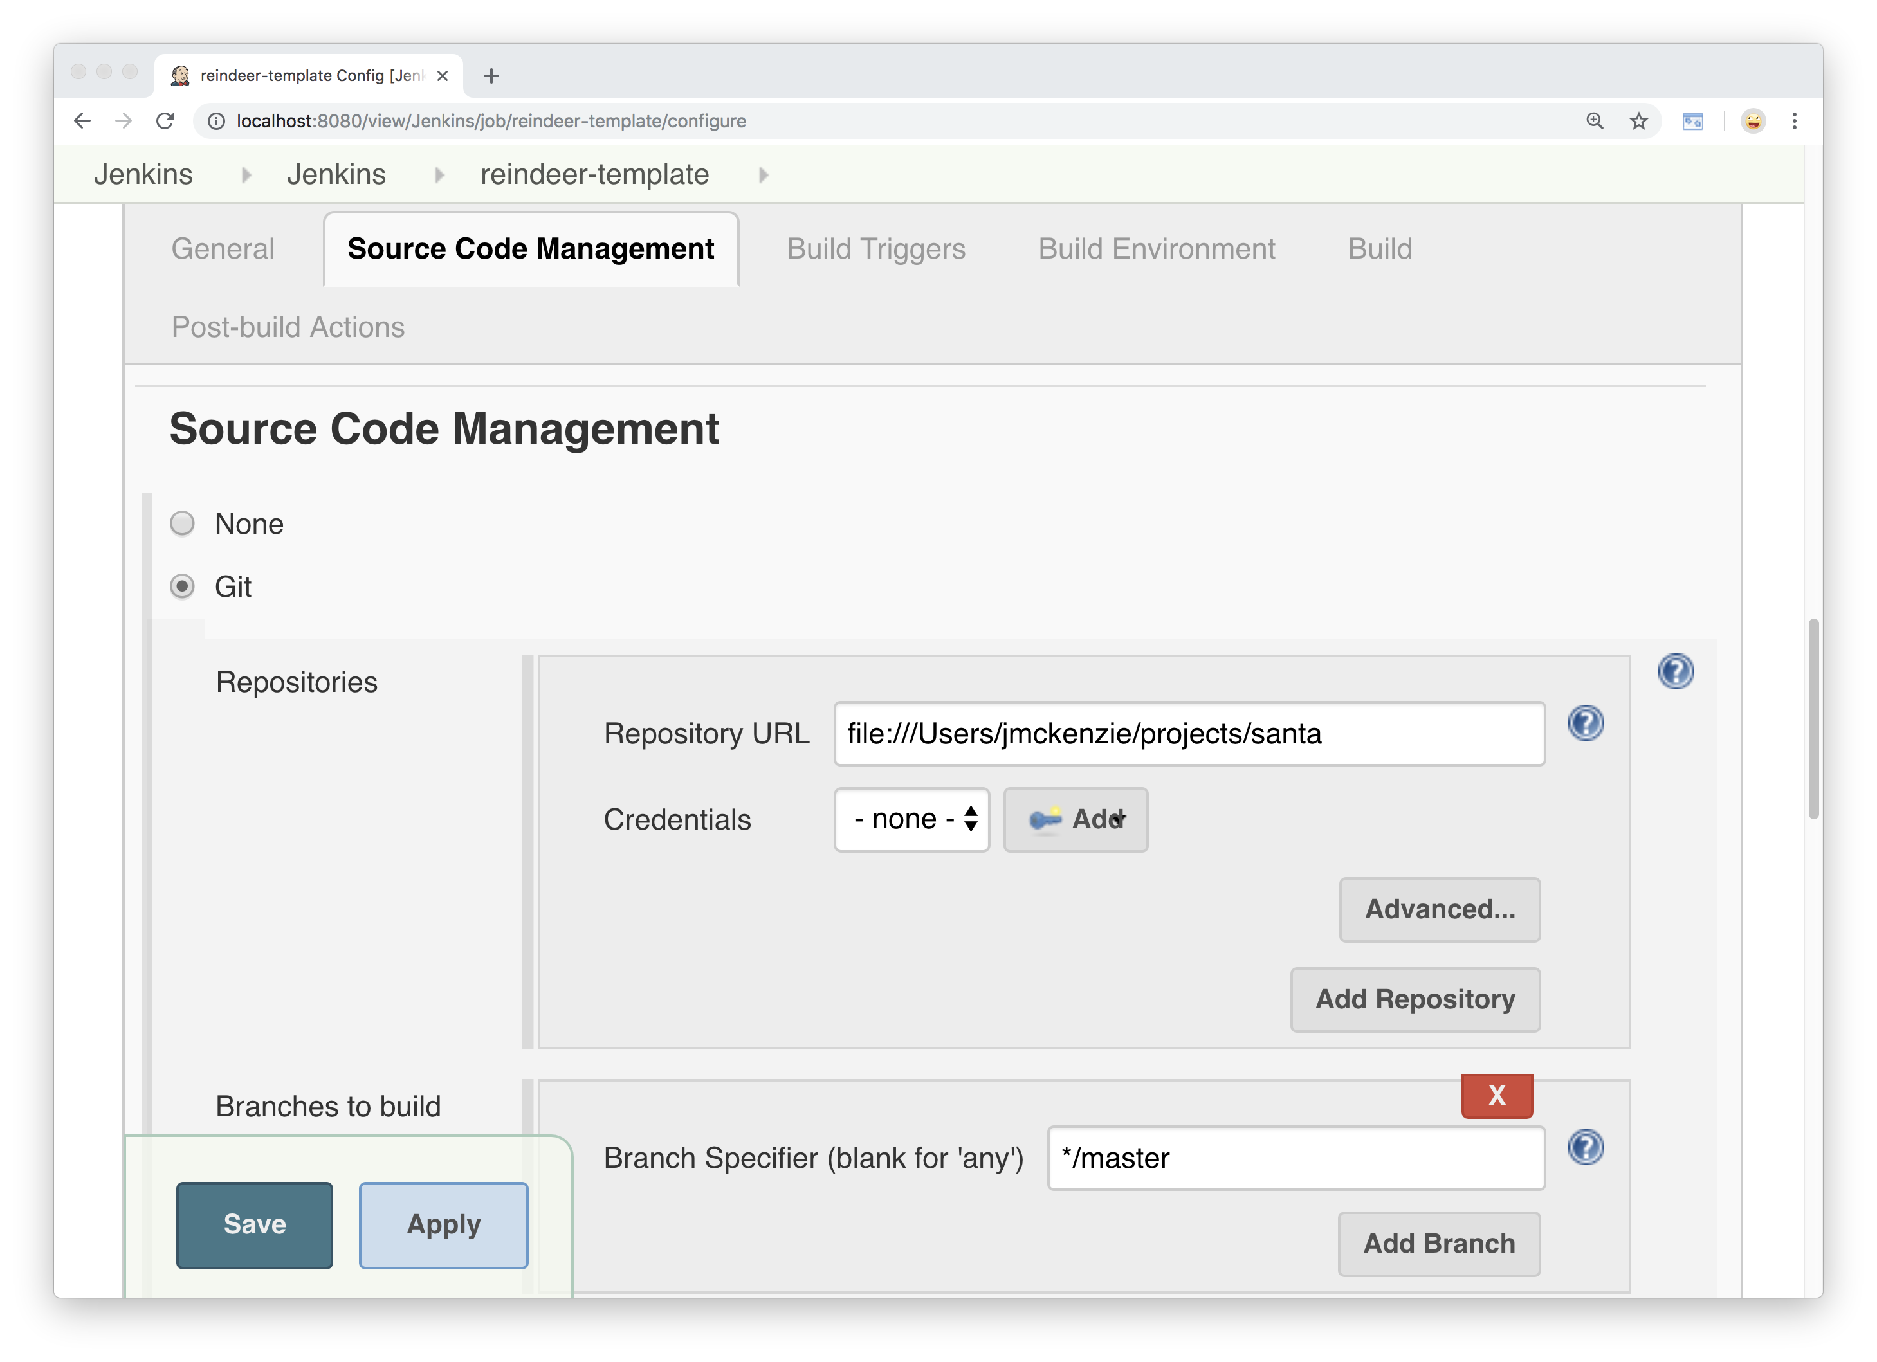
Notes:
We leave our git repo as it is….

Slide 66
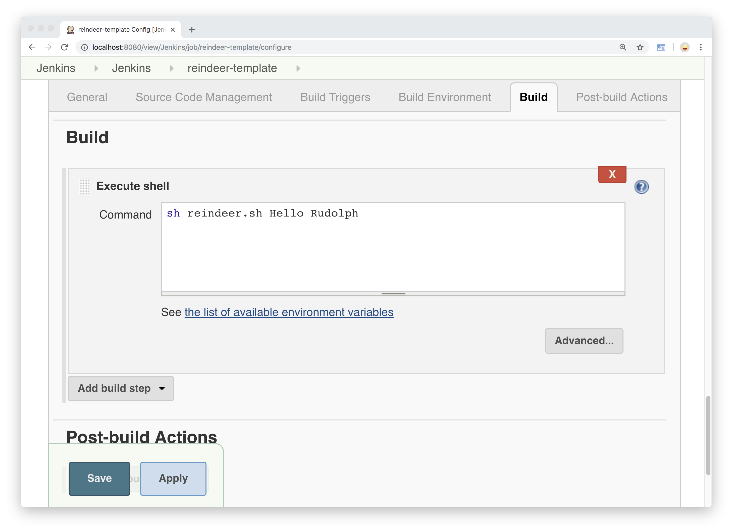
Notes:
We will also change our shell command
To use the parameters

Slide 67
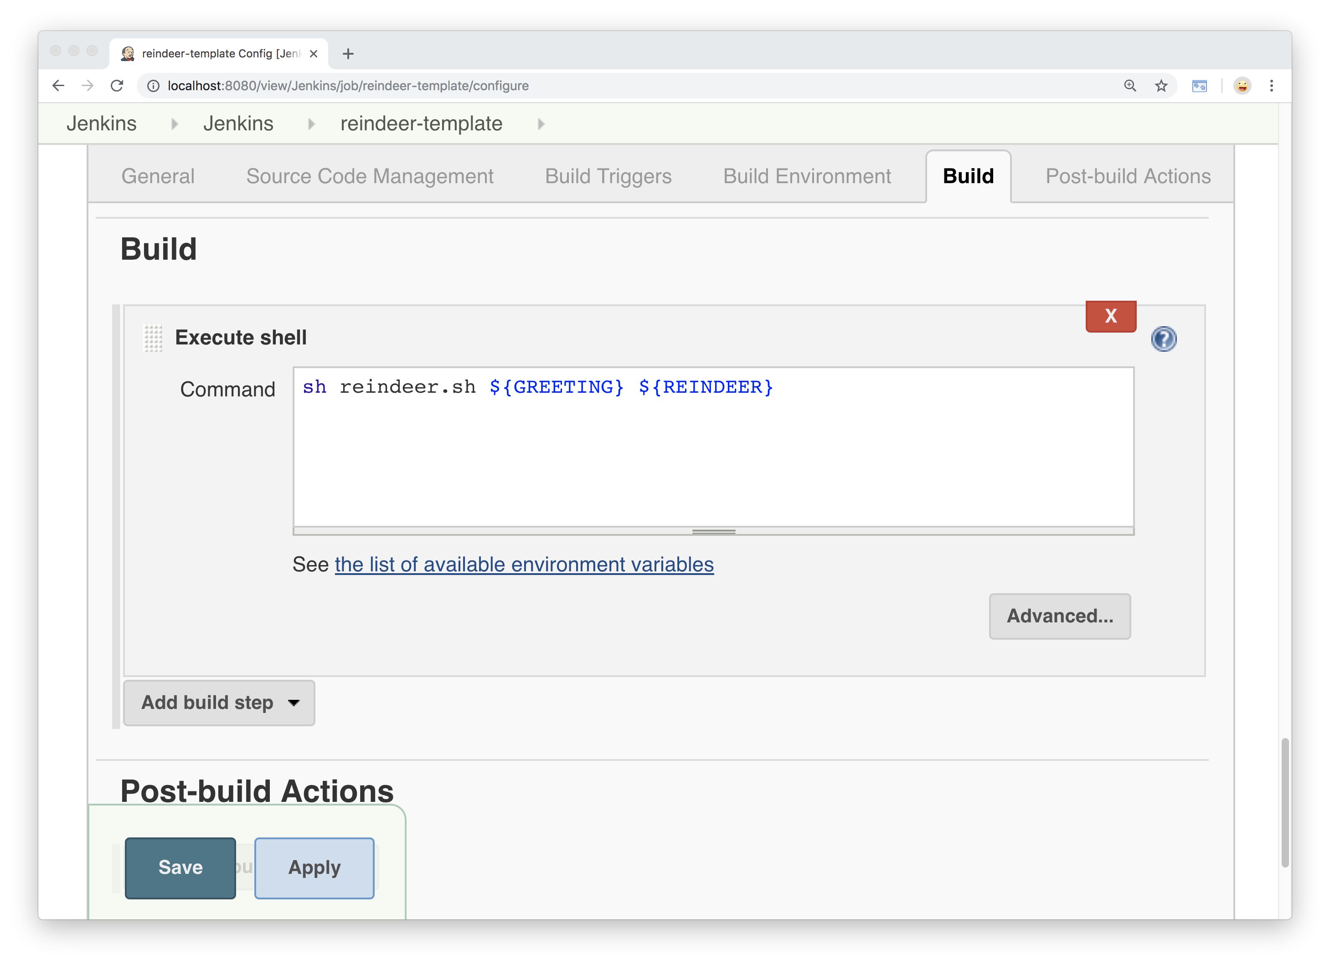
Notes:
Then we will click save…

Slide 68
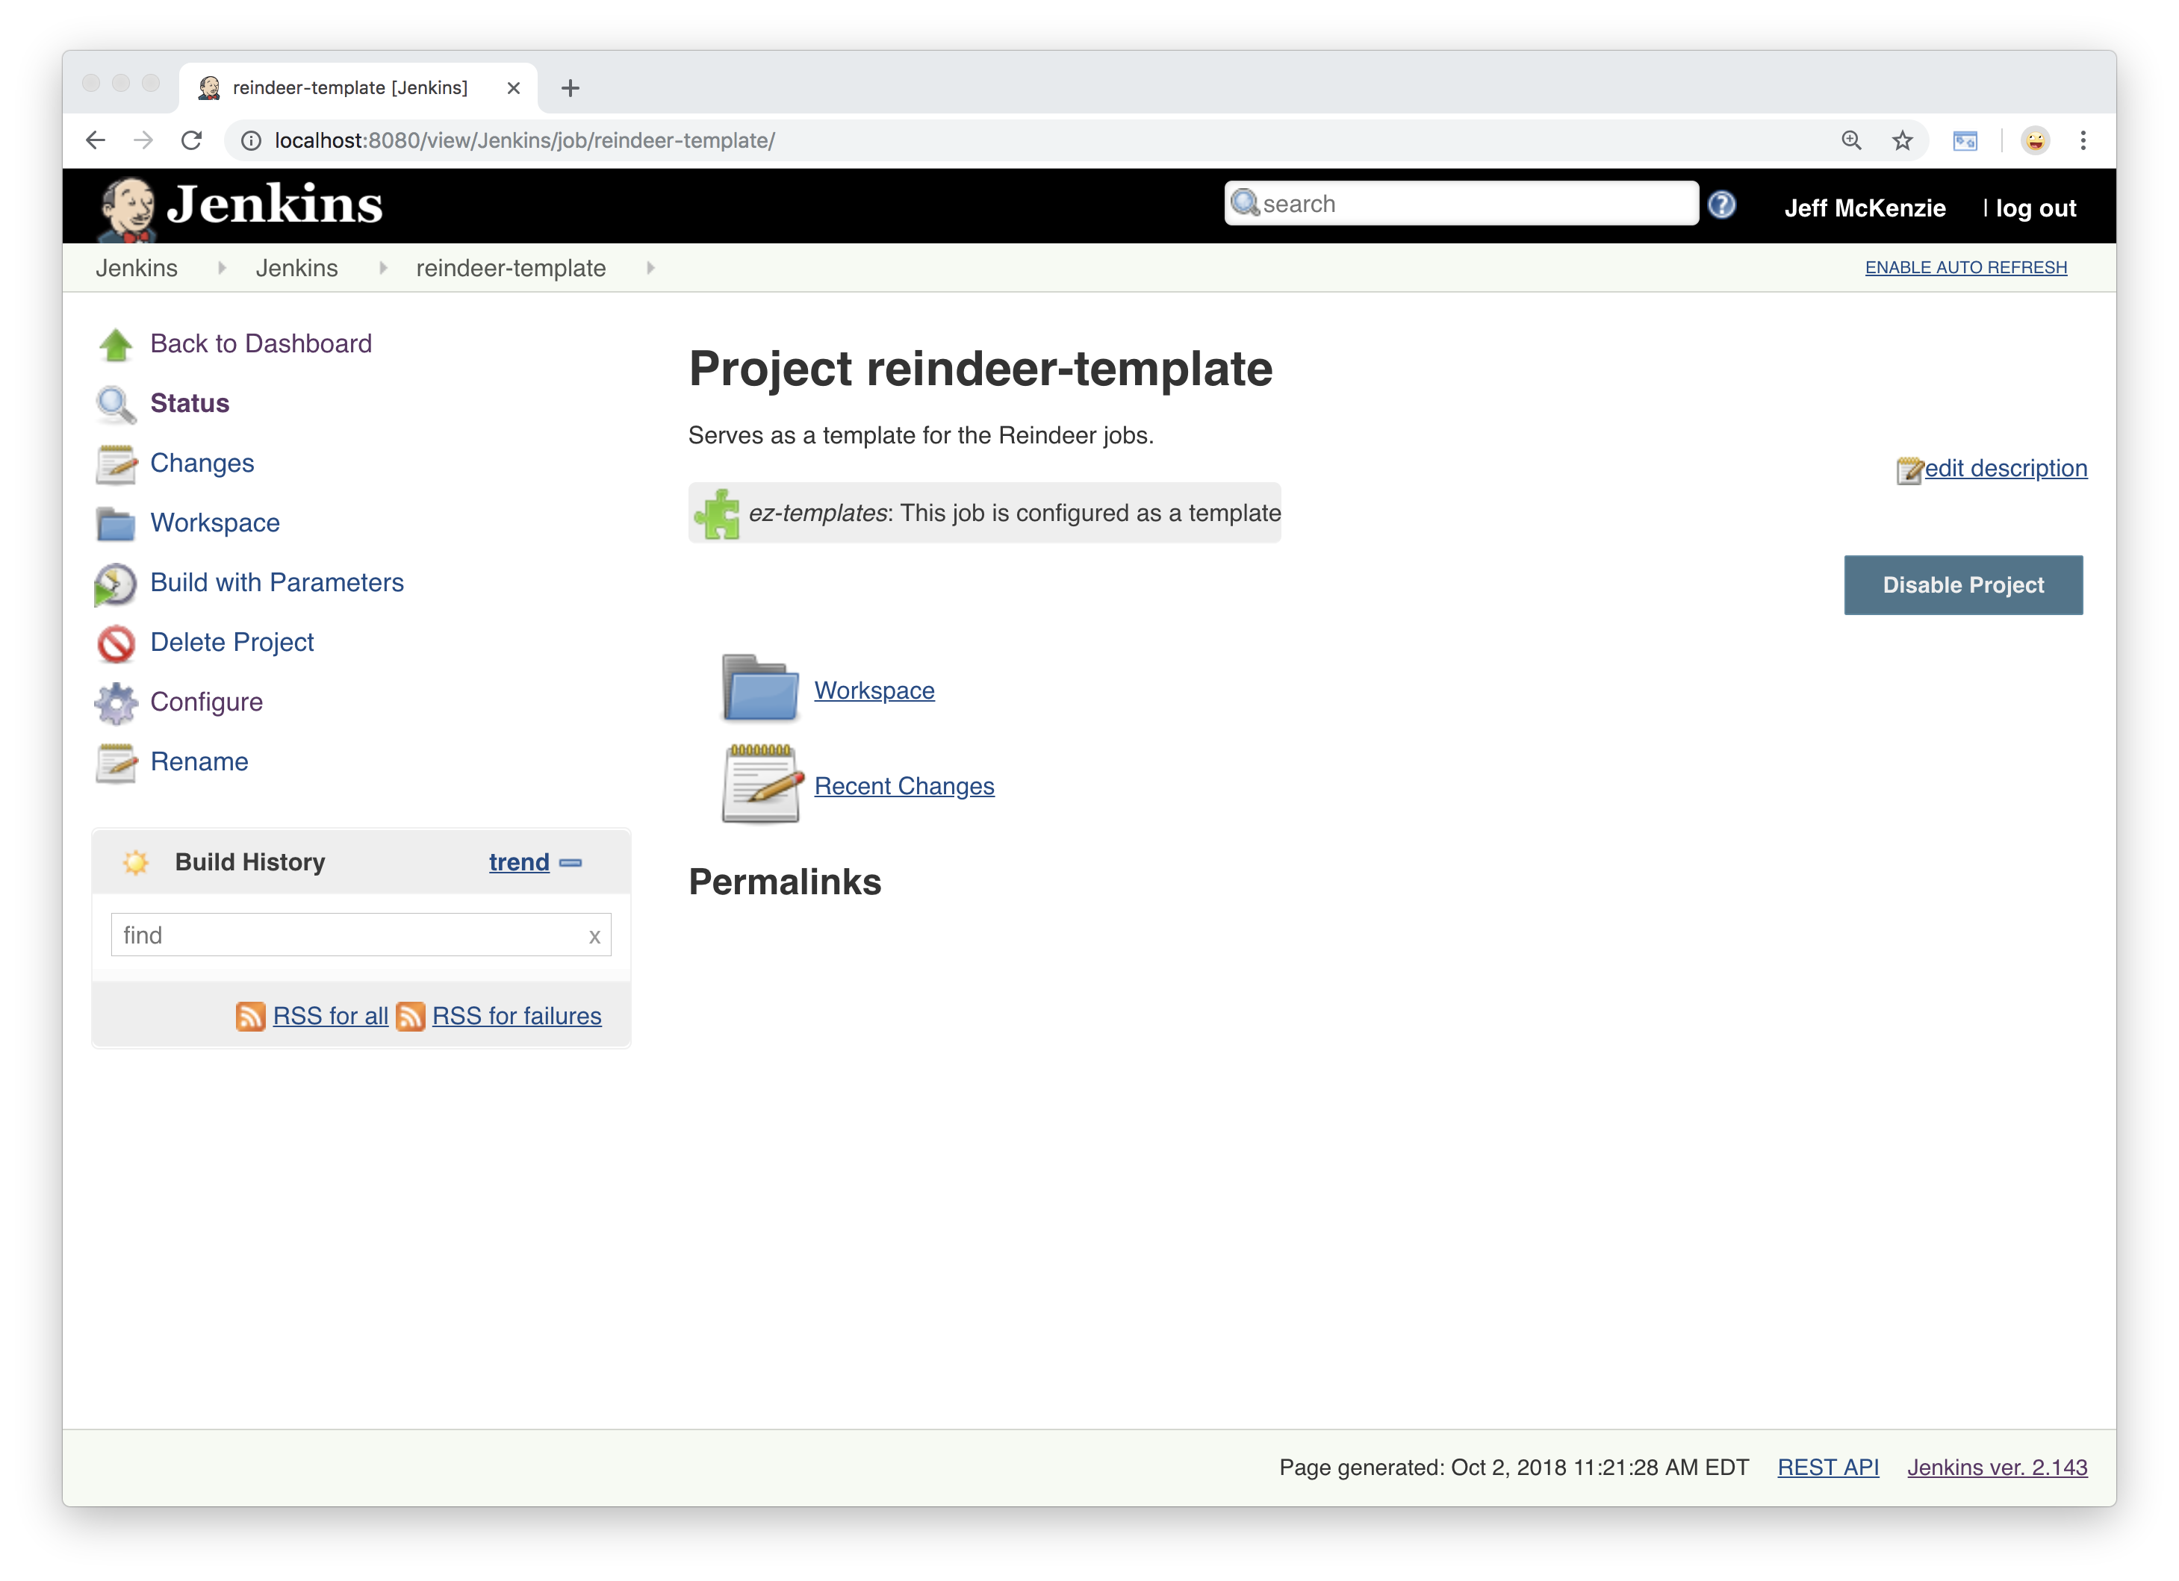
Notes:
Which takes us back to the project page

Slide 69
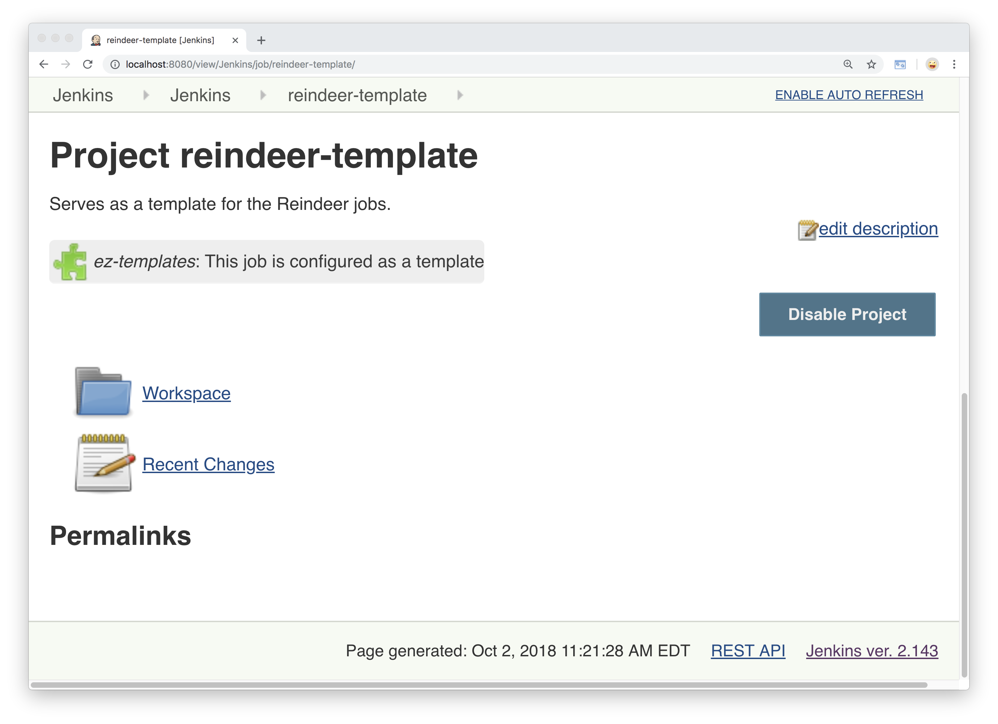
Notes:
If we look closer you’ll see there’s
A note that this project is configured as a template.
Because this is a template and not something we want to run,
We will disable the project, which is important
If the template contains build triggers
Or anything like that.

Slide 70
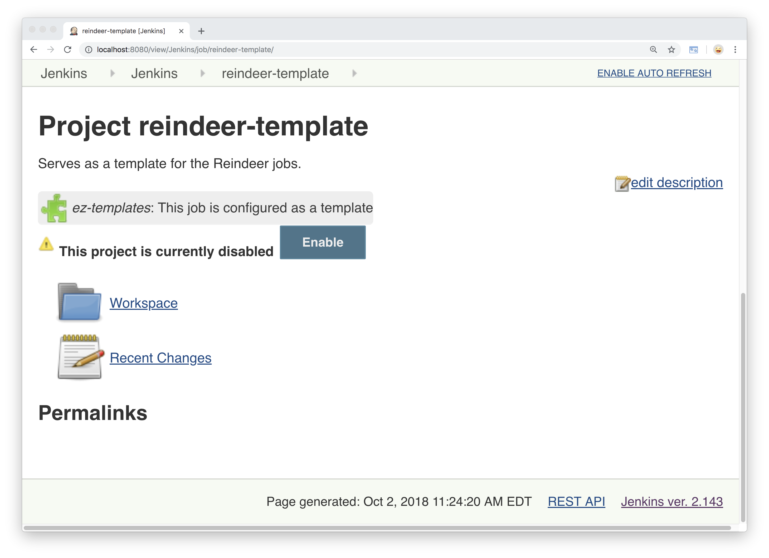
Notes:
So we will do that
And it shows up as disabled.

Slide 71
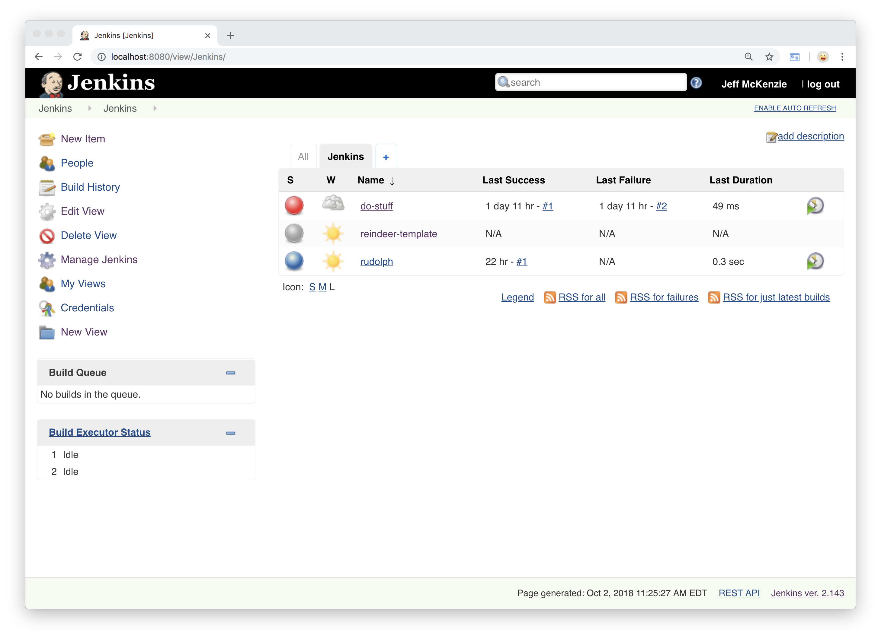
Notes:
Now we have three projects: our dostuff example,
Our Rudolph project,
And our template.
Lets delete and recreate our Rudolph project to use the template.

Slide 72
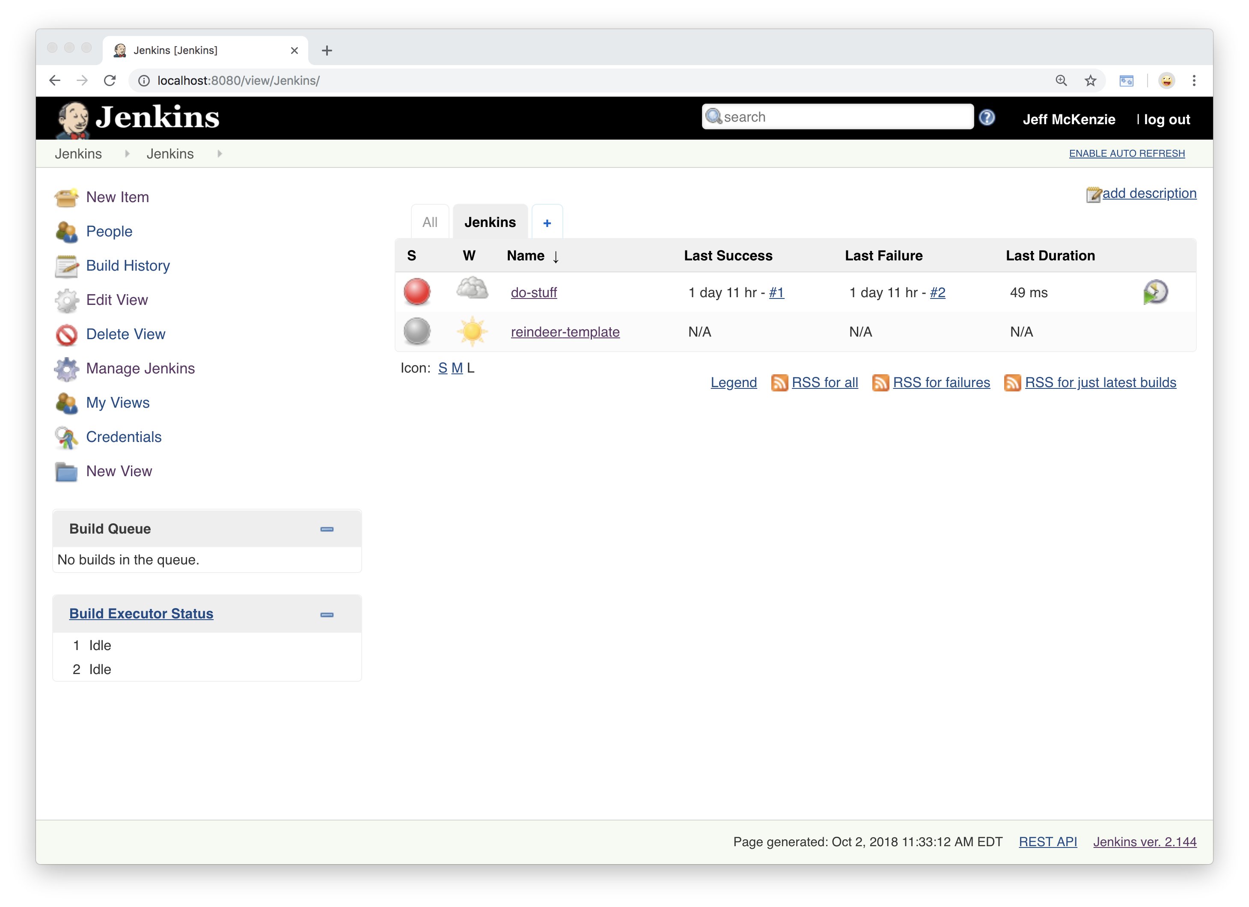
Notes:
Ok Rudolph is gone,
Let’s create a new freestyle job
Called Rudolph and get into it.

Slide 73
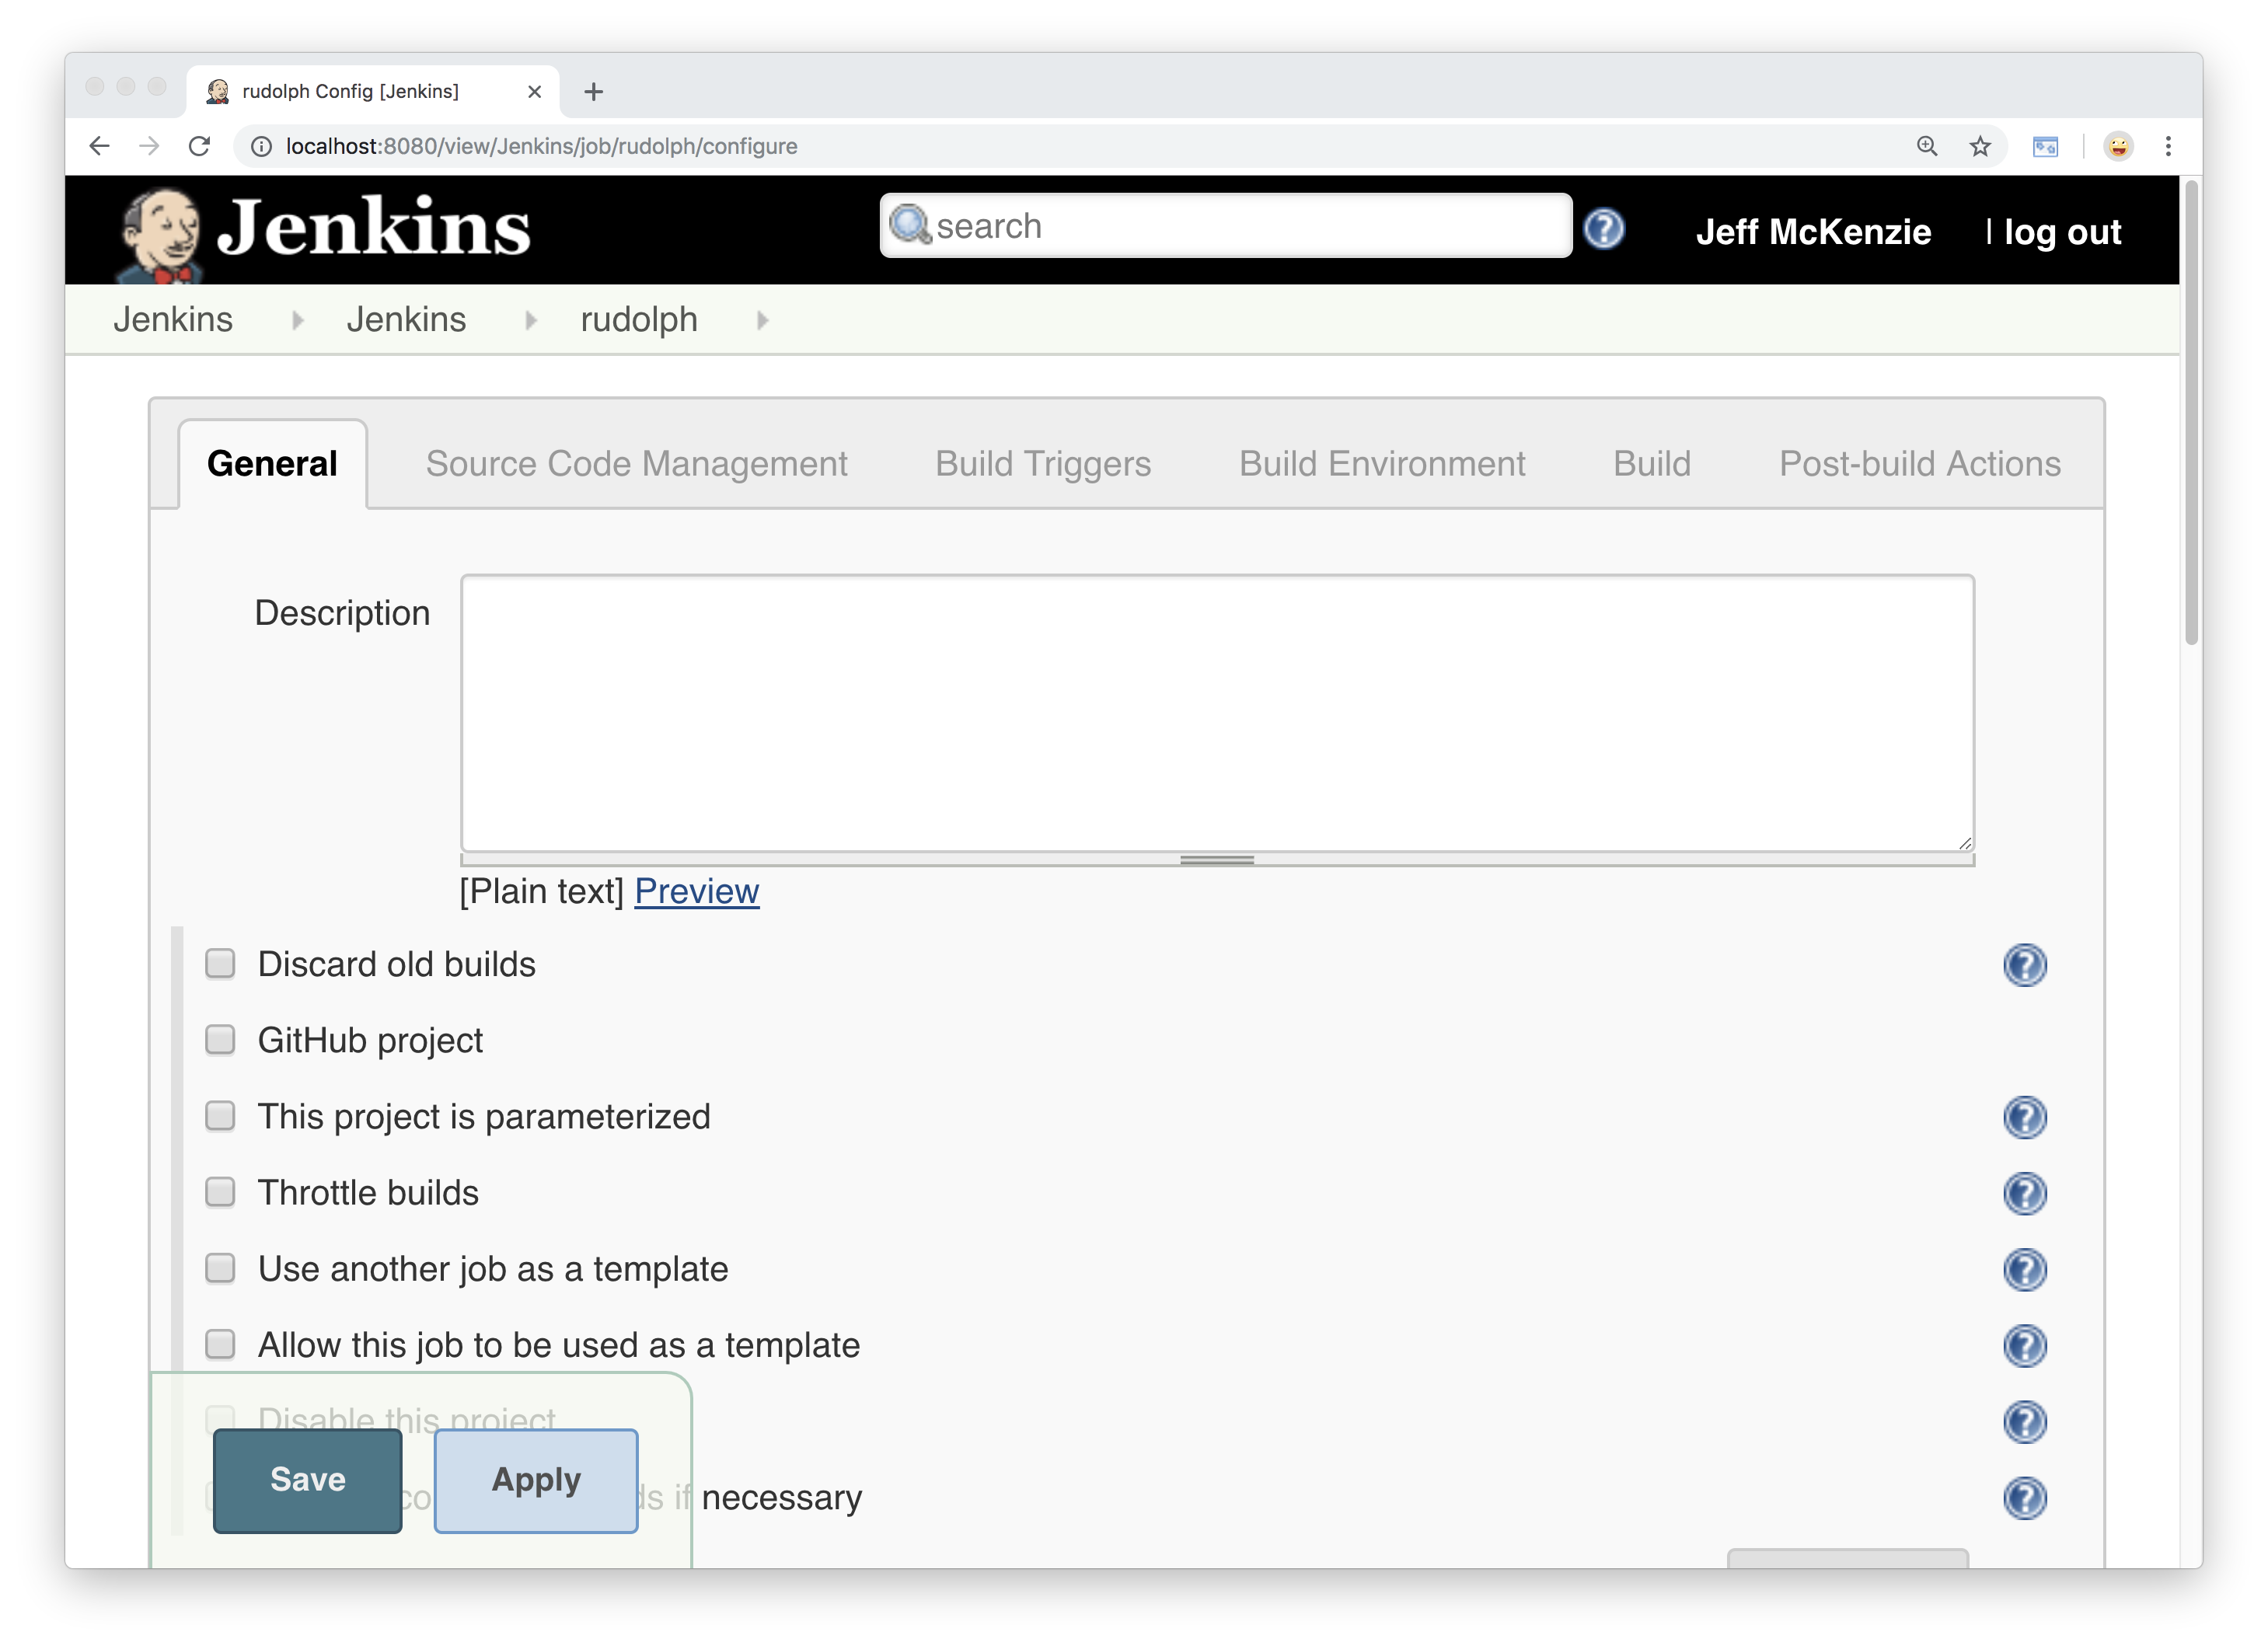
Notes:
We’ll use the same description we had before….

Slide 74

Notes:
This freestyle job says hello to Rudolph….
Then we scroll down to the checkbox that says
“use another job as a template”

Slide 75

Notes:
When we check that we are given a dropdown
Of what template we want to select

Slide 76

Notes:
We will choose reindeer template
If you click the Advanced button on the right side
You will get a bunch of additional options
On how you want this job to interact

Slide 77

Notes:
Such as “retain local job parameter values”
Which we will see in a minute.
Let’s save that and go back to the project page

Slide 78

Notes:
This shows us that Rudolph
Is implementing the reindeer template.
Remember, all we did was add a description,
Select a template, and save it.
Let’s go back into the configuration.

Slide 79

Notes:
We have our description,
Our build history setting…

Slide 80

Notes:
Our GREETING parameter….

Slide 81

Notes:
Our REINDEER parameter

Slide 82

Notes:
Our git settings…

Slide 83

Notes:
And our build step.

Slide 84

Notes:
So the only thing we have to do is
fill in the reindeer parameter
With Rudolph,
And run the project.

Slide 85

Notes:
And our result is the same as before.
So now Santa can talk to as many reindeer as he wants,
And since they are all based on the same template,
The projects are much easier to change and maintain.
Those are the benefits, but there are limitations to this approach.

Slide 86
EZ Template Limitations
…cannot override all settings
…cannot be fully nested
…does not support pipeline jobs
Notes:
First is not all settings can be overridden.
For example, if we wanted to modify
Our build step, our shell command, can only do so
In the template – local changes to that don’t take effect

Slide 87
EZ Template Limitations
…cannot override all settings
…cannot be fully nested
…does not support pipeline jobs
Notes:
Next, you can’t really nest the templates effectively.
Would be nice to have a base template,
And have another template inherit from that.
But you can’t, for example, add parameters to the child template,
Which would make it more useful.

Slide 88
EZ Template Limitations
…cannot override all settings
…cannot be fully nested
…does not support pipeline jobs
Notes:
And lastly, templates only support freestyle jobs,
Not pipeline jobs.
Pipeline jobs is where the real power of Jenkins starts to come in.
So templates are a great option where you have a lot of freestyle jobs
That exhibit a similar pattern, and where parameters would be helpful.

Slide 89

Notes:
So let’s turn to our next option for scaling,
The pipeline job.
Let’s create one called Rudolph pipeline
that does the same thing
Our freestyle job does, to show the differences.
-- comment on pipeline description

Slide 90

Notes:
We will add our description,
And notice that this has less configuration options
Than a freestyle build.
We have the General section…

Slide 91

Notes:
The build triggers section,
And the advanced project options.

Slide 92

Notes:
Btw I really like that the advanced project options
Is display name – really?
But the main part of the pipeline job is the script

Slide 93

Notes:
The script allows you to do the same thing
As a freestyle job, except you can do it
Programmatically, in a concise way.
Let’s take a close-up look at that script

Slide 94
pipeline {
agent any
options {
buildDiscarder(logRotator(numToKeepStr:'3'))
}
parameters {
string(
name: 'GREETING',
defaultValue: 'Hello',
description: 'The way to say hello.'
)
string(
name: 'REINDEER',
defaultValue: 'Rudolph',
description: 'The reindeer to say hello to.'
)
}
stages {
stage('Say Hi to Rudolph') {
steps {
checkout scm: [
$class: 'GitSCM’,
branches: [
[name: '*/master']
],
userRemoteConfigs: [
[url: 'file:///Users/jmckenzie/projects/santa']
]
]
sh 'sh reindeer.sh "${GREETING}" "${REINDEER}"'
}
}
}
}
Notes:
Here’s the whole thing – As you can see, not a lot of code here
Using a DSL – what is a DSL?
There are two different syntax formats for pipeline scripts
Scripting syntax
Declarative syntax (newer)
With scripting syntax you tell Jenkins how to perform a task
With declarative, you tell Jenkins what you want to do.
Using declarative here, let’s break this down

Slide 95
pipeline {
agent any
options {
buildDiscarder(logRotator(numToKeepStr:'3'))
}
}
Notes:
On the Jenkins site, there’s a reference area
for all of these commands and syntax,
So you can look all this stuff up
A pipeline script has to start with the pipeline block.
Then you specify the agent, or where this is going to run
For our purposes this can run anywhere…
We can set the build history to keep the last 3 builds,
just like we did in the freestyle job

Slide 96
pipeline {
agent any
options {
buildDiscarder(logRotator(numToKeepStr:'3'))
}
parameters {
string( name: 'GREETING',
defaultValue: 'Hello',
description: 'The way to say hello. ')
}
}
Notes:
Then we can add the greeting parameter,
Again, same settings and values

Slide 97
pipeline {
agent any
options { … }
parameters {
…
string( name: 'REINDEER',
defaultValue: 'Rudolph',
description: 'The reindeer to say hello to.')
}
}
Notes:
Add our reindeer parameter…

Slide 98
pipeline {
agent any
options { … }
parameters { … }
stages {
stage('Say Hi to Rudolph’) {
steps {
}
}
}
}
Notes:
Then we add the stages block,
Which is just a way to group commands into sections.
We have only one stage, and we can give it a name…
And within a stage, we have steps.

Slide 99
pipeline {
…
stage('Say Hi to Rudolph’) {
steps {
checkout scm: [$class: 'GitSCM',
branches: [[name: '*/master']],
userRemoteConfigs: [[url:
'file:///Users/jmckenzie/projects/santa’]]]
}
}
}
Notes:
Our first step will be do to the checkout
From the git repository

Slide 100
pipeline {
…
stage('Say Hi to Rudolph’) {
steps {
checkout scm:[ … ]
sh 'sh reindeer.sh
"${GREETING}" "${REINDEER}"'
}
}
}
Notes:
And the second step is to execute the shell script
Using the SH command and our parameters.

Slide 101

Notes:
So here’s what it looks like back in the pipeline project…
And let’s run that and see what we get

Slide 102

Notes:
We have a successful build, and if you’ll notice
There’s a stage view here as well….

Slide 103

Notes:
Which shows the name of the stage
And how long it took to run.

Slide 104
Notes:
If we go back to our pipeline,
There’s another option here for definition…

Slide 105

Notes:
Which is “pipeline script from SCM”
Or source control management,

Slide 106

Notes:
We can choose a git repo where this is coming from,
Which is great because it allows us
To version control that pipeline script
Just like we would with any other code.

Slide 107
pipeline {
agent any
options {
buildDiscarder(logRotator(numToKeepStr:'3'))
}
parameters {
string(
name: 'GREETING',
defaultValue: 'Hello',
description: 'The way to say hello.'
)
string(
name: 'REINDEER',
defaultValue: 'Rudolph',
description: 'The reindeer to say hello to.'
)
}
stages {
stage('Say Hi to Rudolph') {
steps {
checkout scm: [
$class: 'GitSCM’,
branches: [
[name: '*/master']
],
userRemoteConfigs: [
[url: 'file:///Users/jmckenzie/projects/santa']
]
]
sh 'sh reindeer.sh "${GREETING}" "${REINDEER}"'
}
}
}
}
Notes:
So that’s great and everything,
But Santa still has a problem –

Slide 108

Notes:
He has to copy this script
to any pipeline project that needs it.
So let’s fix that.
===================
https://commons.wikimedia.org/wiki/File:Mr_Santa_Claus_(HS85-10-30308).jpg
British Library [Public domain or Public domain], via Wikimedia Commons

Slide 109

Notes:
If we go to the manage Jenkins page,
Into Configure System…

Slide 110

Notes:
And we scroll down a bit,
We get to a section called Global Pipeline Libraries

Slide 111

Notes:
Which says…
Shareable libraries available to any Pipeline jobs
Running on this system.
That means we can create shared code
(written in groovy)
Accessible to any pipeline script.
To do that, we click add…

Slide 112

Notes:
Then you’ll add information about your library
-- a name: we’ll call it Jenkins-lib

Slide 113


Slide 114

Notes:
Default version refers to version control,
So we will just list the master branch

Slide 115

Notes:
Then we add the git repo
we want to pull the shared code from

Slide 116

Notes:
Again we’ll point that to a separate git repo locally
And click save

Slide 117

Notes:
So these are our 2 git repos –
Santa, which contains our shell script,
And Jenkins-lib, which contains
Our global pipeline library
Jenkins expects to see a directory
Called VARS, with groovy scripts
underneath that
-- let’s look at the reindeer groovy script
in the library

Slide 118
- reindeer.groovy
#!/usr/bin/env groovy
def call(Map<String, Object> options) {
try {
node {
String greeting = options."greeting".toString()
String reindeer = options."reindeer".toString()
stage("Say Hi to ${reindeer}") {
checkout scm: [
$class: 'GitSCM’,
branches: [[name: '*/master']],
userRemoteConfigs: [[url:
'file:///Users/jmckenzie/projects/santa’]]]
sh "sh reindeer.sh ${greeting} ${reindeer}"
}
}
}
catch (Throwable err) {
throw err
}
}
Notes:
so this is a rewrite of our pipeline script in groovy
Groovy is a scripting language
Similar to ruby,
that runs on the JVM
This is even less code than our pipeline script.
Let’s look at it in more detail.

Slide 119
- reindeer.groovy
#!/usr/bin/env groovy
def call(Map<String, Object> options) {
try {
node {
}
}
catch (Throwable err) {
throw err
}
}
Notes:
You create a method using the DEF keyword,
And then name your method “call” --
You refer to the method in Jenkins by the file name
Rather than the actual method name,
Which we will see in a little bit.
We’re going to pass in a Map object called “options”
Which is simply a key-value pair collection.
We can use try and catch,
And the node block in where we place
What will run in the pipeline

Slide 120
- reindeer.groovy
#!/usr/bin/env groovy
def call(Map<String, Object> options) {
try {
node {
String greeting =
options."greeting".toString()
String reindeer =
options."reindeer".toString()
}
}
catch (Throwable err) { ... }
}
Notes:
Then we declare two variables –
Greeting and reindeer, that hold our parameters.

Slide 121
- reindeer.groovy
def call(Map<String, Object> options) {
...
String greeting = ...
String reindeer = ...
stage("Say Hi to ${reindeer}") {
}
}
}
catch (Throwable err) { ... }
}
Notes:
Then we add the stage block –
And here we can actually incorporate
The variable name into the Jenkins output

Slide 122
- reindeer.groovy
def call(Map<String, Object> options) {
...
stage("Say Hi to ${reindeer}") {
checkout scm: [
$class: 'GitSCM’,
branches: [[name: '*/master']],
userRemoteConfigs: [[url:'file: ///Users/jmckenzie/projects/santa’]]]
}
...
}
Notes:
Then the git checkout from our santa repo,
to pull our reindeer shell script

Slide 123
- reindeer.groovy
def call(Map<String, Object> options) {
...
stage("Say Hi to ${reindeer}") {
checkout scm: [ ... ]
sh "sh reindeer.sh ${greeting}
${reindeer}"
}
...
}
Notes:
And finally our call to the shell script,
Where we can pass the variables in.
Let’s create a new pipeline job and see how this works.

Slide 124

Notes:
We’ll call it Rudolph-pipeline-shared

Slide 125

Notes:
We’re going to say hello to Rudolph with a shared groovy method.

Slide 126

Notes:
We go down to the pipeline script area
And just add a few lines here –
And that’s it –
Lets take a closer look.

Slide 127
#!groovy
@Library('jenkins-lib') _
options = [
greeting: 'Hello',
reindeer: 'Rudolph'
]
reindeer(options)
Notes:
The first line tells Jenkins you’re executing groovy –
Second line is a reference to the global library
You want to use – (note underscore)
Then you create the map object with the variable values,
And call the method by passing in the options.
Jenkins will look for the file called reindeer
and execute the method in it
Let’s run this and look at the result…

Slide 128

Notes:
First you can see Jenkins is
loading the library from git…

Slide 129

Notes:
Then it gets changes from the Santa repo…

Slide 130

Notes:
Then it runs our script
and we get the expected output…

Slide 131

Notes:
And when we look at the stage view
We can see our variable value (Rudolph)
Was used to name it.

Slide 132

Notes:
So that’s better – we have a very small project/job
That uses shared code and is easy to maintain.
However, we still have to create all those jobs.
Now Santa’s a busy man…
============
https://commons.wikimedia.org/wiki/File:HanRenne.JPG
By GrottesdeHan [CC BY-SA 3.0 (https://creativecommons.org/licenses/by-sa/3.0)], from Wikimedia Commons

Slide 133

Notes:
He and Mrs claus have a lot to do around Christmas,
And he really doesn’t want to have to create millions of individual jobs.
He’s already automated his communication with his reindeer –
Wouldn’t it be nice if he could automate his automation?
Well it turns out he can…
====================
https://commons.wikimedia.org/wiki/File:Christmas_came_early_for_one_Alaska_village_151016-Z-MW427-433.jpg
By Staff Sgt. Edward Eagerton [Public domain], via Wikimedia Commons

Slide 134

Notes:
Using the Job DSL plugin for Jenkins.
- a pipeline script allows you to
Programmatically control what a job does,
- A job dsl script allows you to
Programmatically create jobs themselves.

Slide 135

Notes:
This is not built into Jenkins,
But you can install it through plugin Manager.

Slide 136

Notes:
Let’s see how that works --
You create a DSL job as a freestyle project

Slide 137

Notes:
Give description –
Creates all reindeer jobs

Slide 138

Notes:
Then we go down to build and select the step
Process job DSLs –
Again, this will only show up
if you have the plugin installed

Slide 139

Notes:
Have a couple options –
We can pull from filesystem,
Which means we can version control this –
Or we can enter a script right here,
Which we will do for demo purposes.

Slide 140

Notes:
And on that page there’s a link to the
Job DSL API that you can visit
To learn more about the scripting syntax

Slide 141

Notes:
It has a really nice viewer
That you can search
To find out more about how
To create Jenkins items
Through the DSL

Slide 142

Notes:
So here’s the space to put our script
Before we do this,
We need to make one adjustment to our pipeline script….

Slide 143
#!groovy
@Library('jenkins-lib') _
options = [
greeting: 'Hello',
reindeer: 'Rudolph'
]
reindeer(options)
Notes:
Going to do 2 things –
Put this in source control under the name “Jenkinsfile”
Switch out the hard-coded values to use parameters

Slide 144
- Jenkinsfile
#!groovy
@Library('jenkins-lib') _
options = [
greeting: GREETING,
reindeer: REINDEER
]
reindeer(options)
Notes:
Otherwise, it’s the same.
Lets go back to our dsl project and start to build it

Slide 145

Notes:
To create a pipeline job or project,
We simply use the pipelineJob command,
With the name of the project –
We’ll call this one Prancer.
Then we give it a description.

Slide 146

Notes:
We add our build/log history –
We want to keep the last 3 build logs.

Slide 147

Notes:
We add our GREETING parameter

Slide 148

Notes:
Then our reindeer parameter

Slide 149

Notes:
And then finally the build definition itself –
This just tells Jenkins what pipeline script to pull
And which git repo to get it from.
So let’s run this and see what it does…

Slide 150

Notes:
So it tells us we’ve created
the prancer job successfully..
Let’s go take a look.

Slide 151

Notes:
So if we go back to the main list,
You can see the prancer job,
Which was created programmatically
Through the DSL Script.
Let’s run it.

Slide 152

Notes:
If we look at the stage view,
we can see that it runs successfully,
But this time saying hi to prancer--
Also at the bottom you can see that
The DSL seed job is listed below.

Slide 153

Notes:
Now if we go in and manually change this job,
Let’s so we want to change to say Yo to prance,
We can do so.

Slide 154

Notes:
And it will run,
But if we go back

Slide 155

Notes:
It shows us that it’s been manually changed,
Which is great so we know if
Someone has messed with since it was generated.
So this is all good, but we’ve only created one job.
The power of Job DSL is that it allows you
To add scripting to declaration

Slide 156
Notes:
So here’s our original DSL script –
Creates the prancer job.
Let’s modify that slightly.

Slide 157

Notes:
At the top we are going to add an array
Of reindeer names,
Loop through each of those names,
And create a job for each name,
Inserting the name where we need it.
Let’s run this.

Slide 158

Notes:
So this created all the jobs –
Let’s look at the main page.

Slide 159

Notes:
There they are.
Now we can drill down into any of these
And run them, and they should
Function just as if we created them manually…

Slide 160

Notes:
So let’s look at comet –
Hasn’t run yet…

Slide 161

Notes:
we run it, and we get the expected result.

Slide 162
Notes:
So a quick recap of really how little effort it takes
[what santa has been able to do]
To get to this end state…

Slide 163
Notes:
…of having all these jobs generated.

Slide 164
- reindeer.groovy
#!/usr/bin/env groovy
def call(Map<String, Object> options) {
try {
node {
String greeting = options."greeting".toString()
String reindeer = options."reindeer".toString()
stage("Say Hi to ${reindeer}") {
checkout scm: [
$class: 'GitSCM’,
branches: [[name: '*/master']],
userRemoteConfigs: [[url:
'file:///Users/jmckenzie/projects/santa’]]]
sh "sh reindeer.sh ${greeting} ${reindeer}"
}
}
}
catch (Throwable err) {
throw err
}
}
Notes:
We have our pipeline code –
One instance –
Shared across all of Jenkins,
Versioned, In source control

Slide 165
- Jenkinsfile
#!groovy
@Library('jenkins-lib') _
options = [
greeting: GREETING,
reindeer: REINDEER
]
reindeer(options)
Notes:
We have our Jenkinsfile,
Again, once instance of it,
Versioned, and in source control

Slide 166
Notes:
And finally, our one DSL job and script
So to scale this out further
You only really need to add an entry in that array.
So all of that in about the same amount
Of code that you probably throw away each day.

Slide 167
Automating
Your
Automation
The Care & Feeding
of Jenkins
Jeff McKenzie
@jeffreymckenzie
mail@mcknz.com

